Slide 1
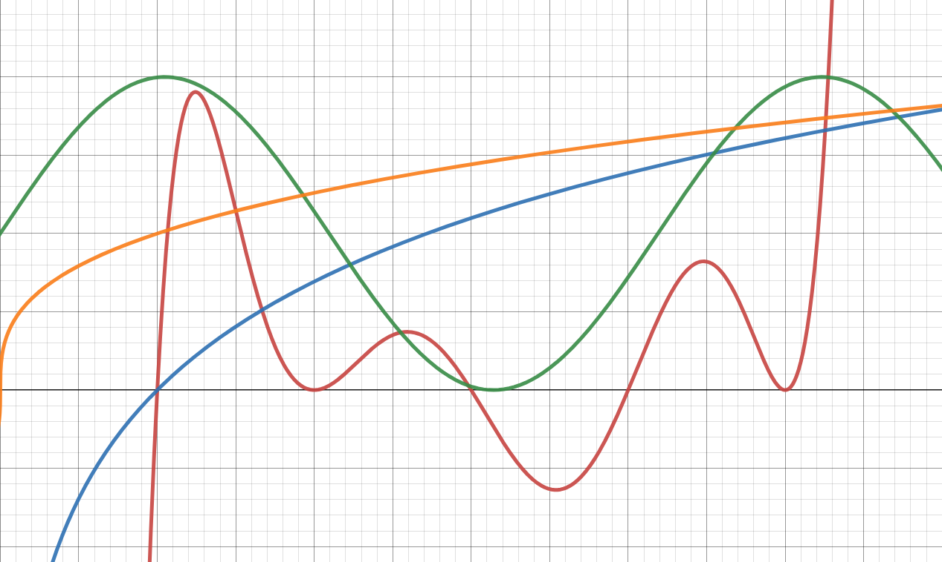
PRECALCULUS FINAL EXAM REVIEW
Academic Achievement Center
Peer Assisted Learning

Slide 2
SIGN THE ATTENDENCE SHEET

Slide 3
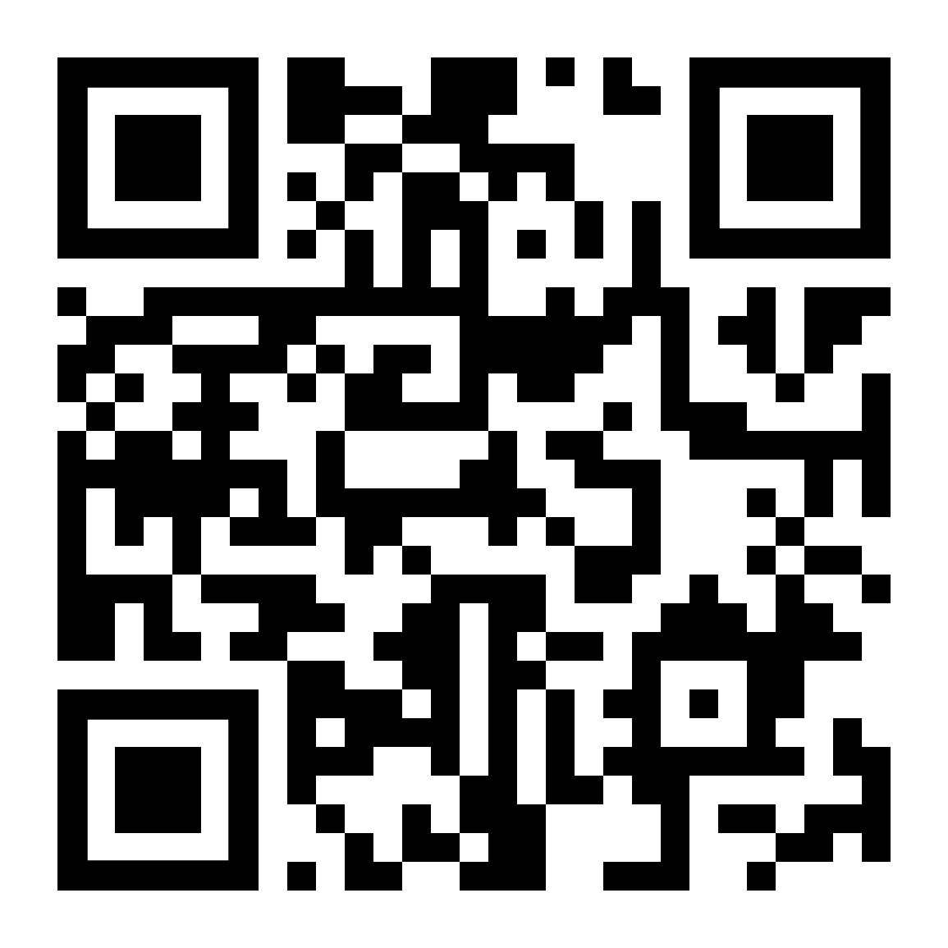
SECTION 1.1
Vote for which problem you want to go over first.

Slide 6
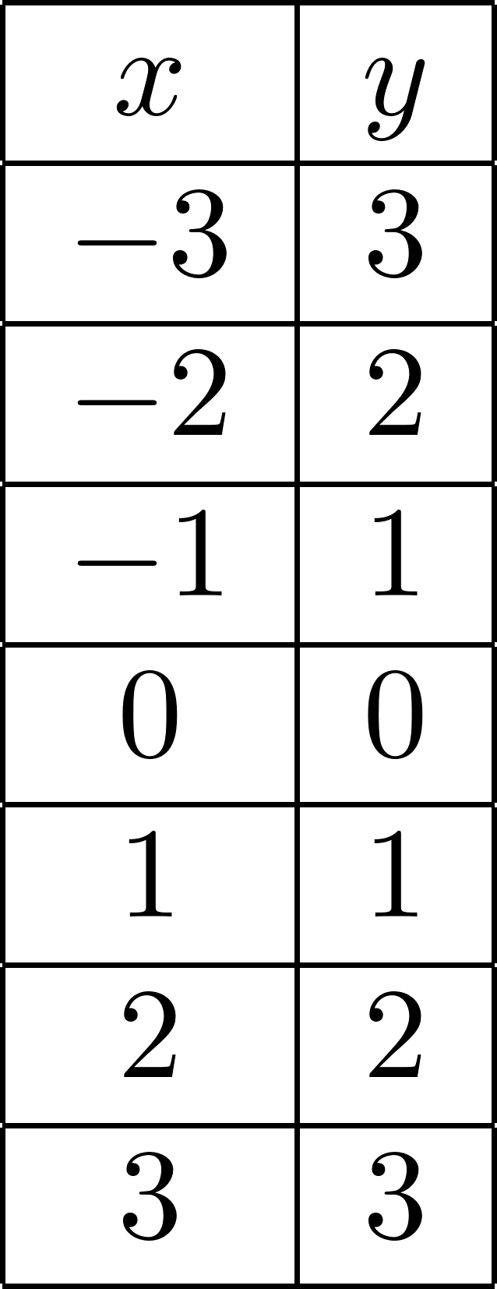

Slide 7
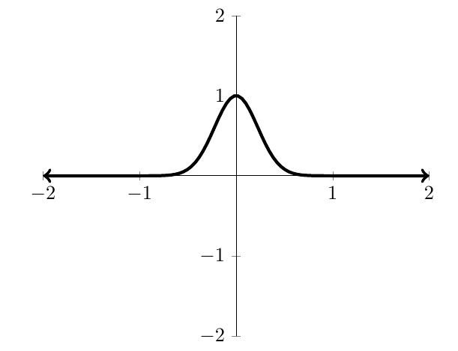

Slide 8
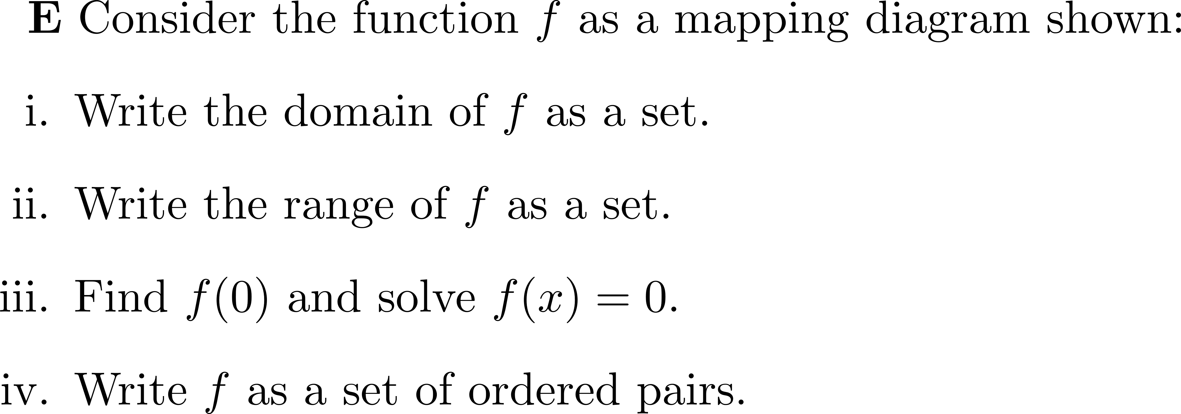
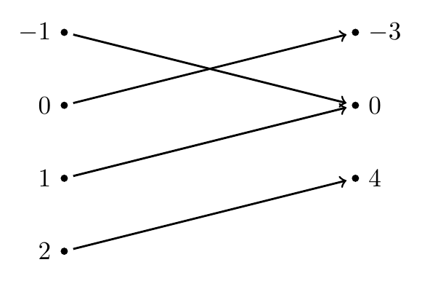

Slide 9
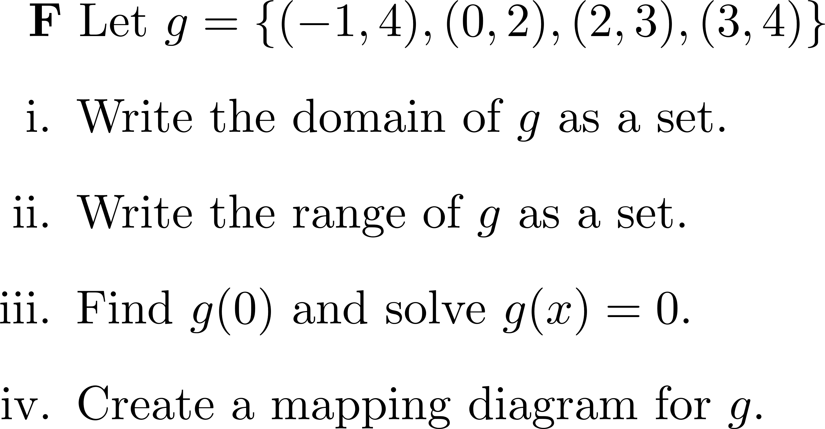

Slide 10
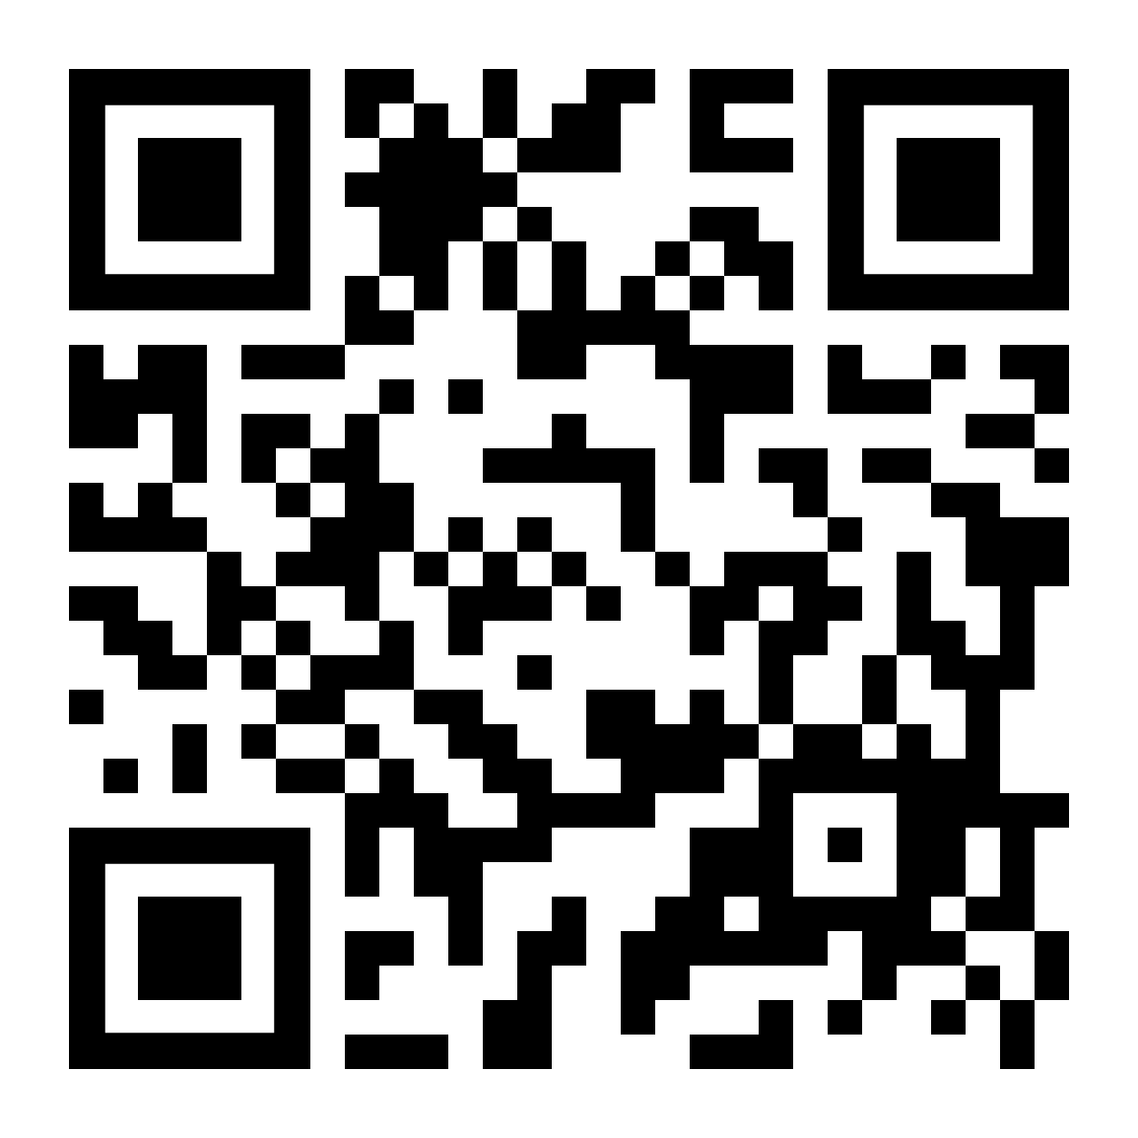
SECTION 1.2
Vote for which problem you want to go over first.

Slide 14
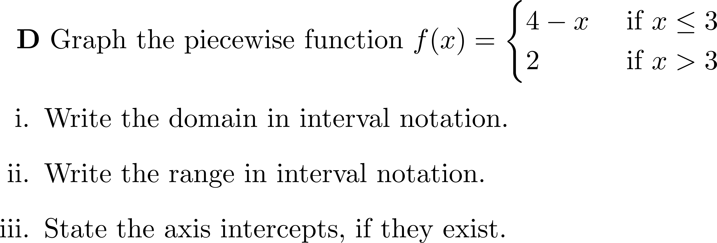

Slide 15
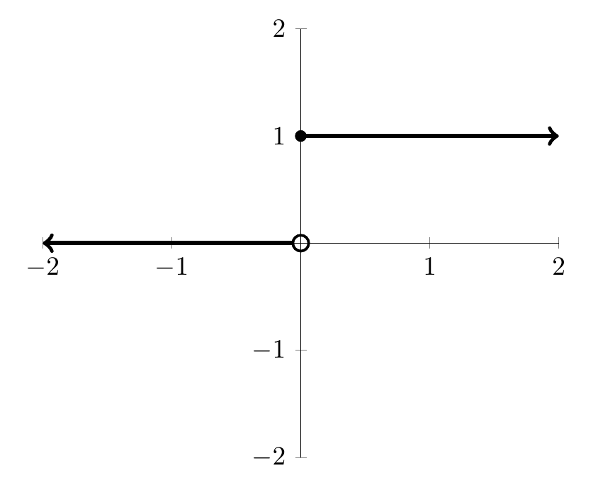

Slide 17
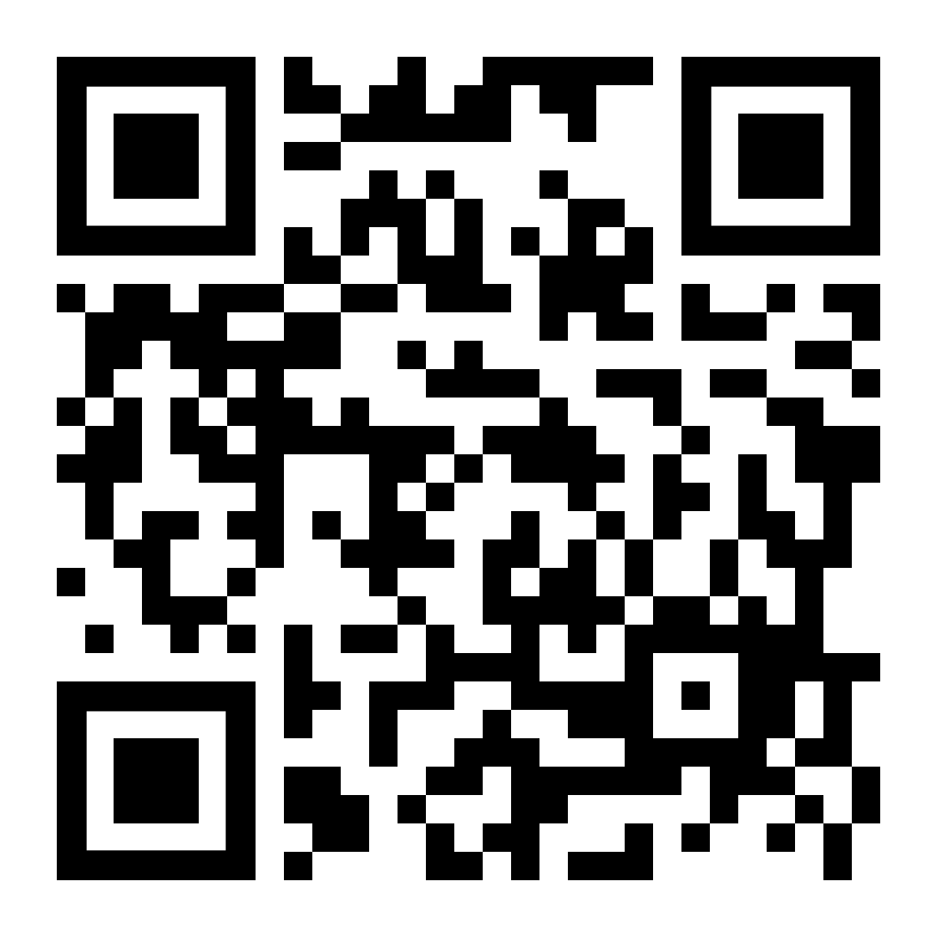
SECTION 1.3
Vote for which problem you want to go over first.

Slide 19
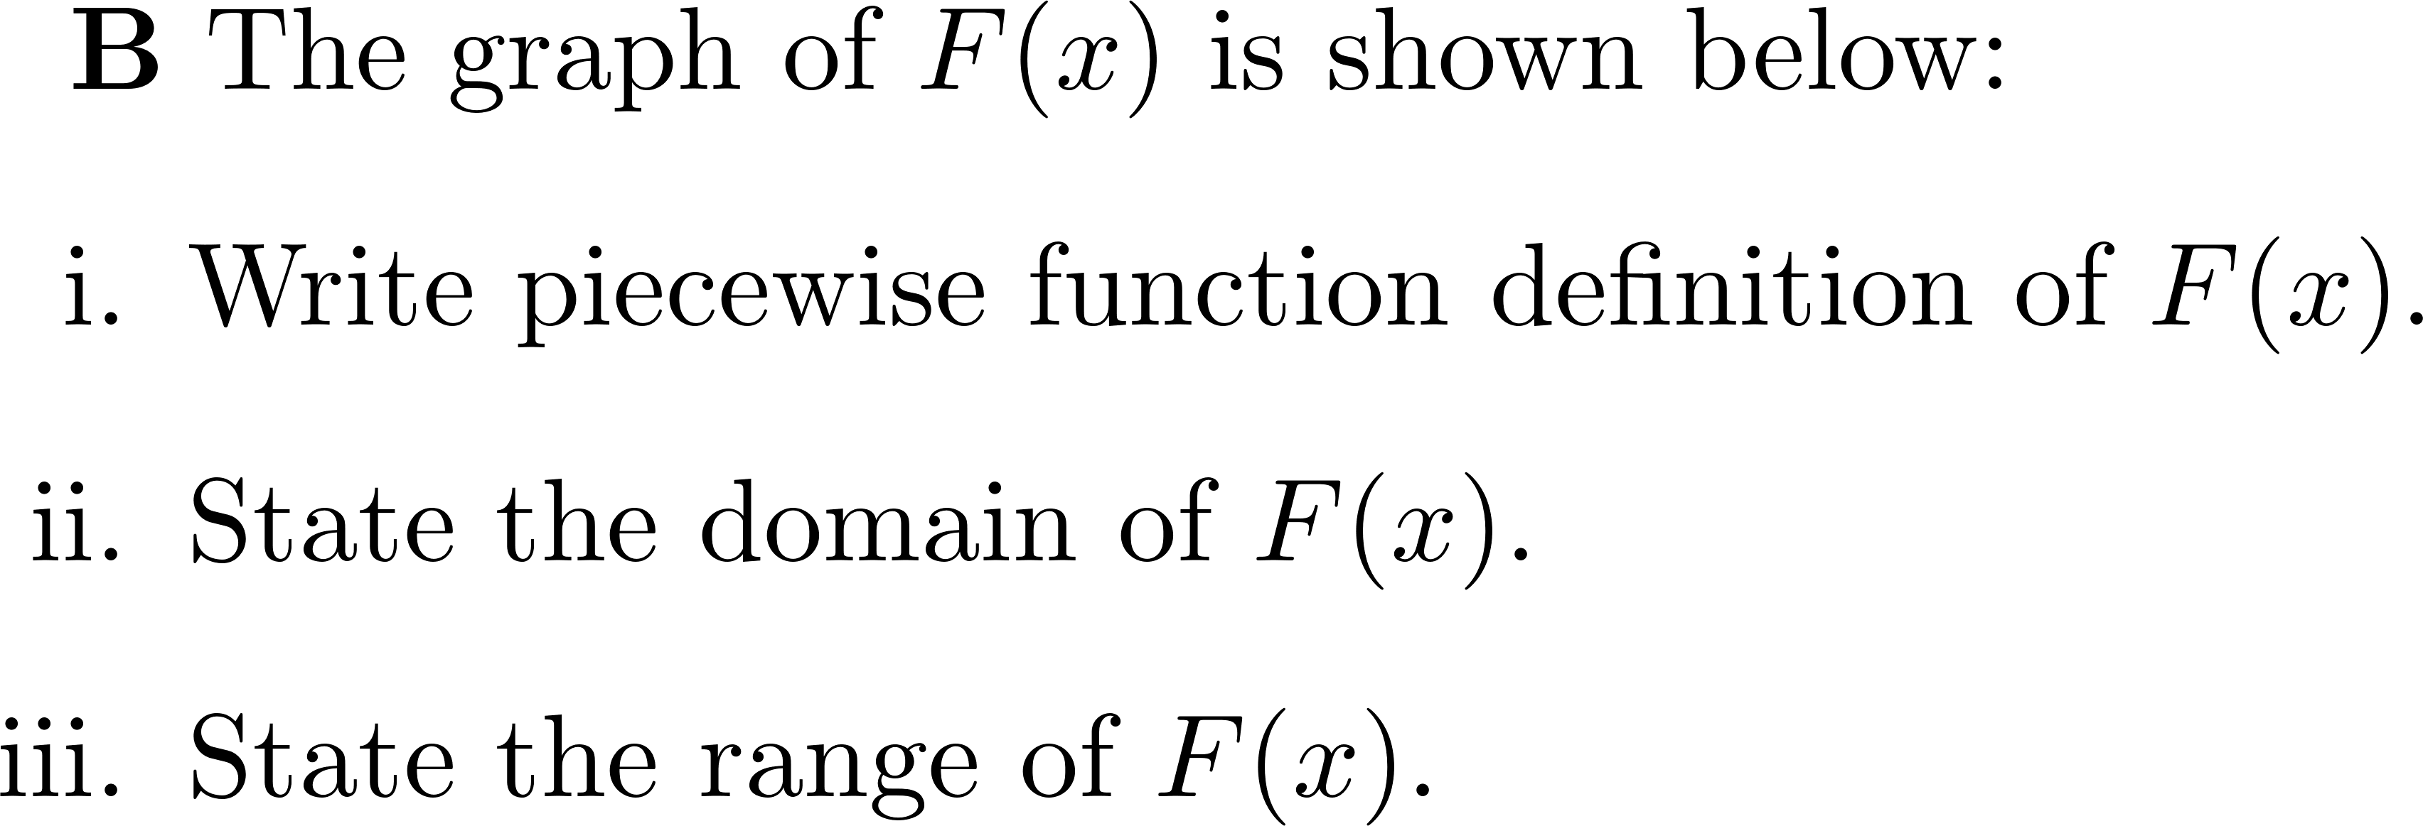
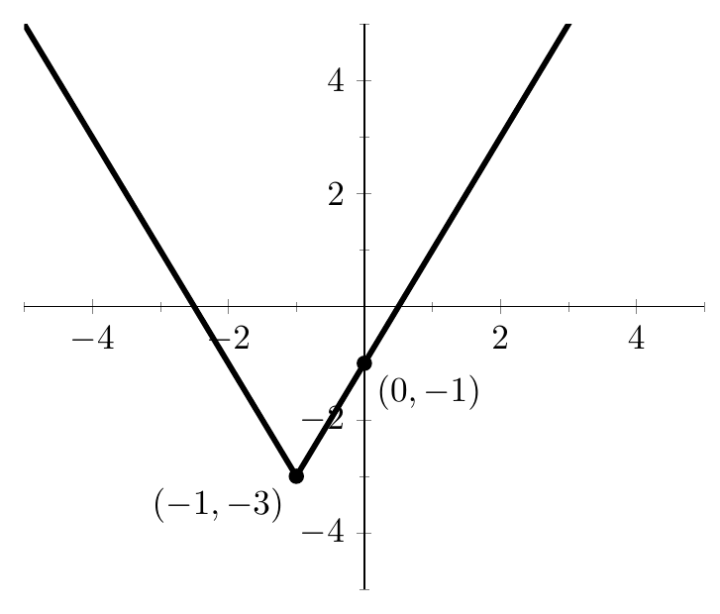

Slide 24
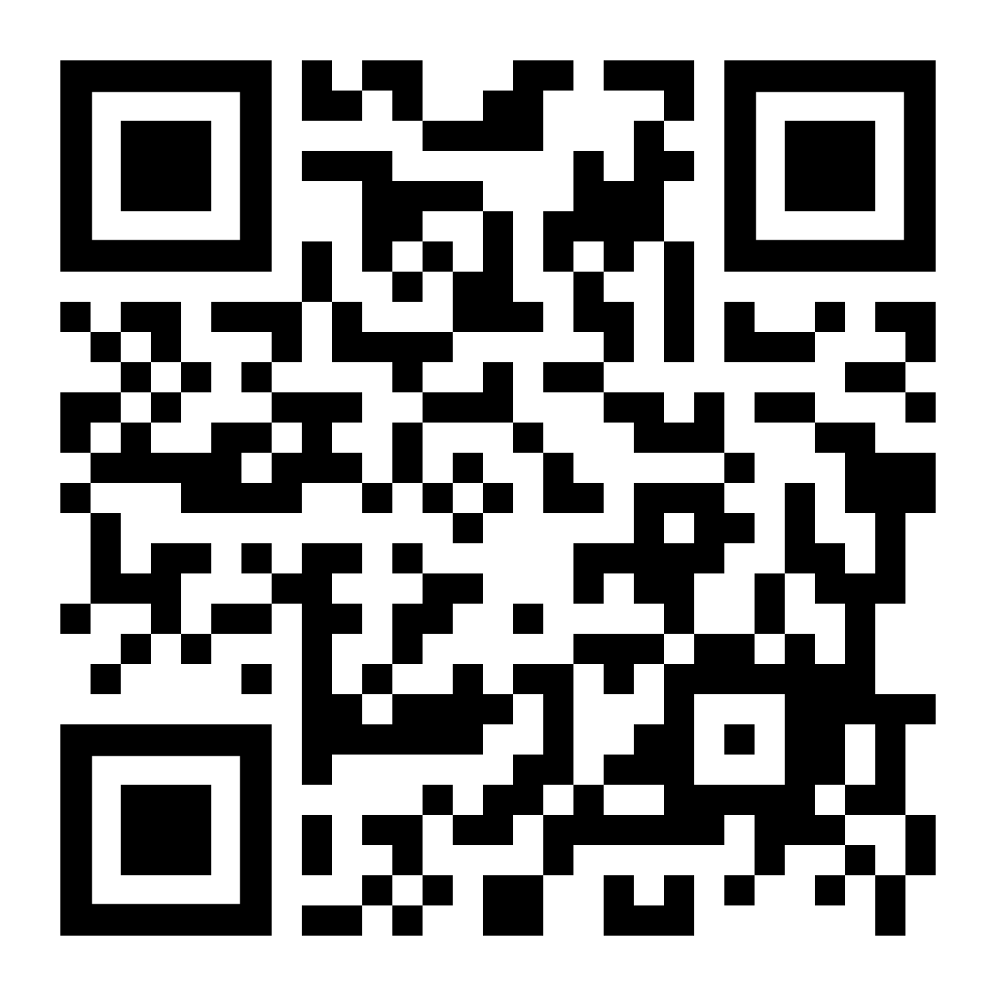
SECTION 1.4
Vote for which problem you want to go over first.

Slide 25
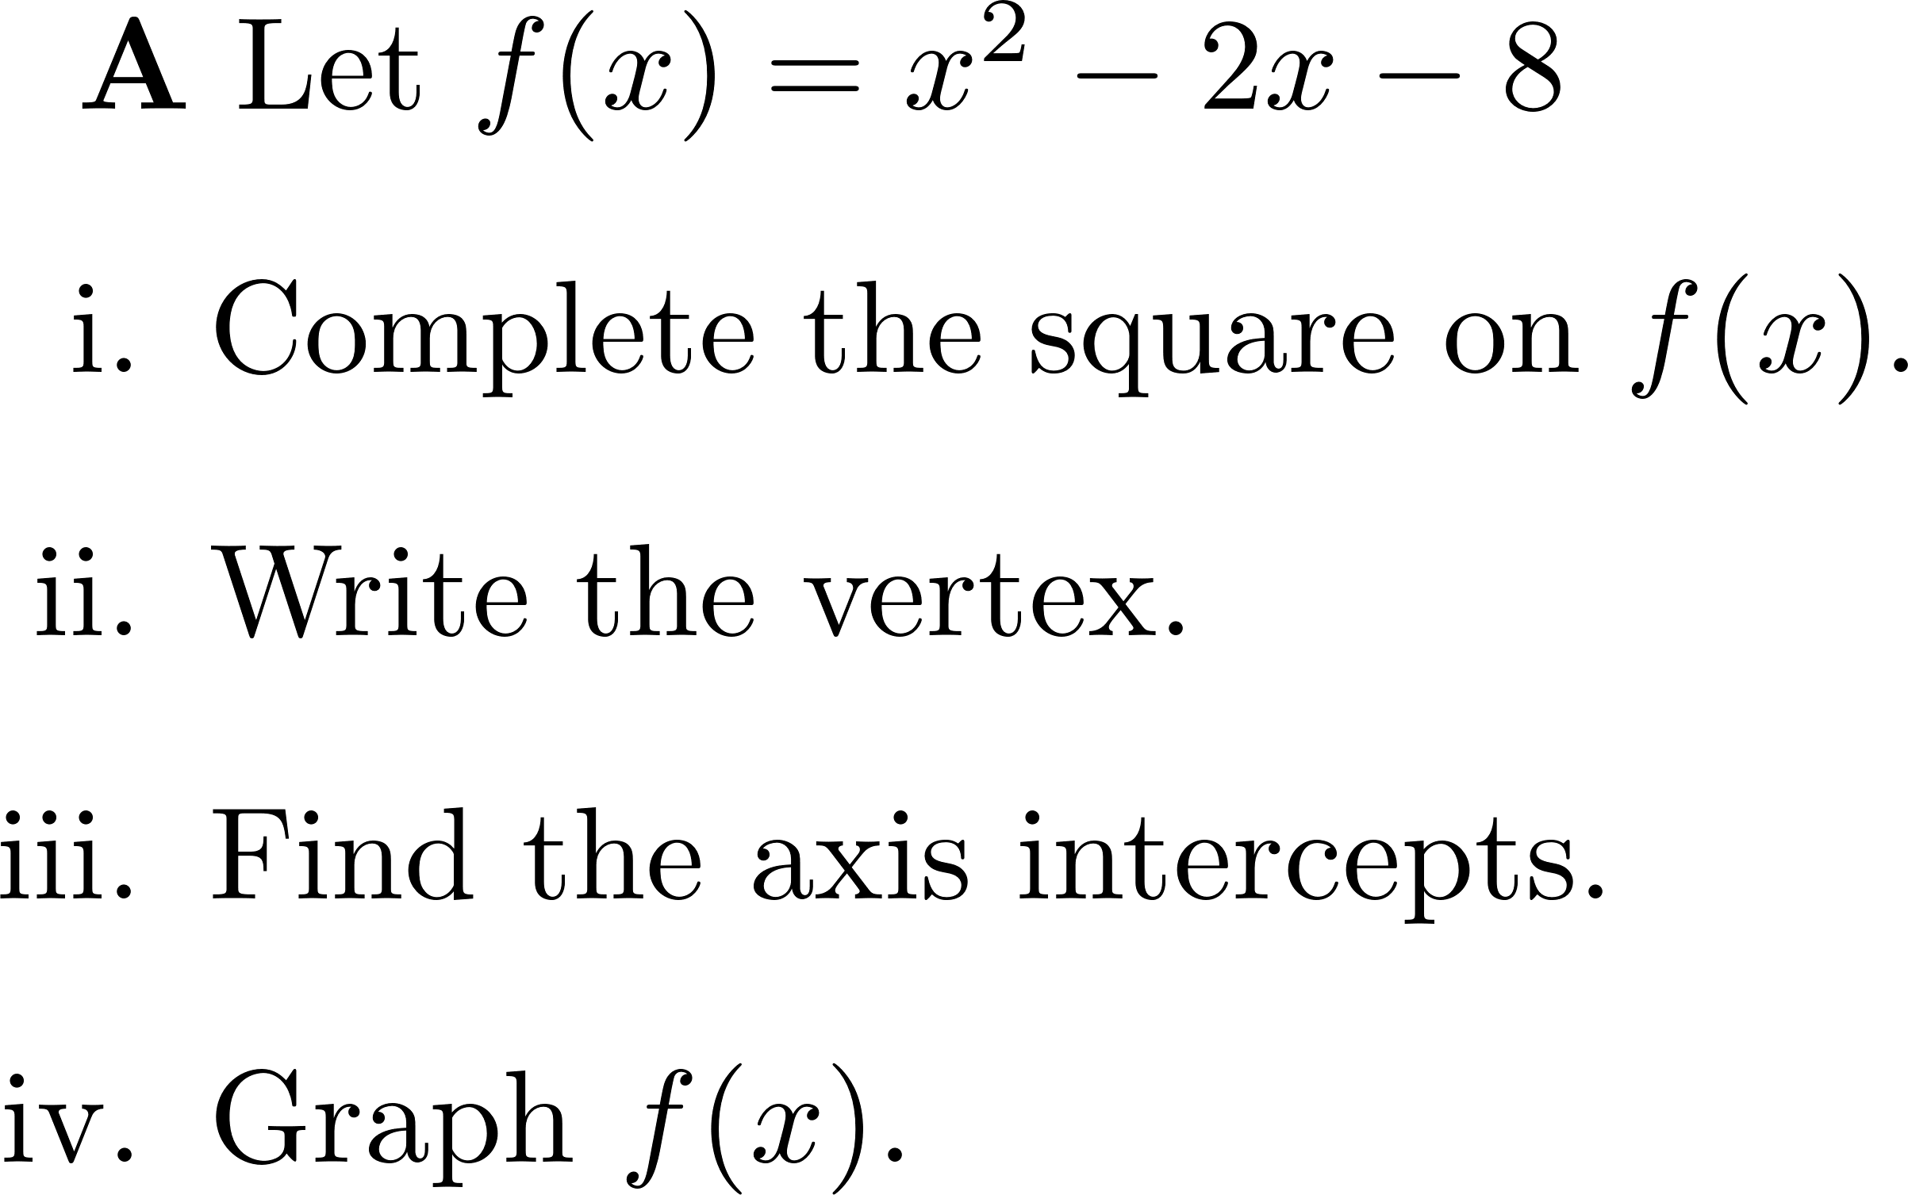

Slide 31
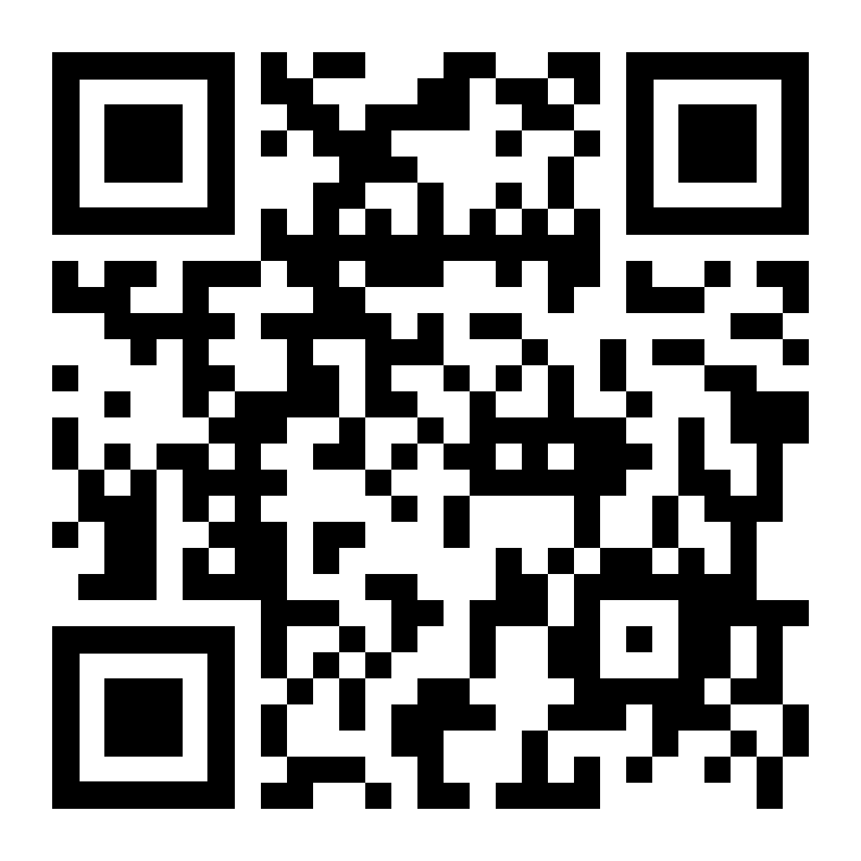
SECTION 2.1
Vote for which problem you want to go over first.

Slide 32
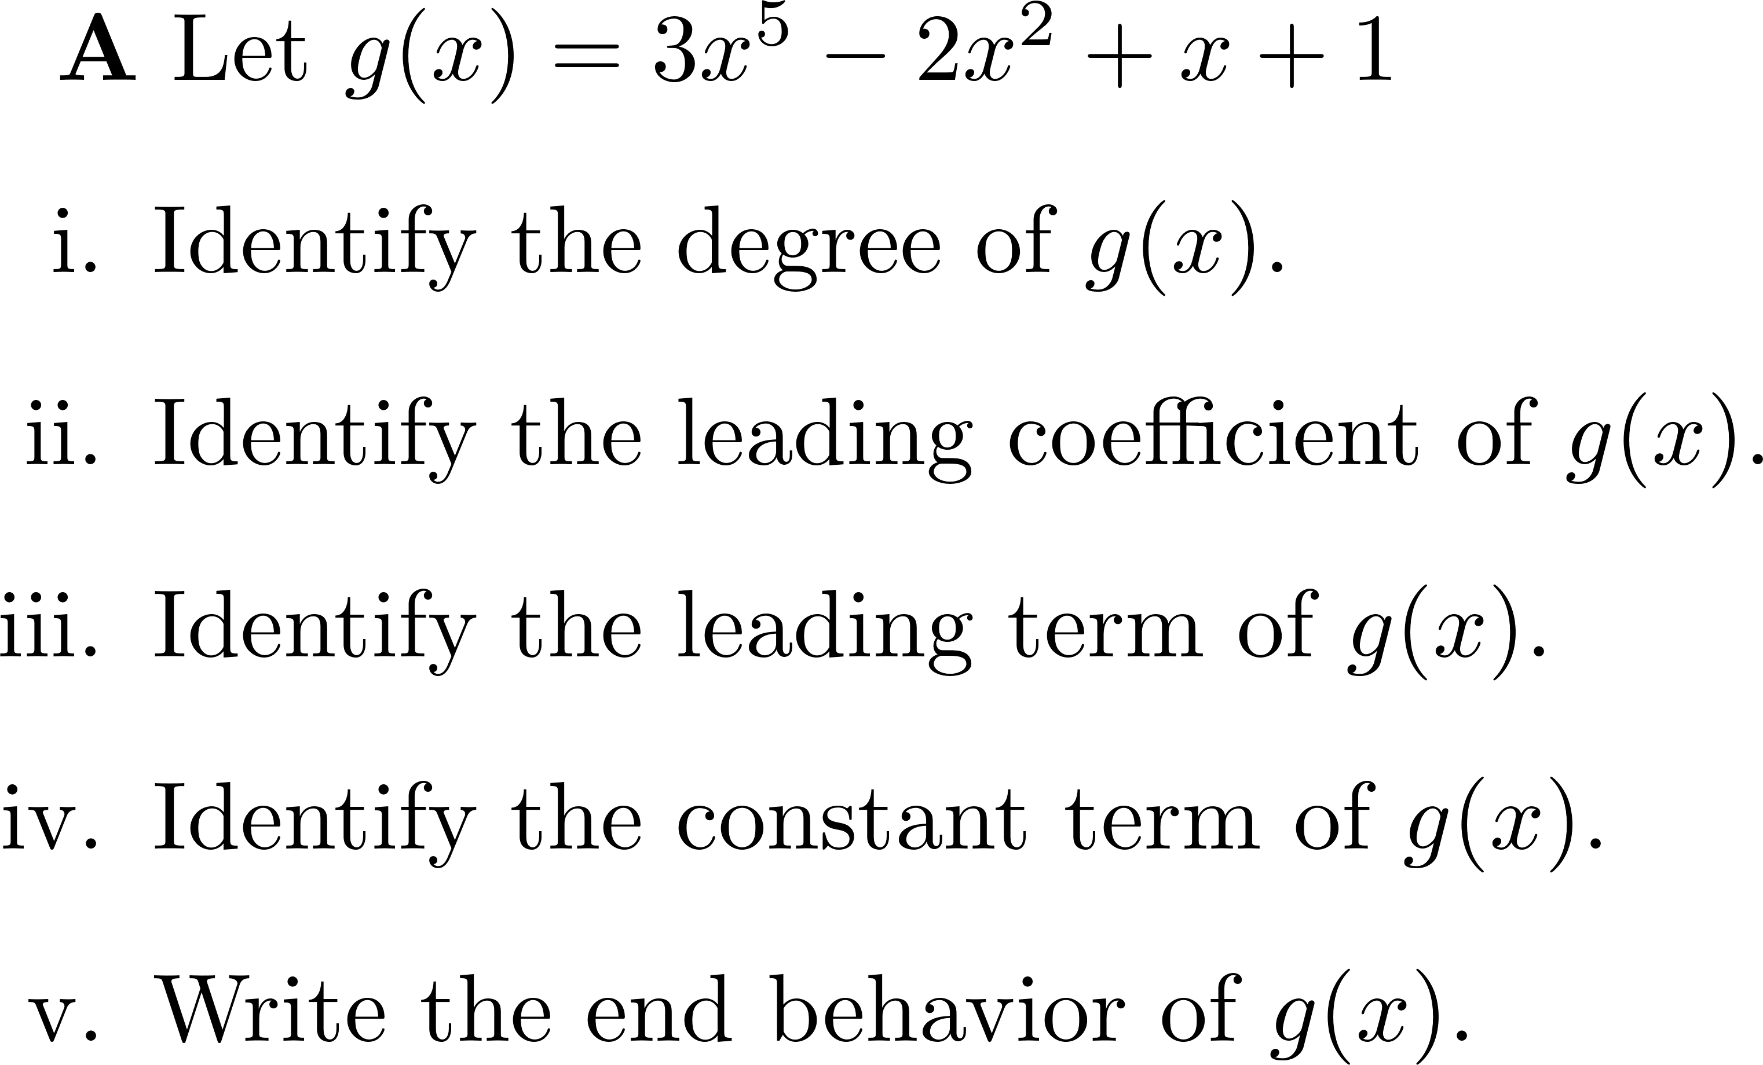

Slide 33
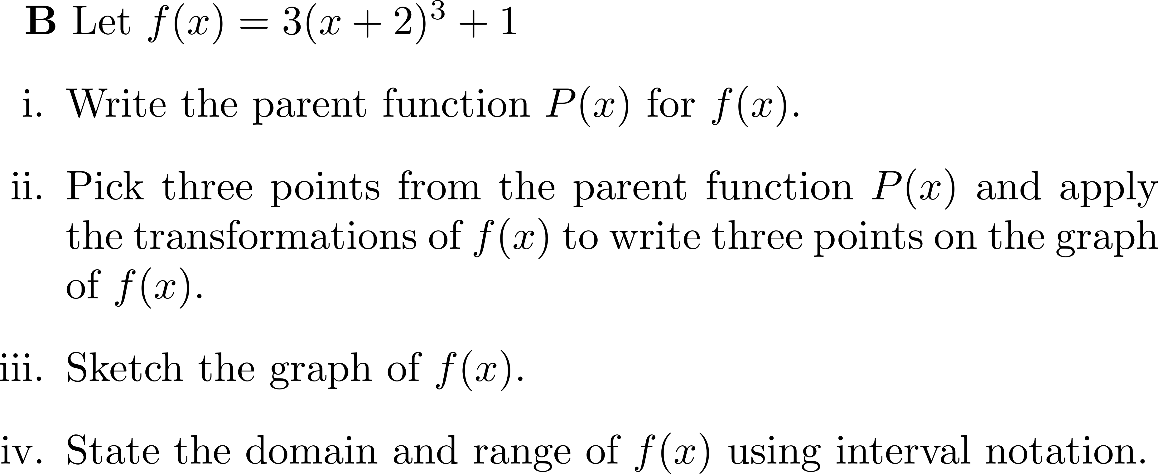

Slide 34
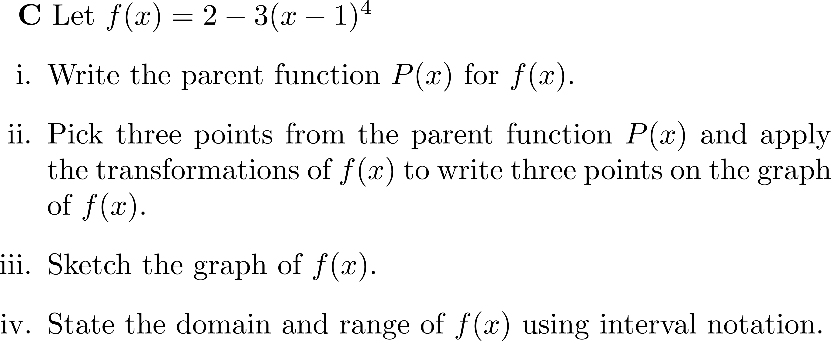

Slide 38
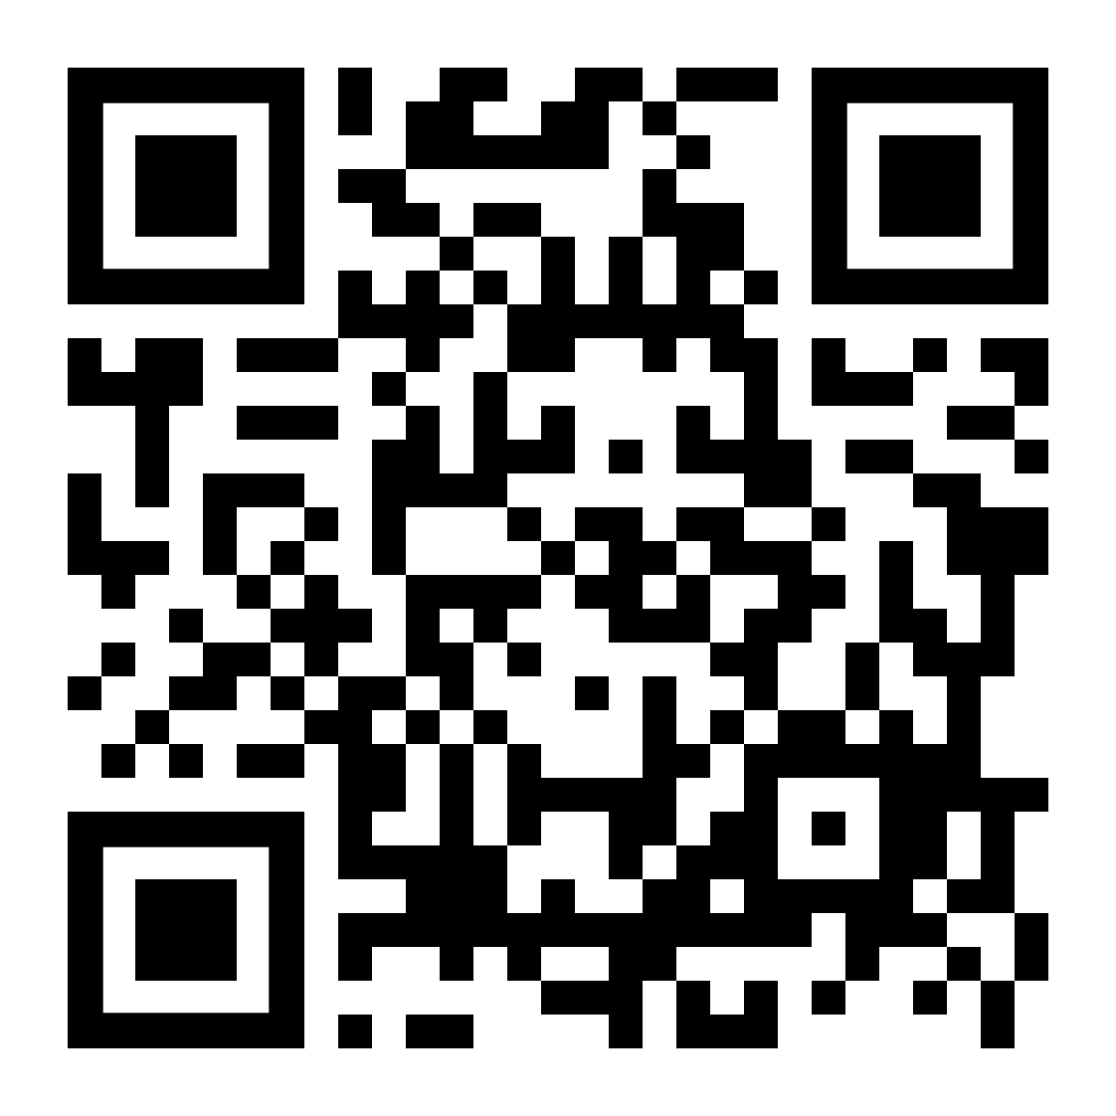
SECTION 2.2
Vote for which problem you want to go over first.

Slide 45
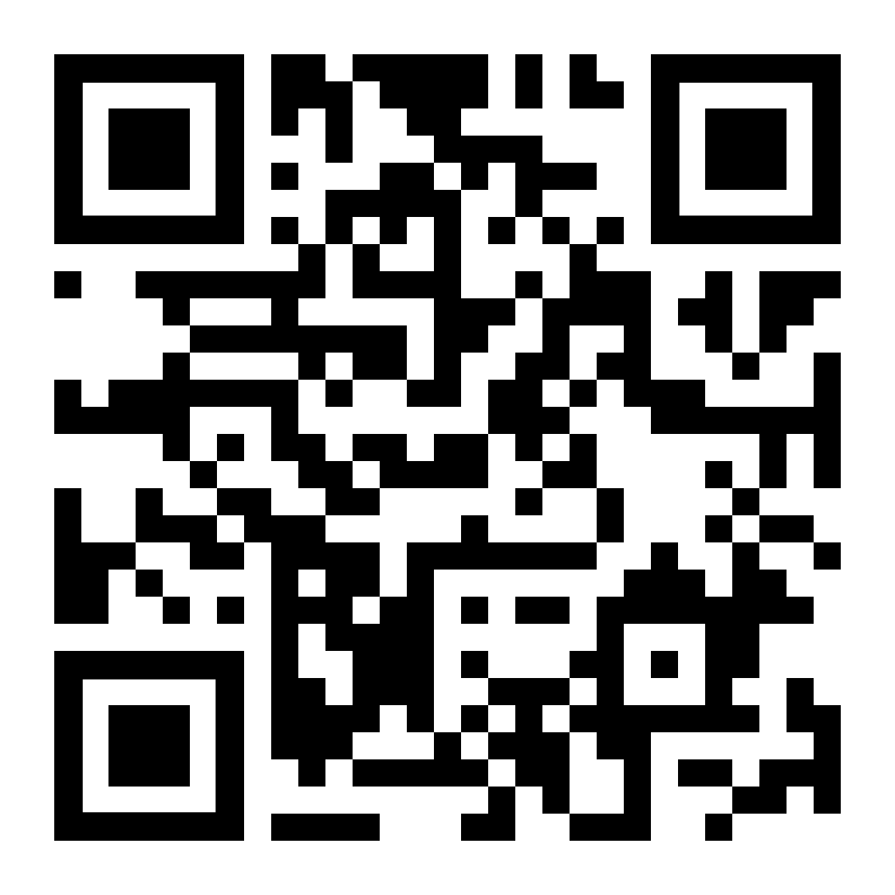
SECTION 2.3
Vote for which problem you want to go over first.

Slide 46
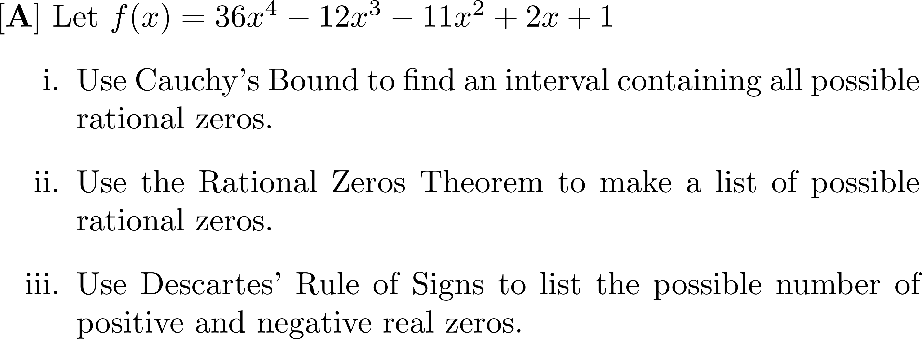

Slide 48
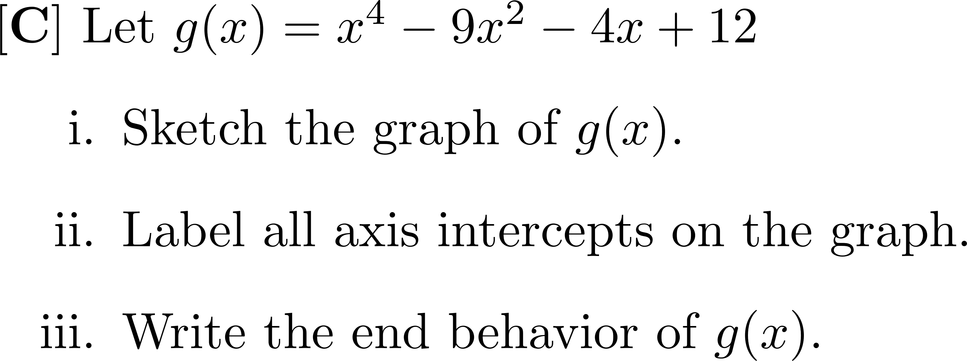

Slide 53
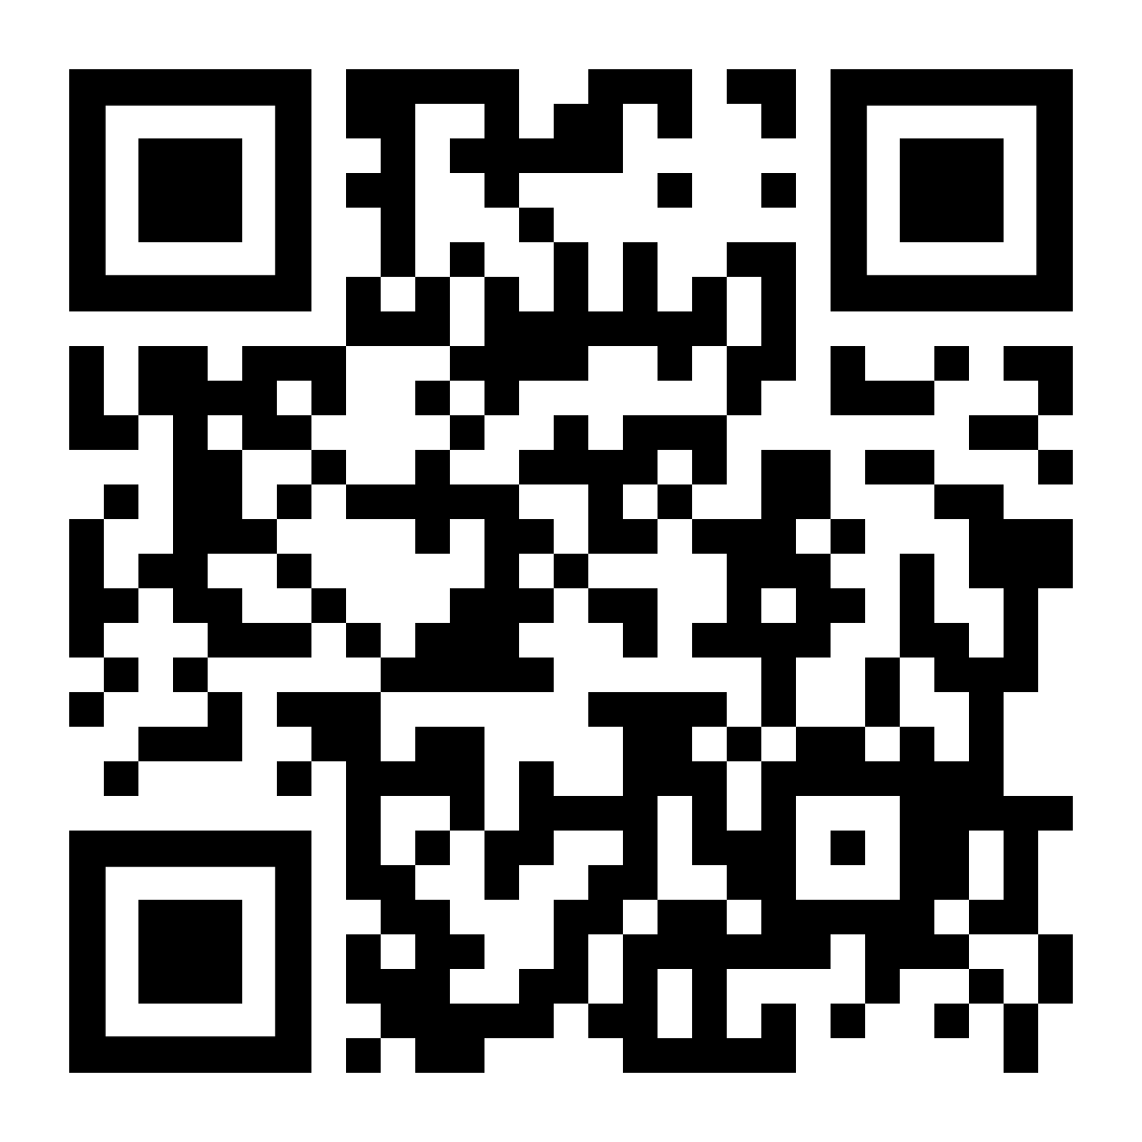
SECTION 3.1
Vote for which problem you want to go over first.

Slide 56
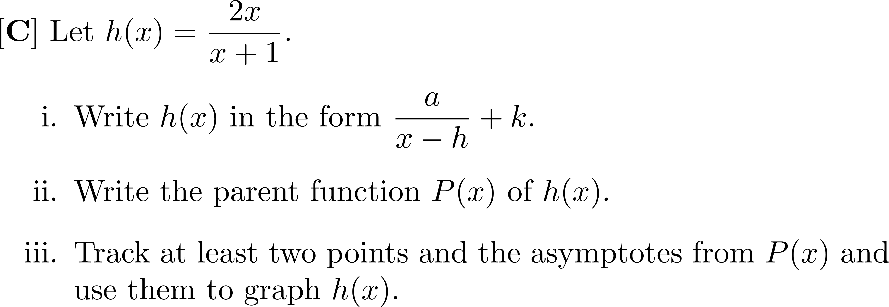

Slide 60
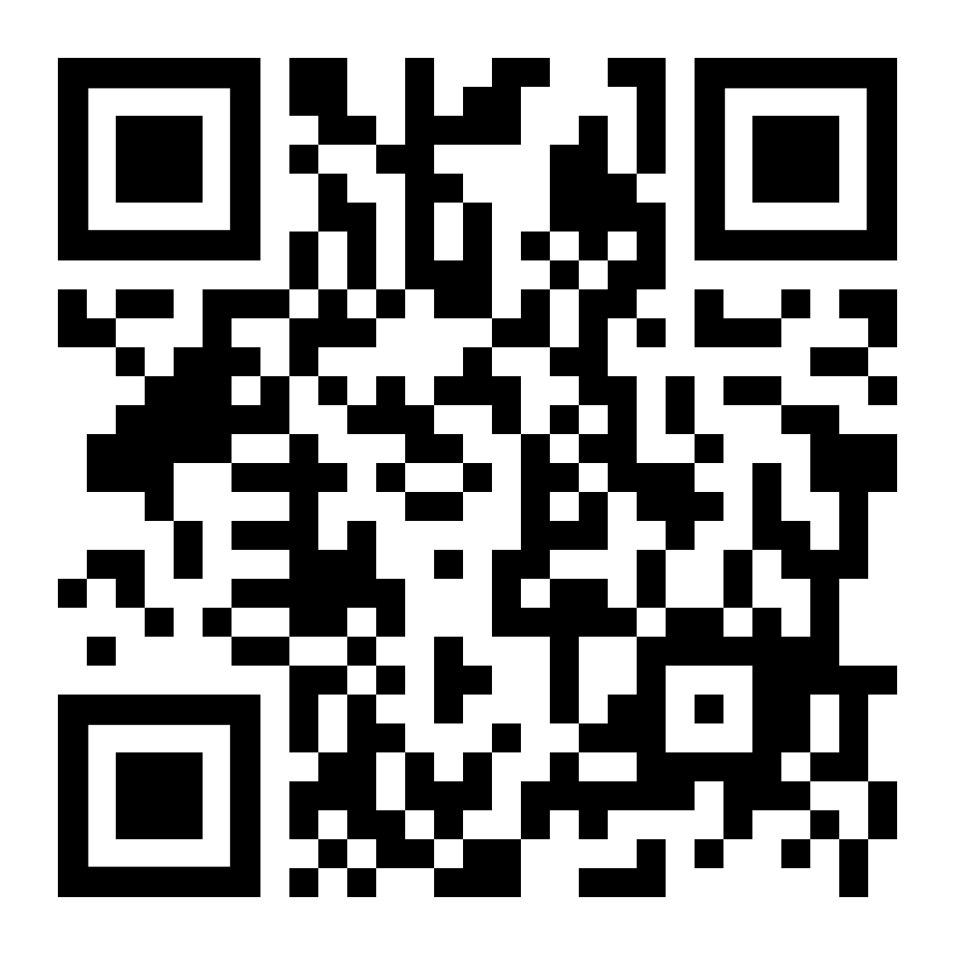
SECTION 3.2
Vote for which problem you want to go over first.

Slide 66
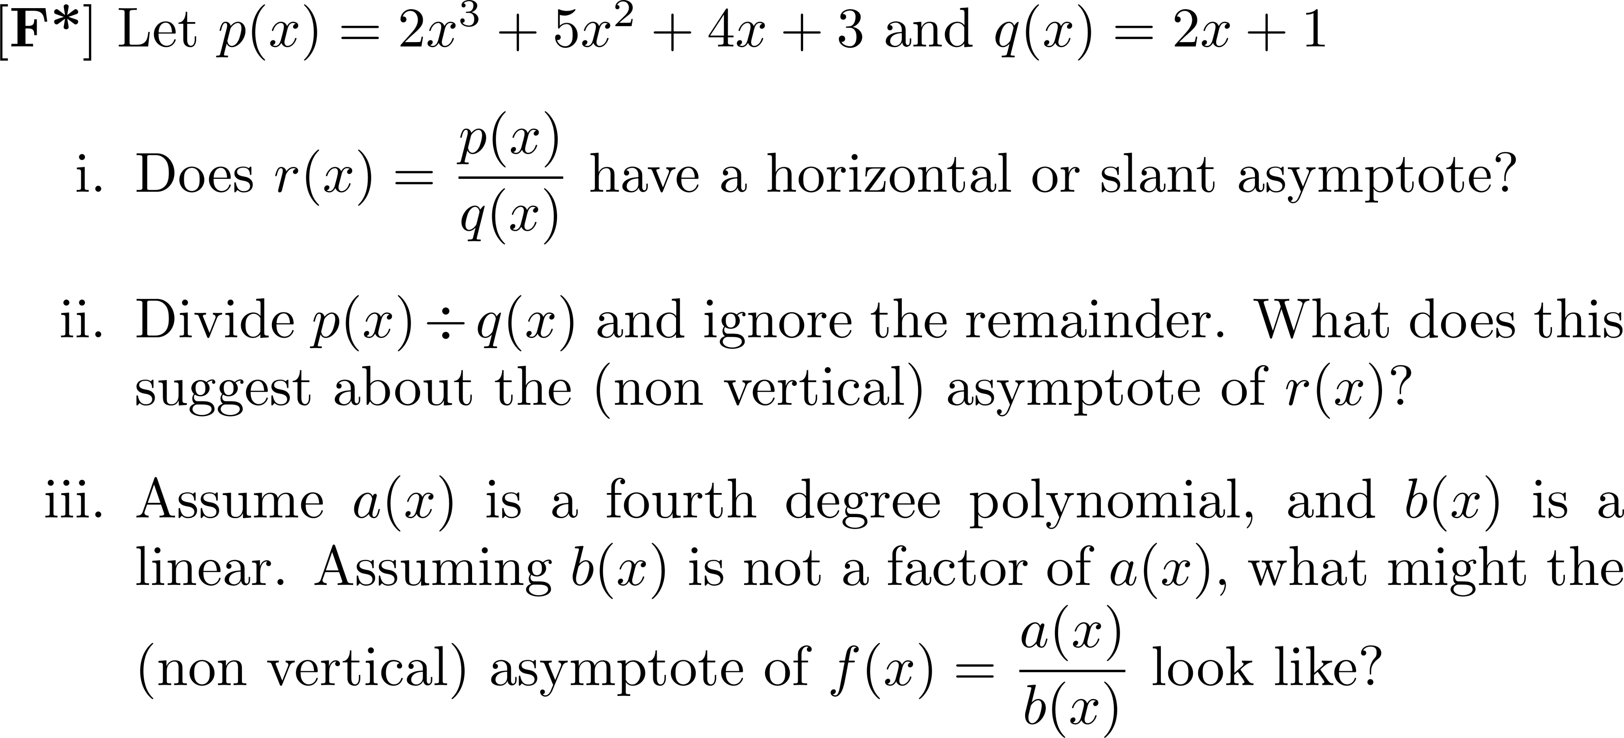

Slide 67
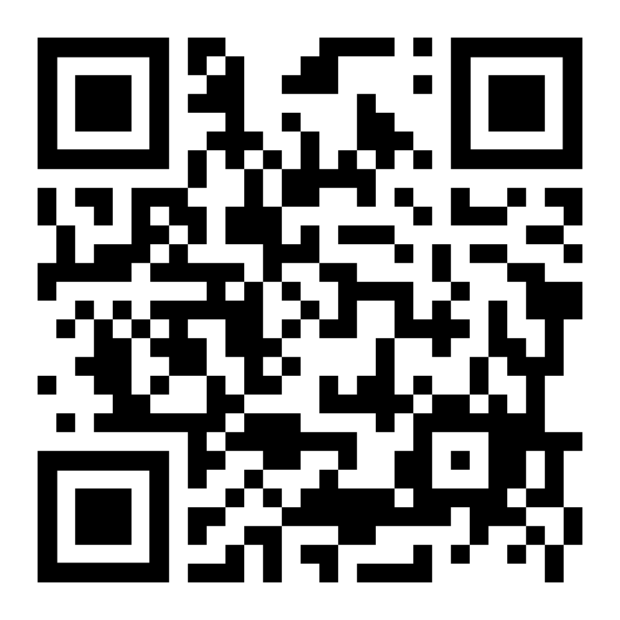
SECTION 3.3
Vote for which problem you want to go over first.

Slide 74
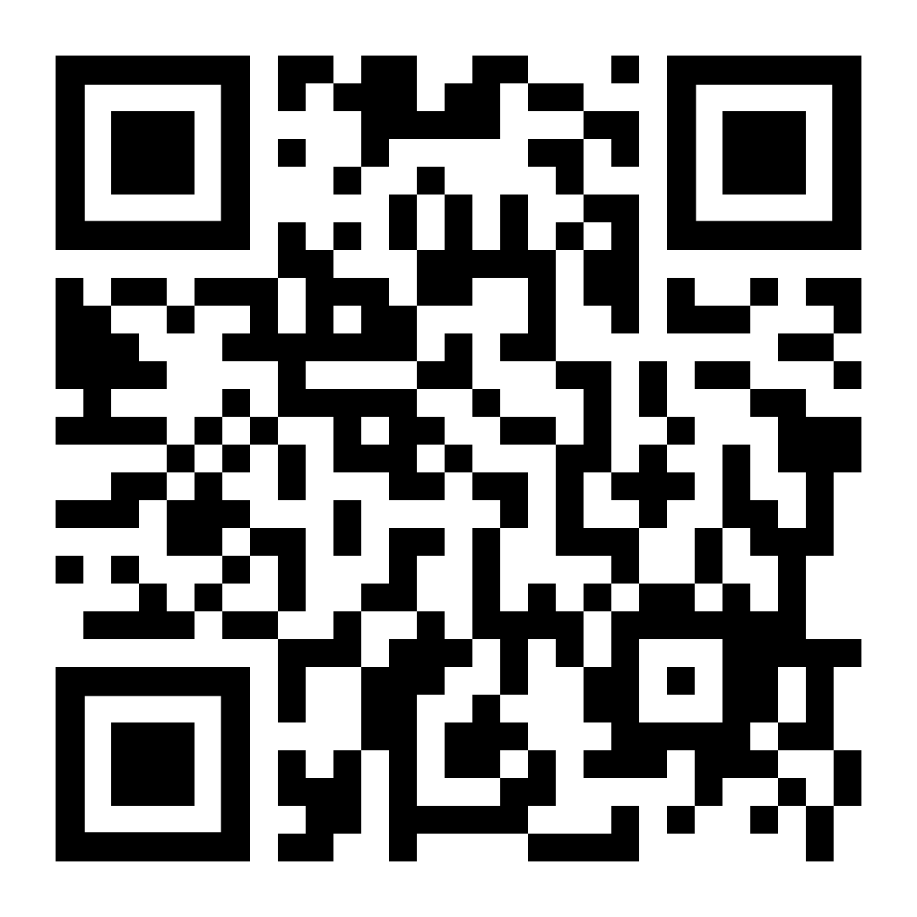
SECTION 4.1
Vote for which problem you want to go over first.

Slide 81
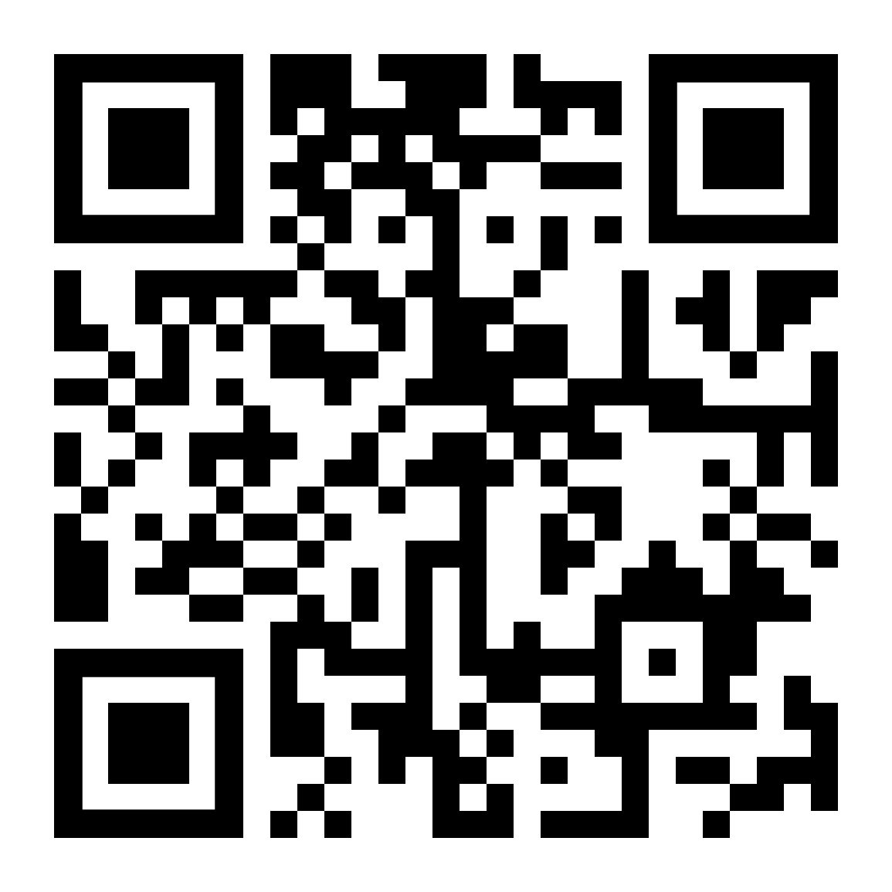
SECTION 4.2
Vote for which problem you want to go over first.

Slide 84
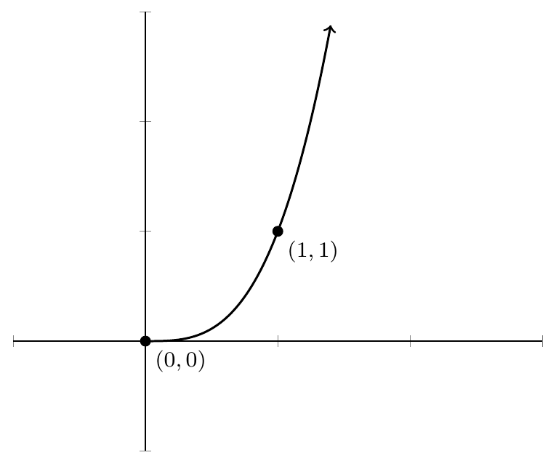

Slide 88
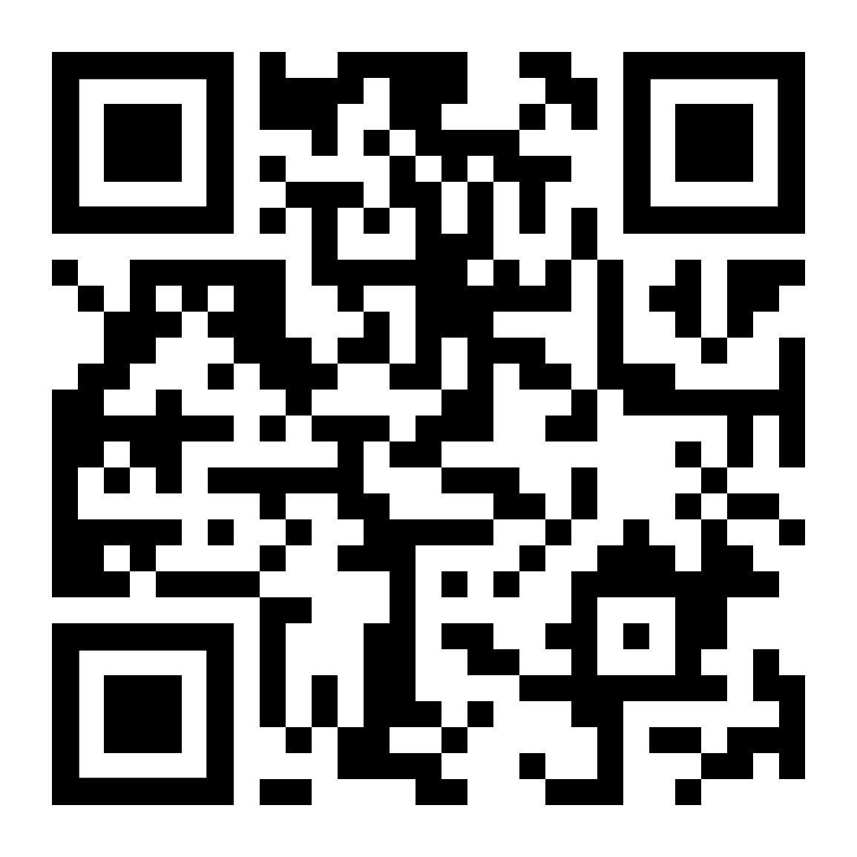
SECTION 4.3
Vote for which problem you want to go over first.

Slide 95
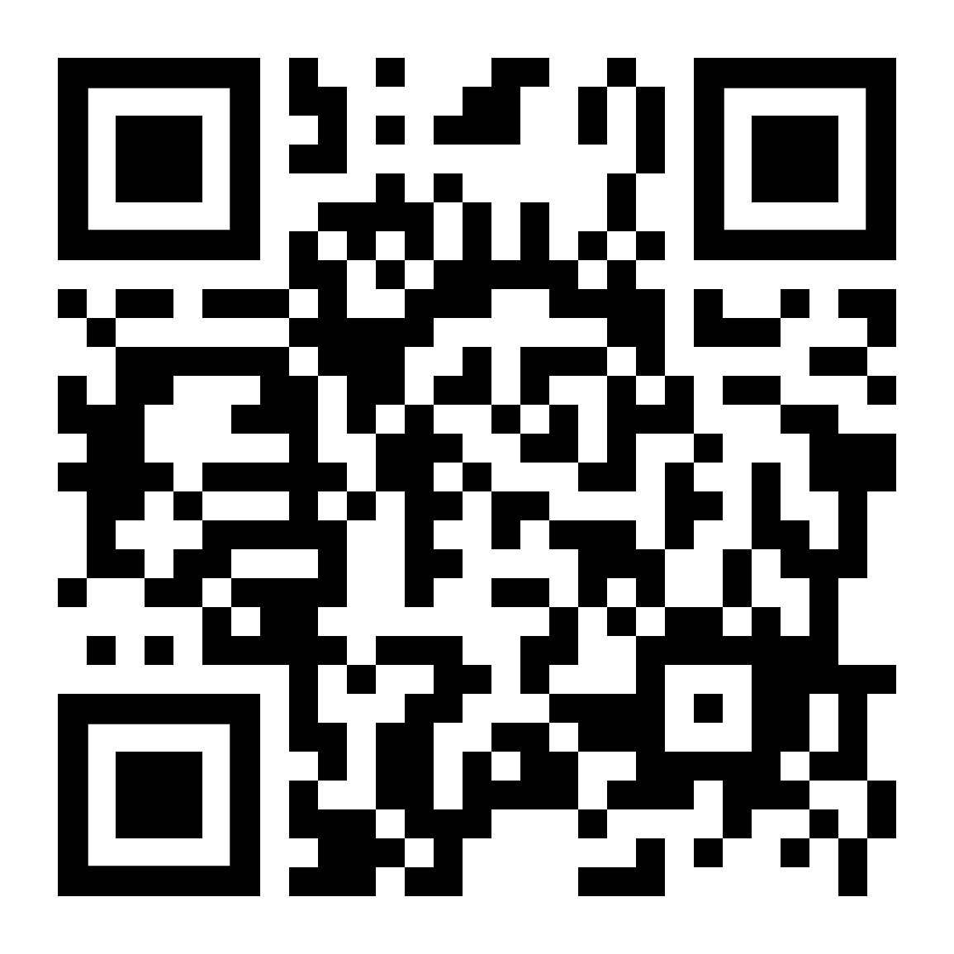
SECTION 5.1
Vote for which problem you want to go over first.

Slide 96
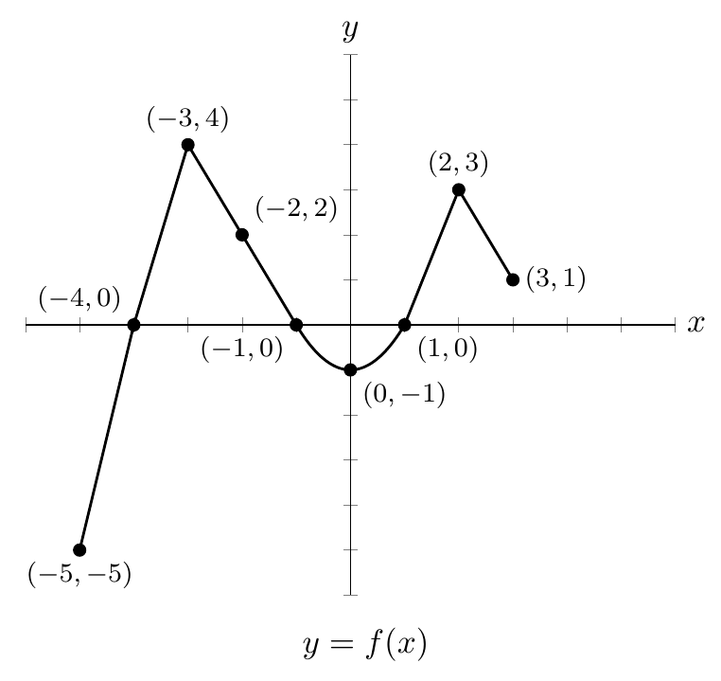
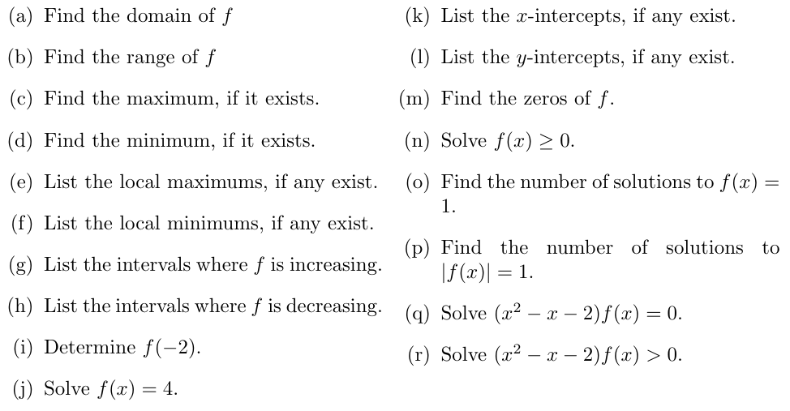

Slide 97
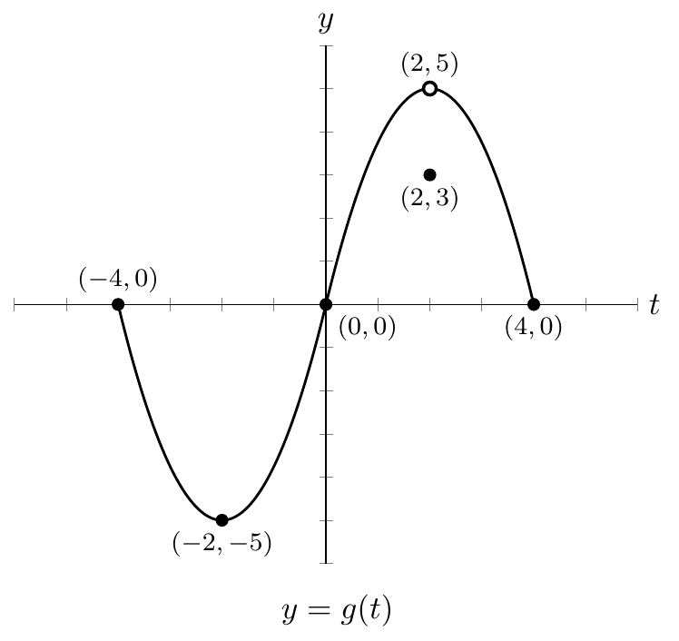
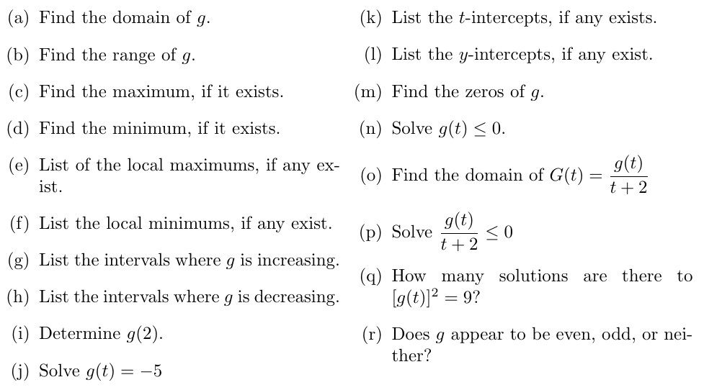

Slide 98
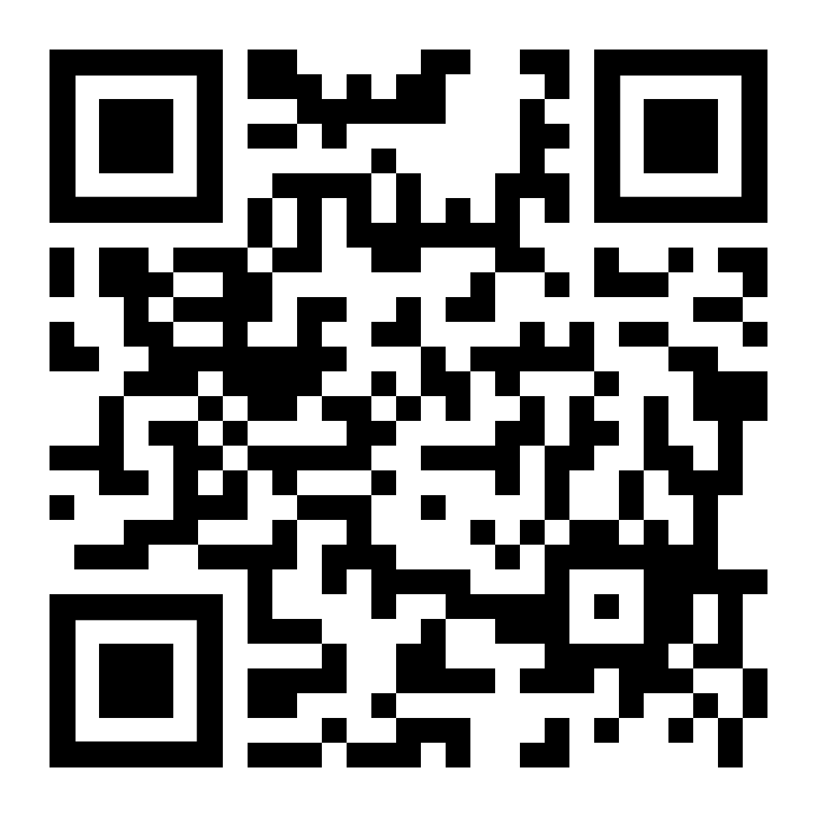
SECTION 5.2
Vote for which problem you want to go over first.

Slide 99
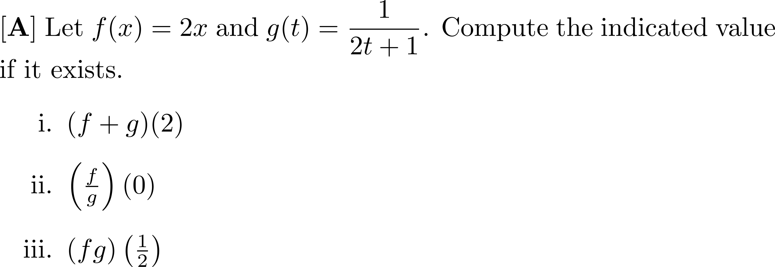

Slide 100
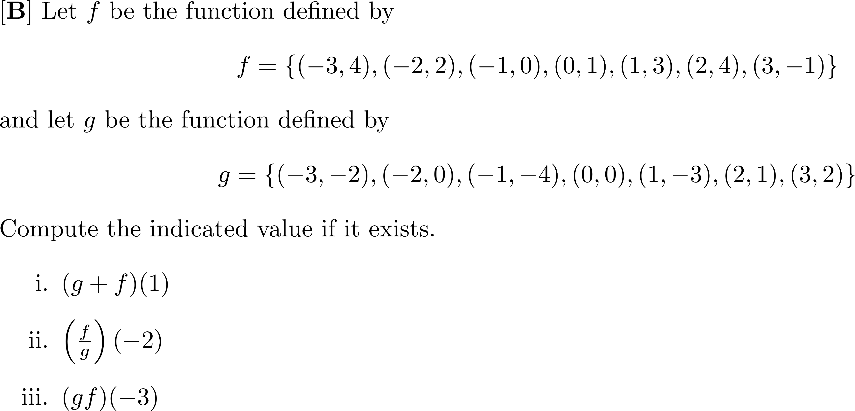

Slide 101
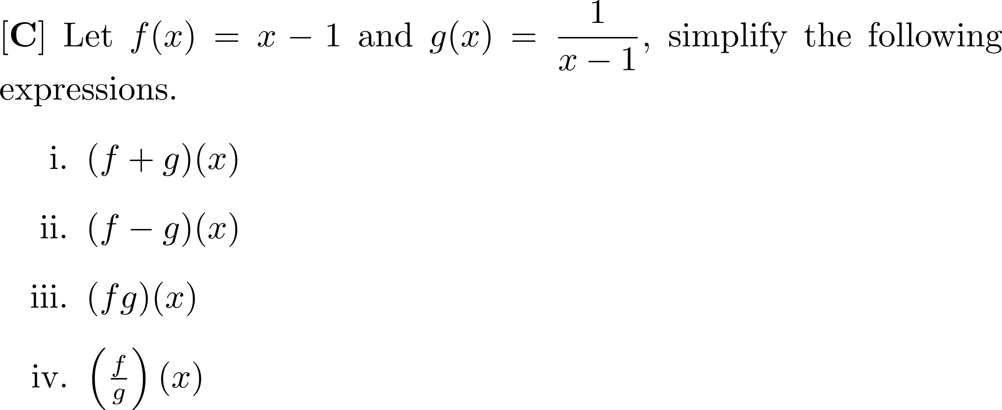

Slide 105
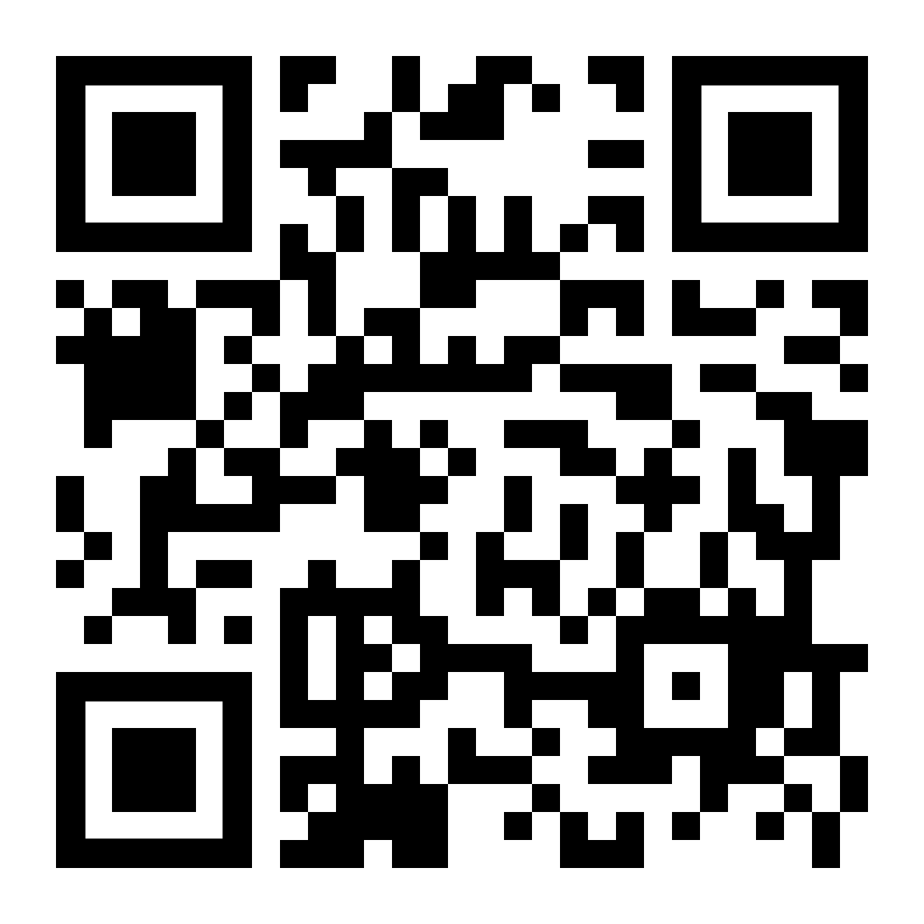
SECTION 5.3
Vote for which problem you want to go over first.

Slide 107
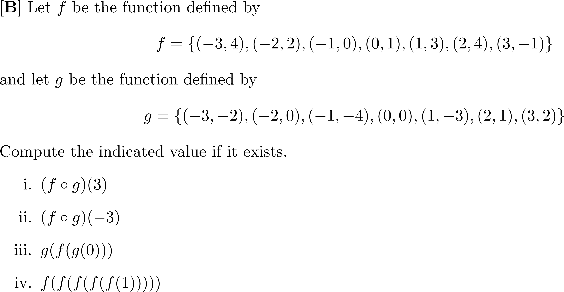

Slide 112
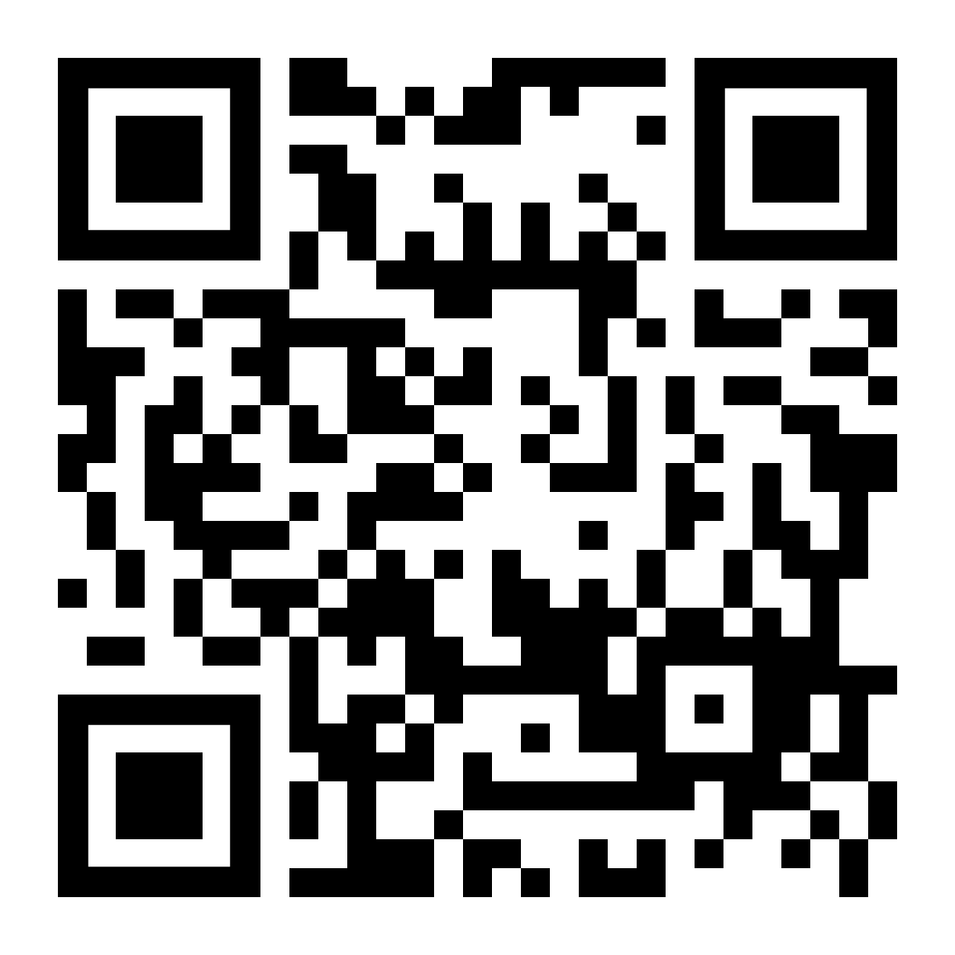
SECTION 5.4
Vote for which problem you want to go over first.

Slide 117
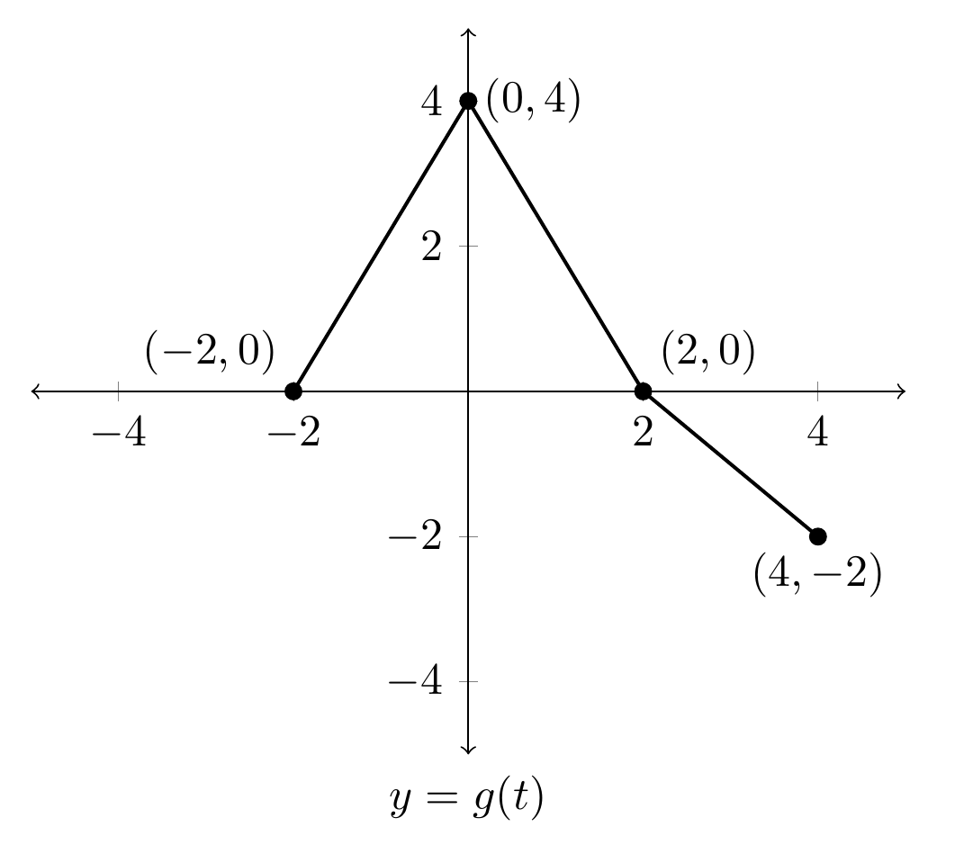

Slide 118
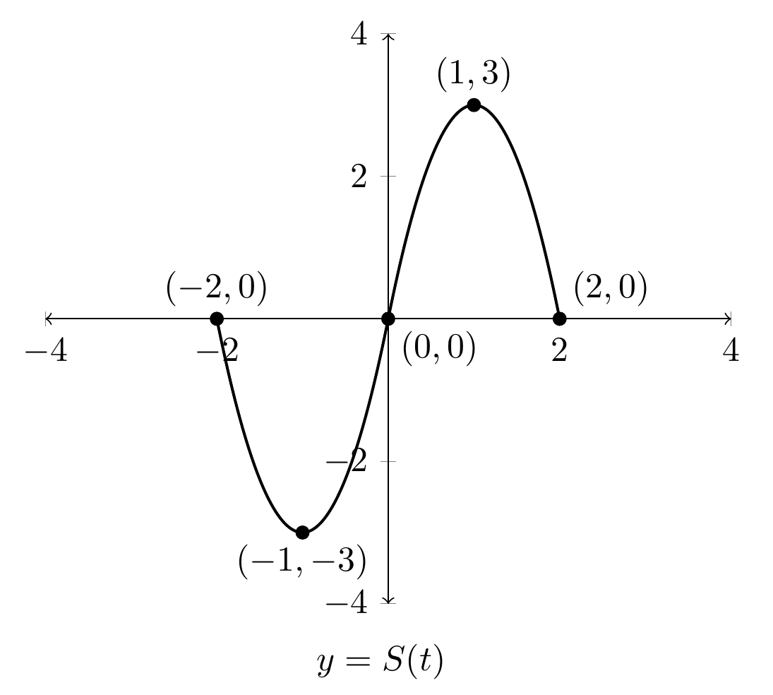

Slide 119
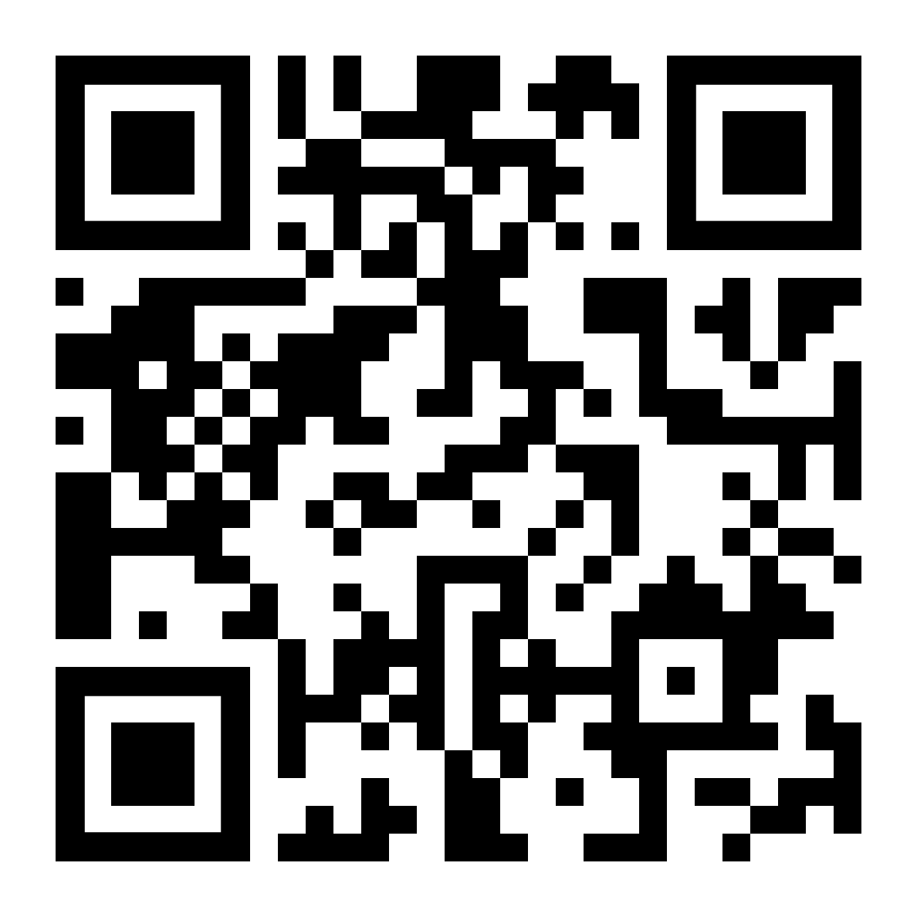
SECTION 5.5
Vote for which problem you want to go over first.

Slide 123
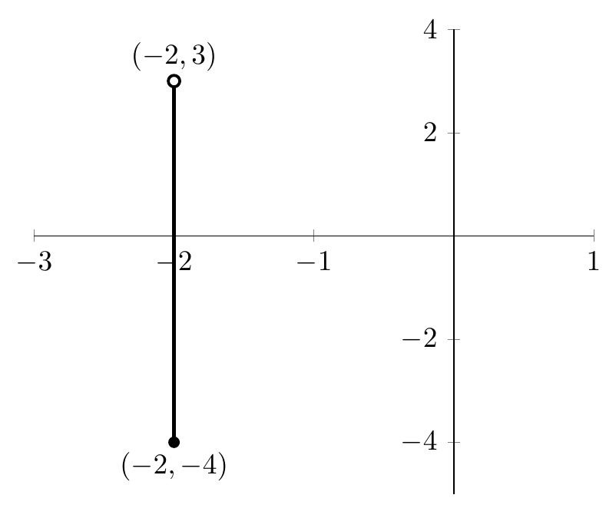

Slide 124
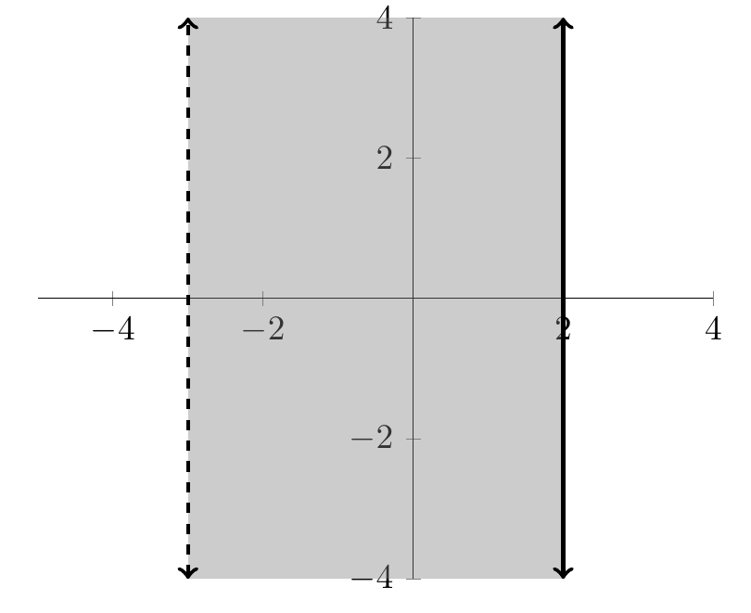

Slide 125
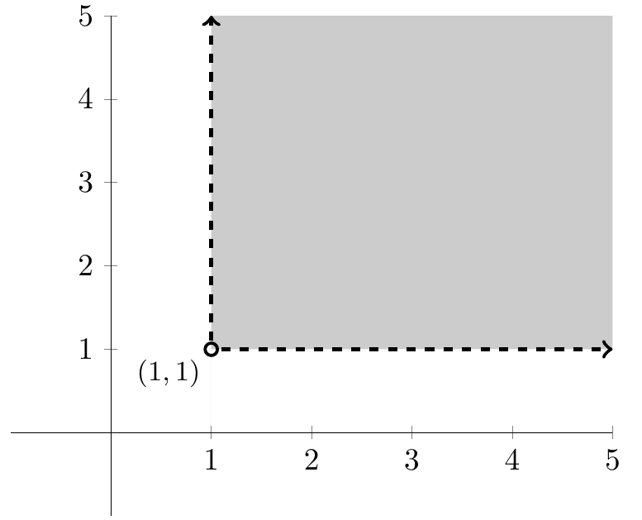

Slide 126
SECTION 5.6
Vote for which problem you want to go over first.

Slide 133
SECTION 6.1
Vote for which problem you want to go over first.

Slide 138
SECTION 6.2
Vote for which problem you want to go over first.

Slide 145
SECTION 6.3
Vote for which problem you want to go over first.

Slide 152
SECTION 6.4
Vote for which problem you want to go over first.

Slide 159
SECTION 6.5
Vote for which problem you want to go over first.

Slide 166
SECTION 7.1
Vote for which problem you want to go over first.

Slide 171
SECTION 7.2
Vote for which problem you want to go over first.

Slide 177
This would not be asked on an exam, but you should be able to do this.

Slide 178
SECTION 7.3
Vote for which problem you want to go over first.

Slide 184
SECTION 7.4
Vote for which problem you want to go over first.

Slide 191
SECTION 7.5
Vote for which problem you want to go over first.

Slide 196
SECTION 8.1
Vote for which problem you want to go over first.

Slide 203
SECTION 8.2
Vote for which problem you want to go over first.

Slide 210
SECTION 8.3
Vote for which problem you want to go over first.

Slide 217
SECTION 9.1
Vote for which problem you want to go over first.

Slide 221
SECTION 9.2
Vote for which problem you want to go over first.

Slide 225
GOOD LUCK
PLEASE scan the QR code to the right, this is a survey to evaluate how I have done overall as a PAL leader this semester. This goes through the AAC (my boss) and is anonymous. We appreciate your feedback!
Answers to the first two questions:
Name of your PAL leader:
Roman Simkins
Name of your PAL class:
MATH1300

