Slide 2
PLEASE SIGN ATTENDANCE YOU DO NOT WANT TO MISS POTENTIAL BONUS POINTS

Slide 3
Precalculus SI
EXAM III - Review

Slide 4
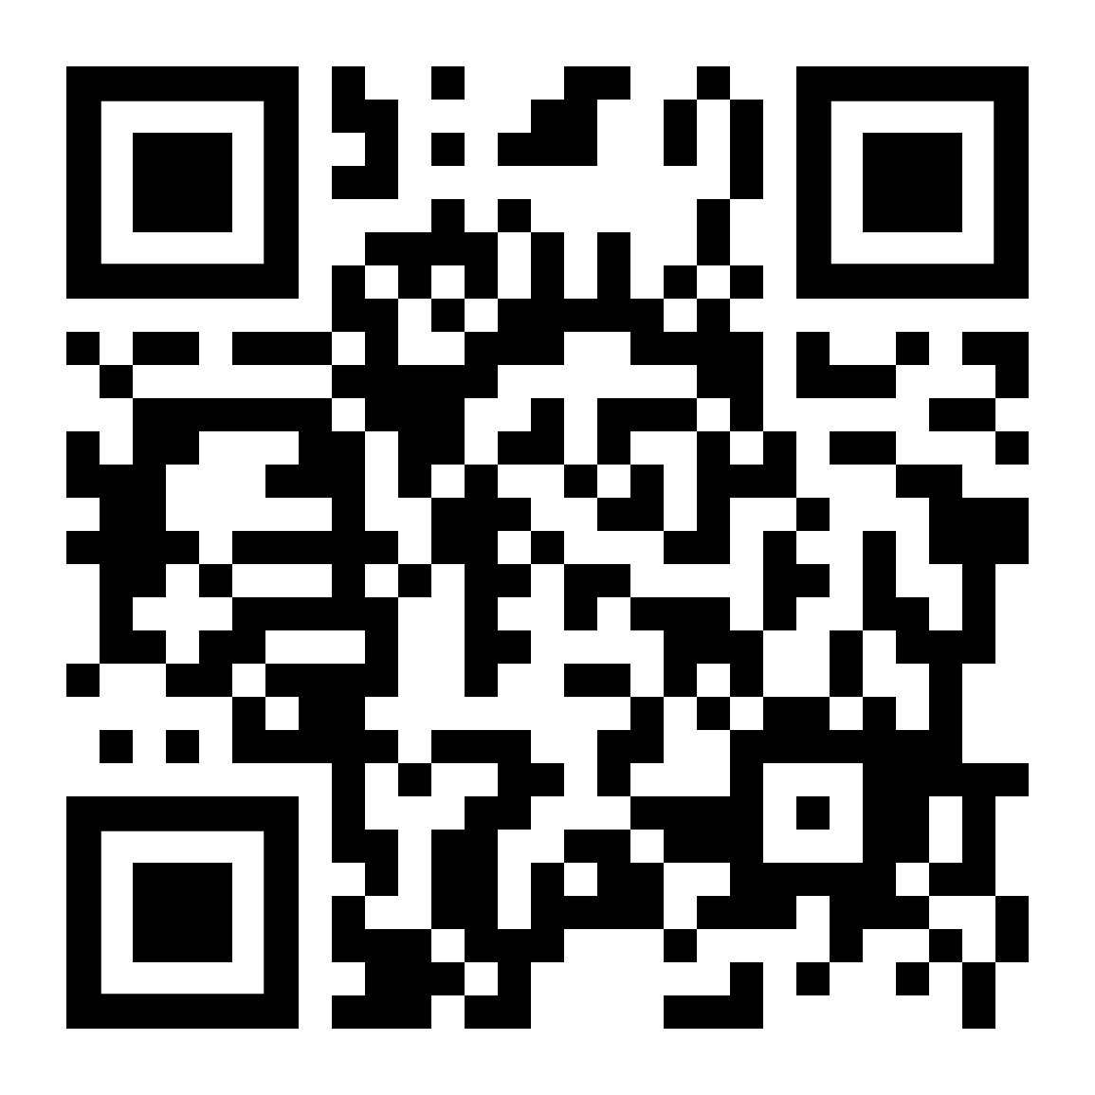
SECTION 5.1
Vote for which problem you want to go over first.

Slide 5
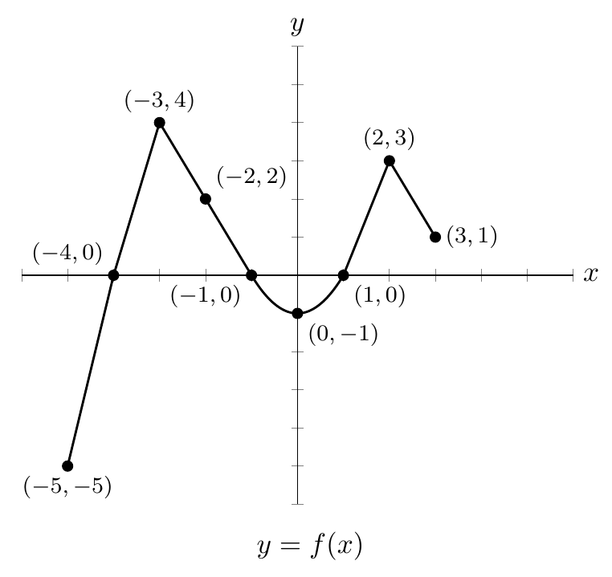
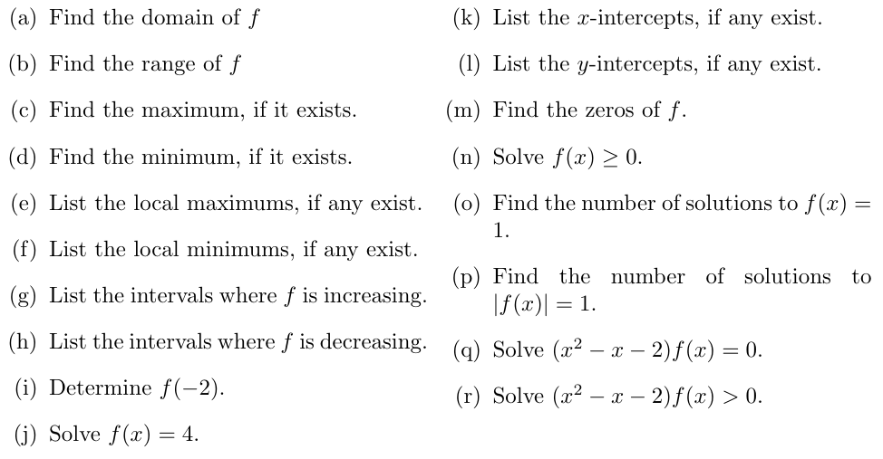

Slide 6
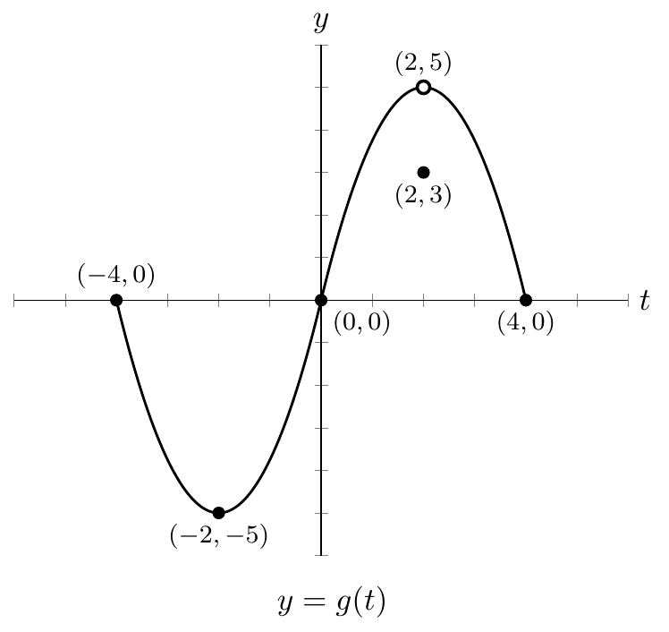
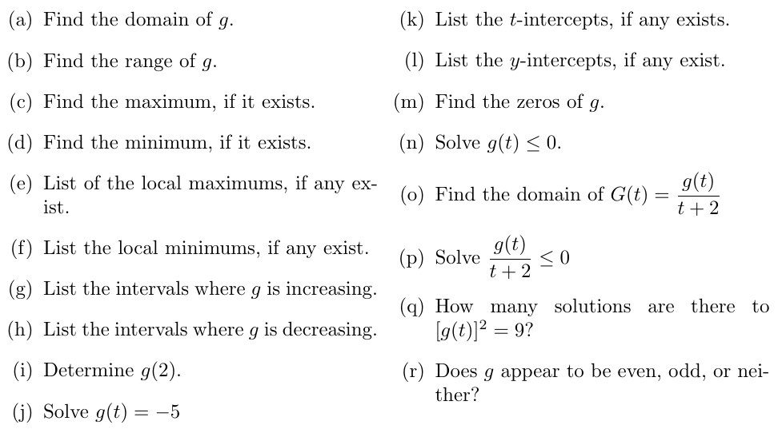

Slide 7
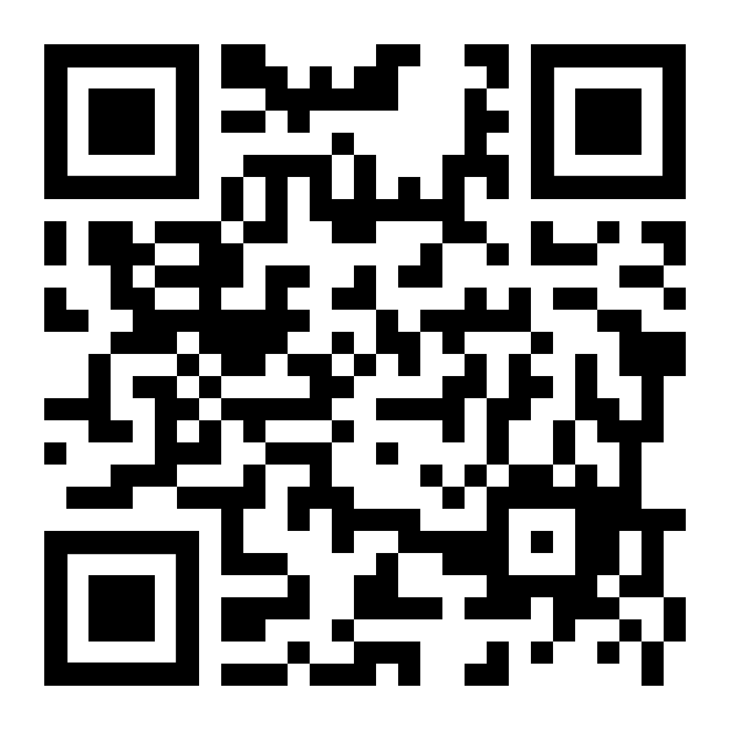
SECTION 5.2
Vote for which problem you want to go over first.

Slide 8
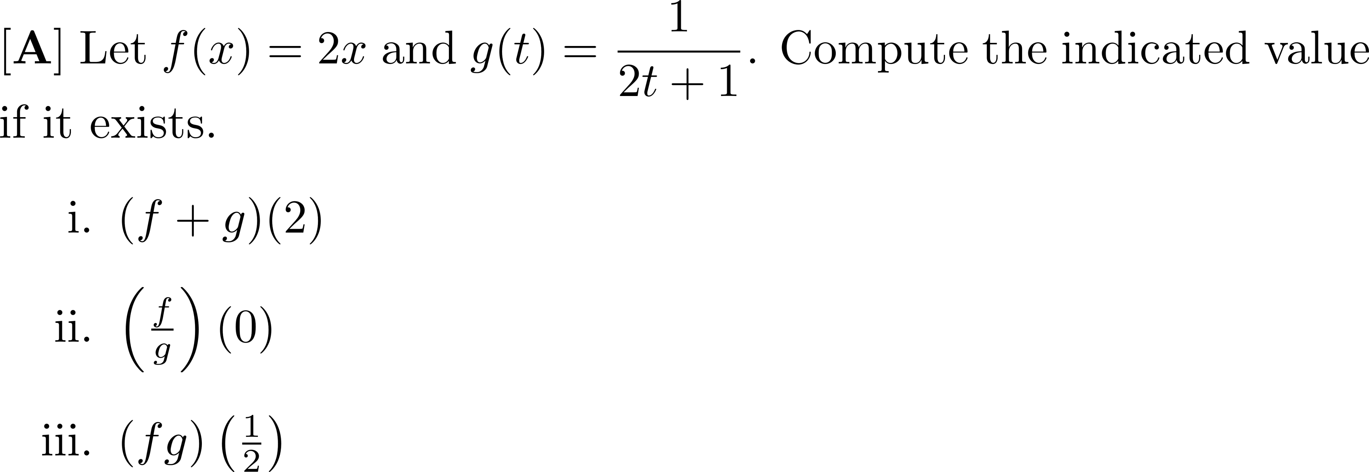

Slide 9
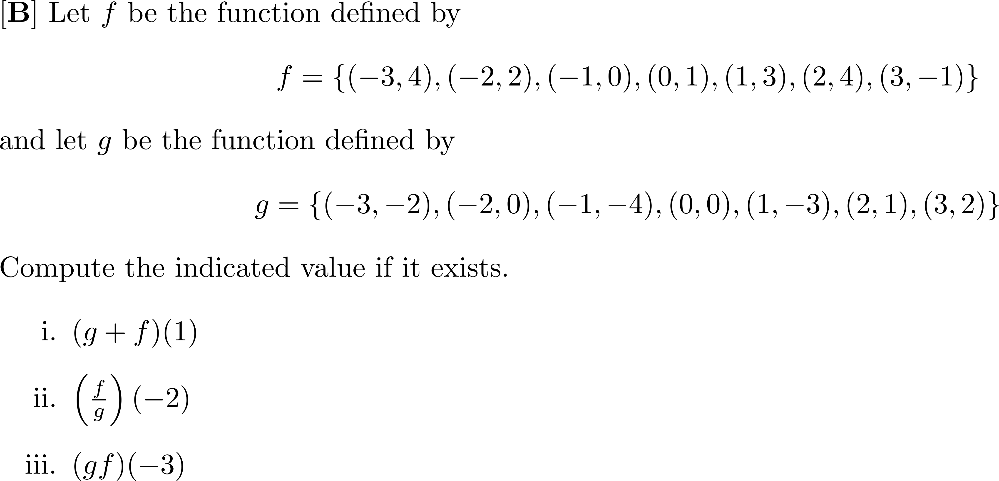

Slide 10
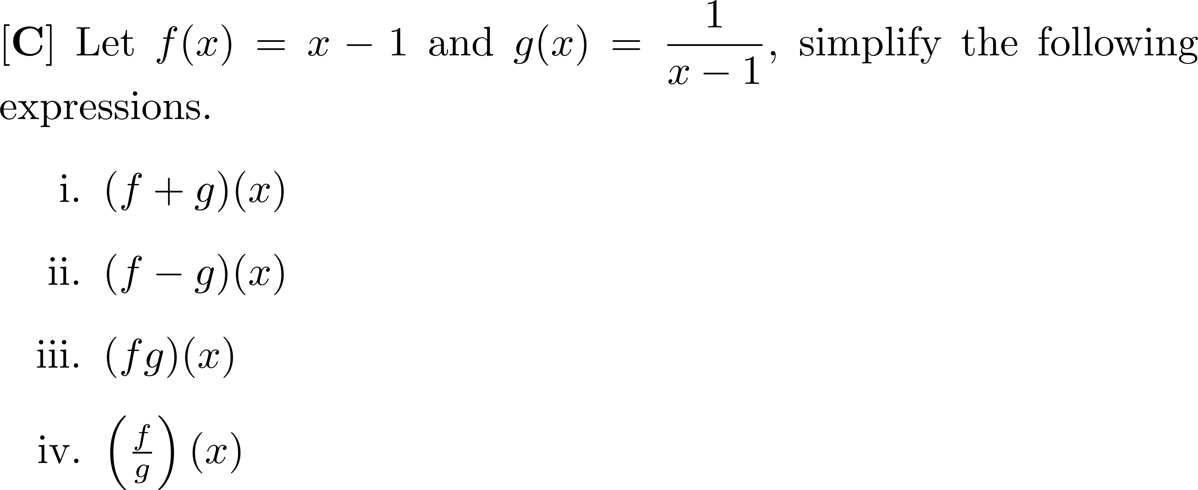

Slide 14
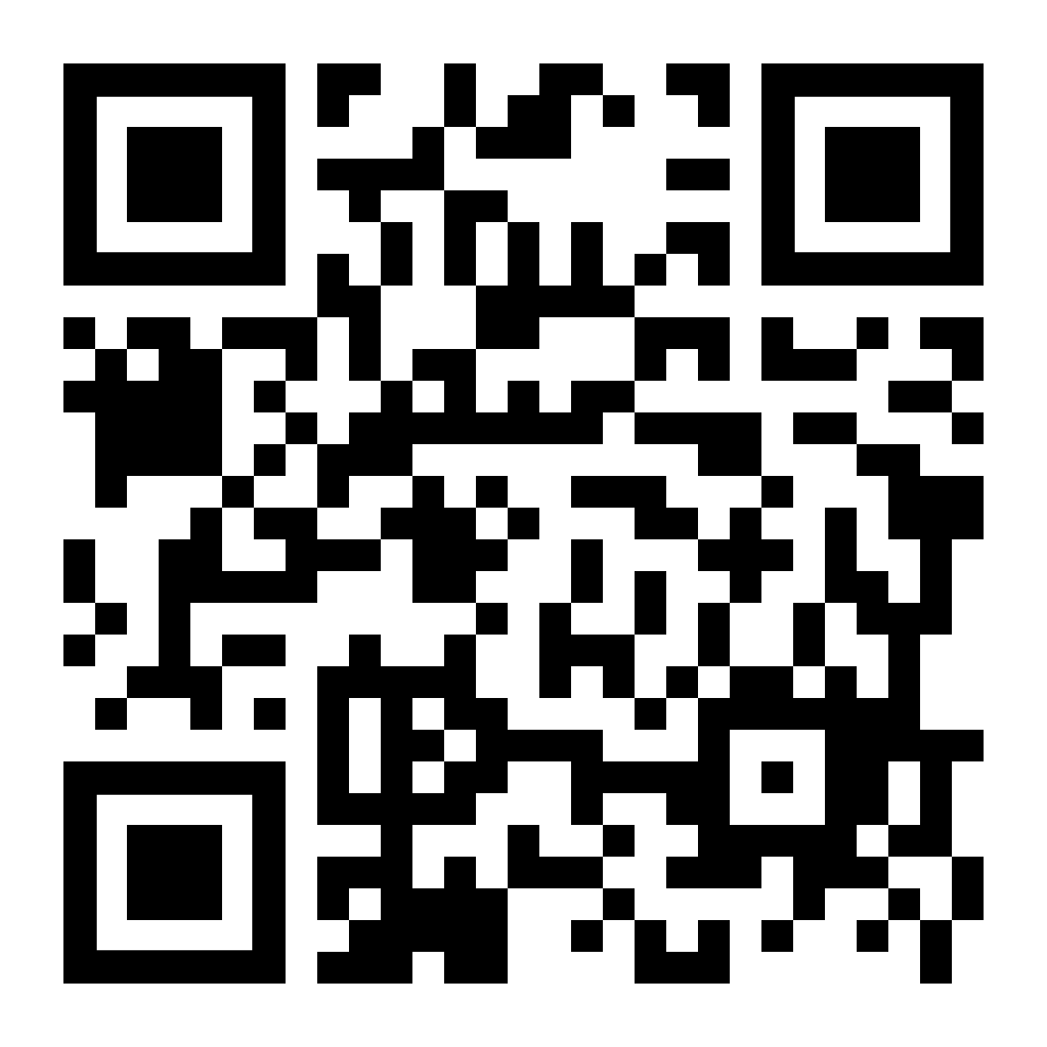
SECTION 5.3
Vote for which problem you want to go over first.

Slide 16
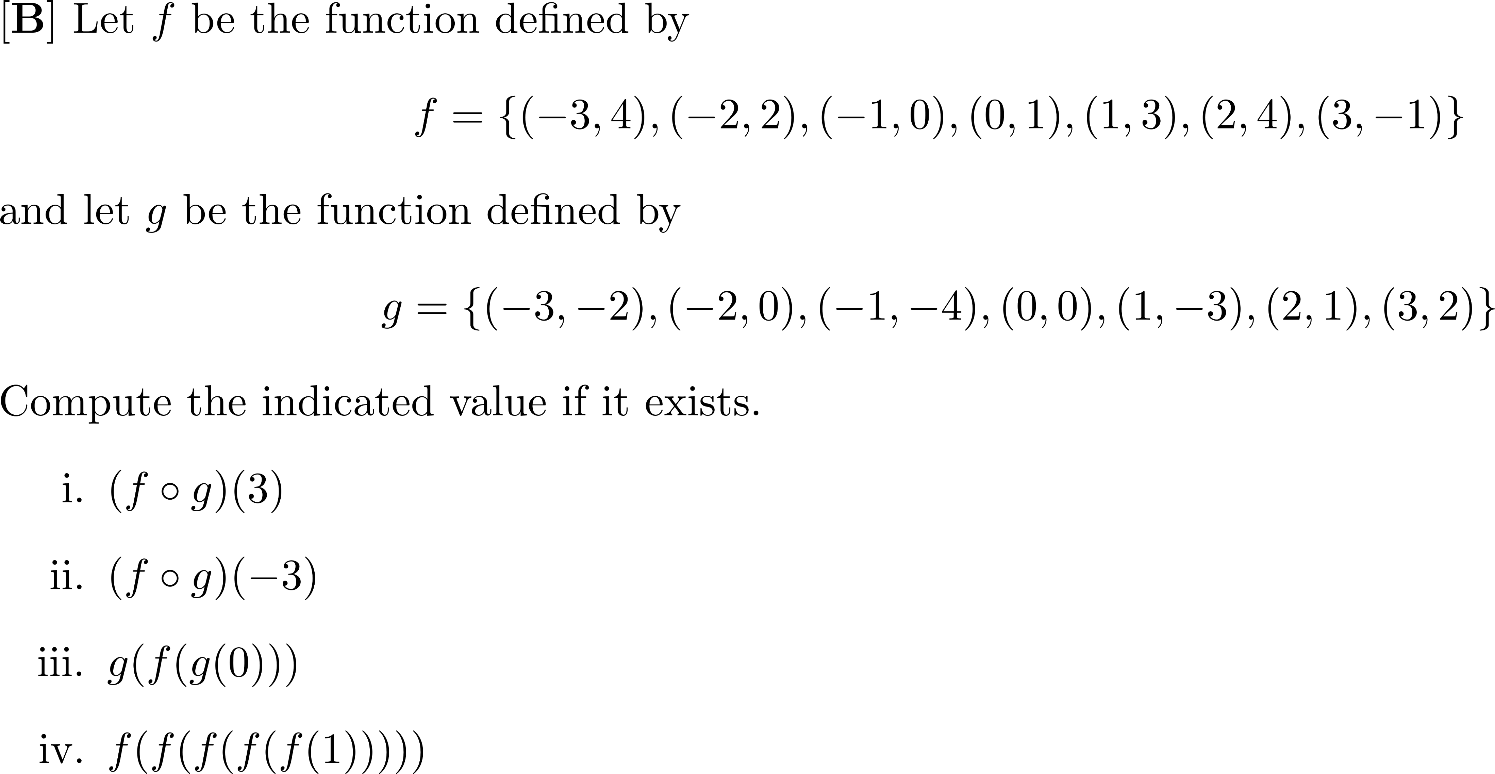

Slide 21
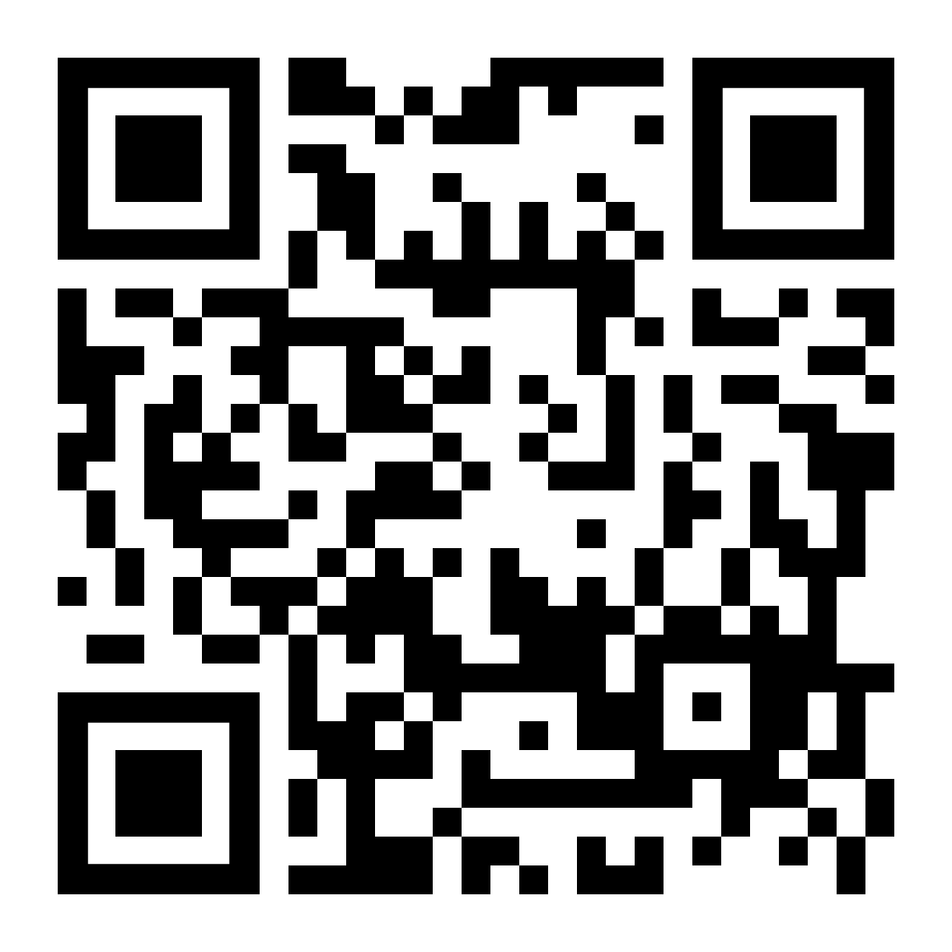
SECTION 5.4
Vote for which problem you want to go over first.

Slide 26
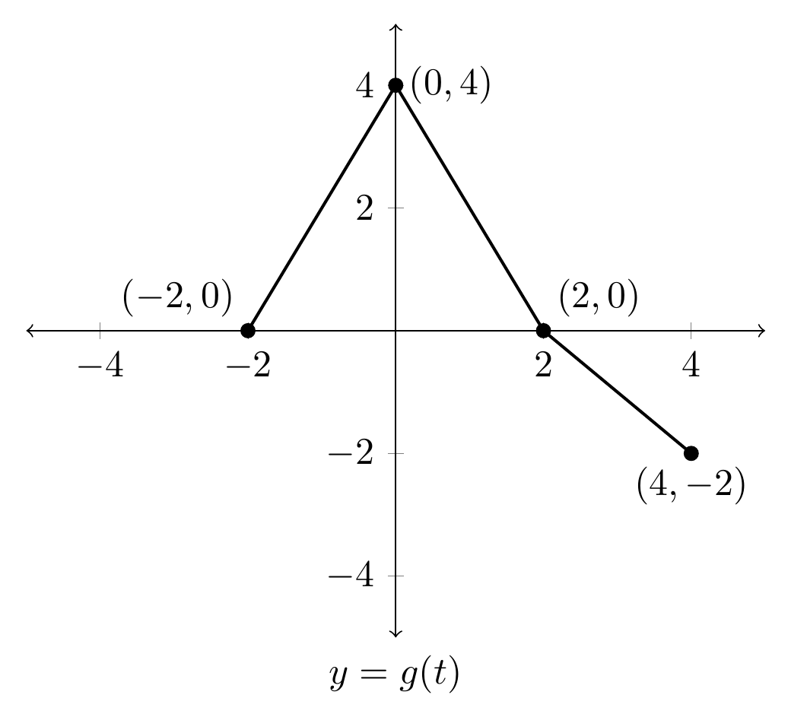

Slide 27
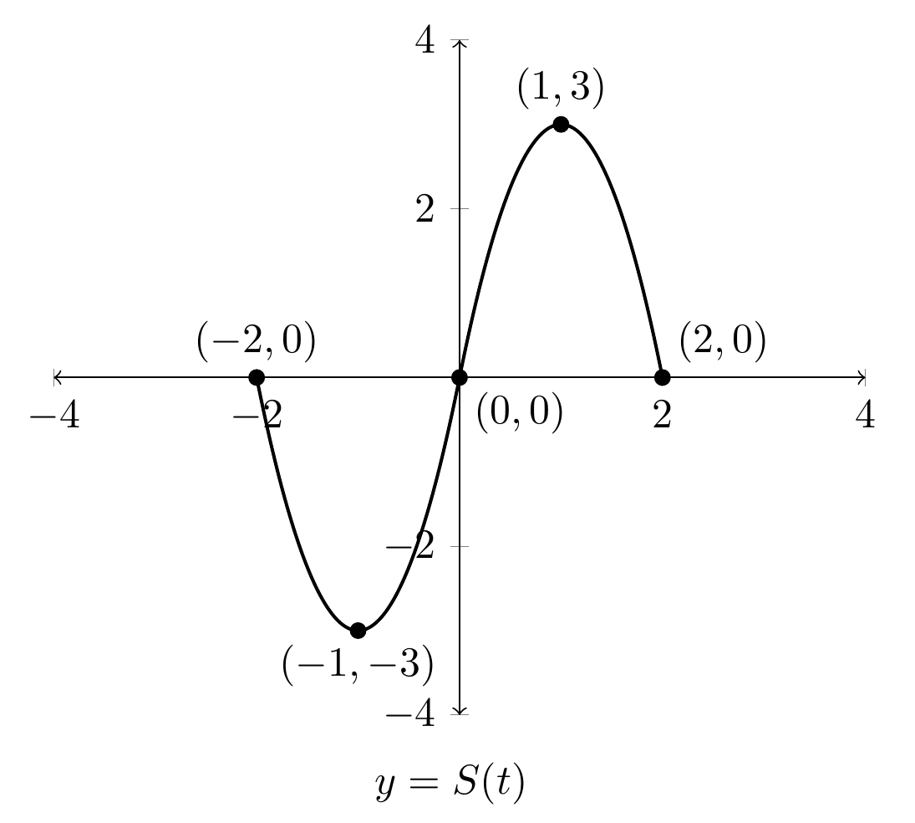

Slide 28
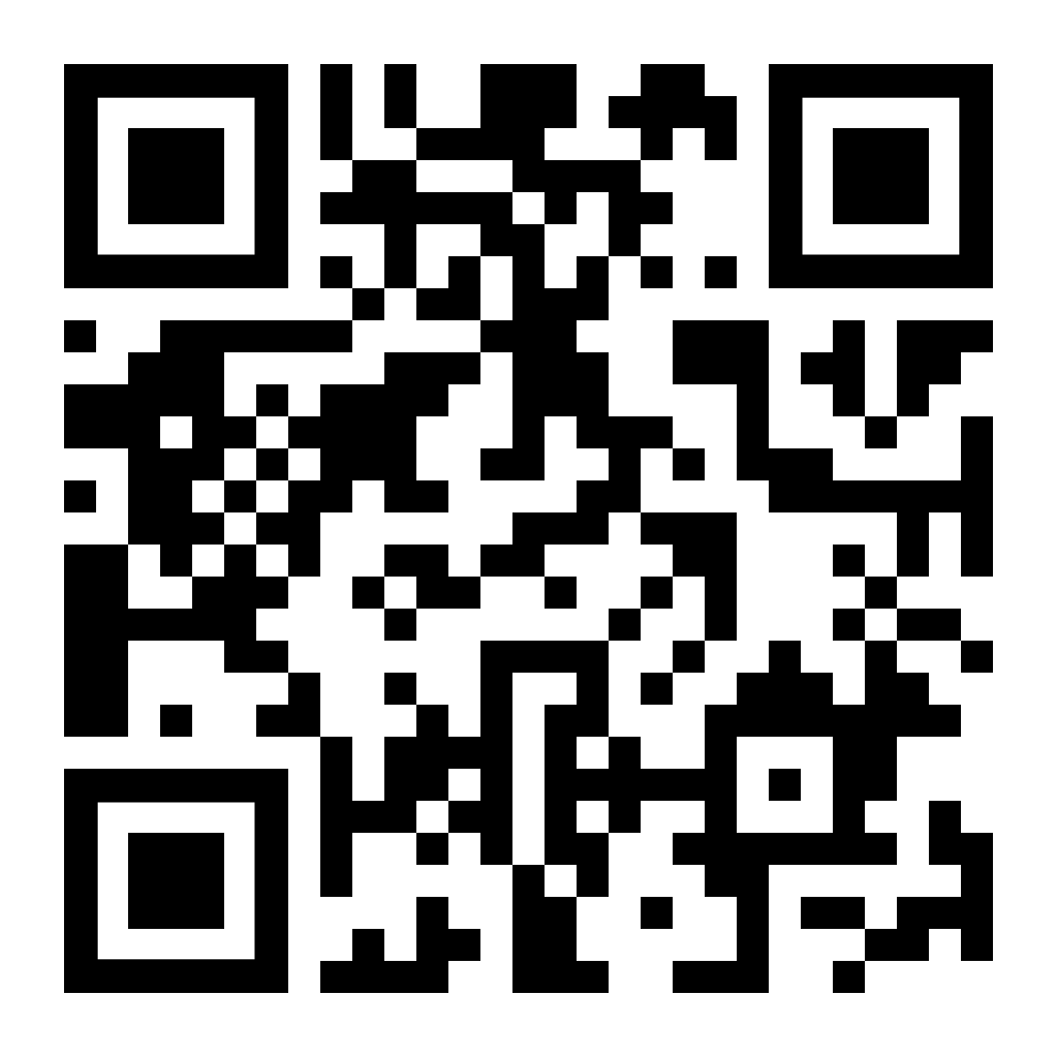
SECTION 5.5
Vote for which problem you want to go over first.

Slide 32
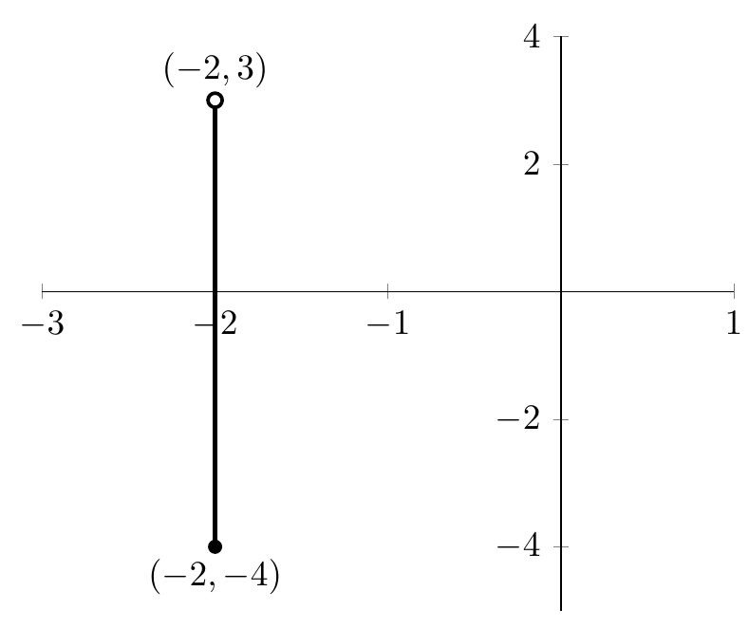

Slide 33
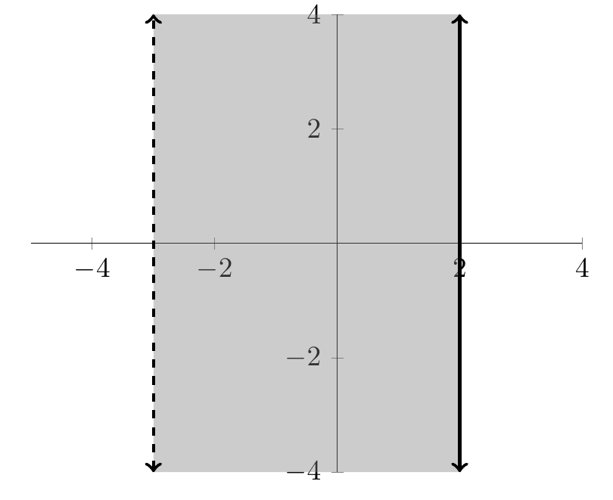

Slide 34
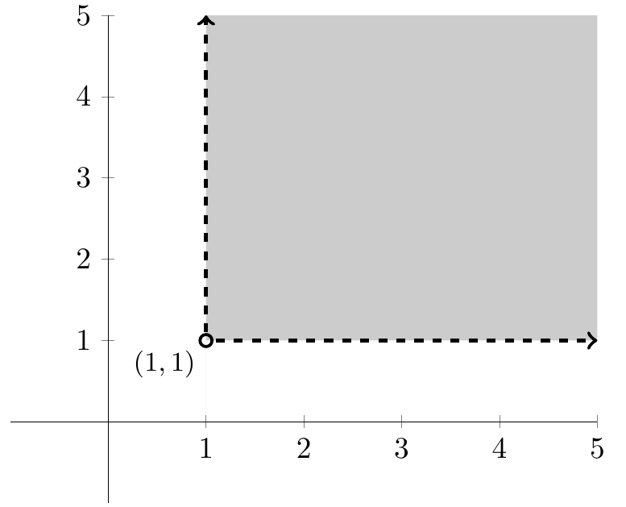

Slide 35
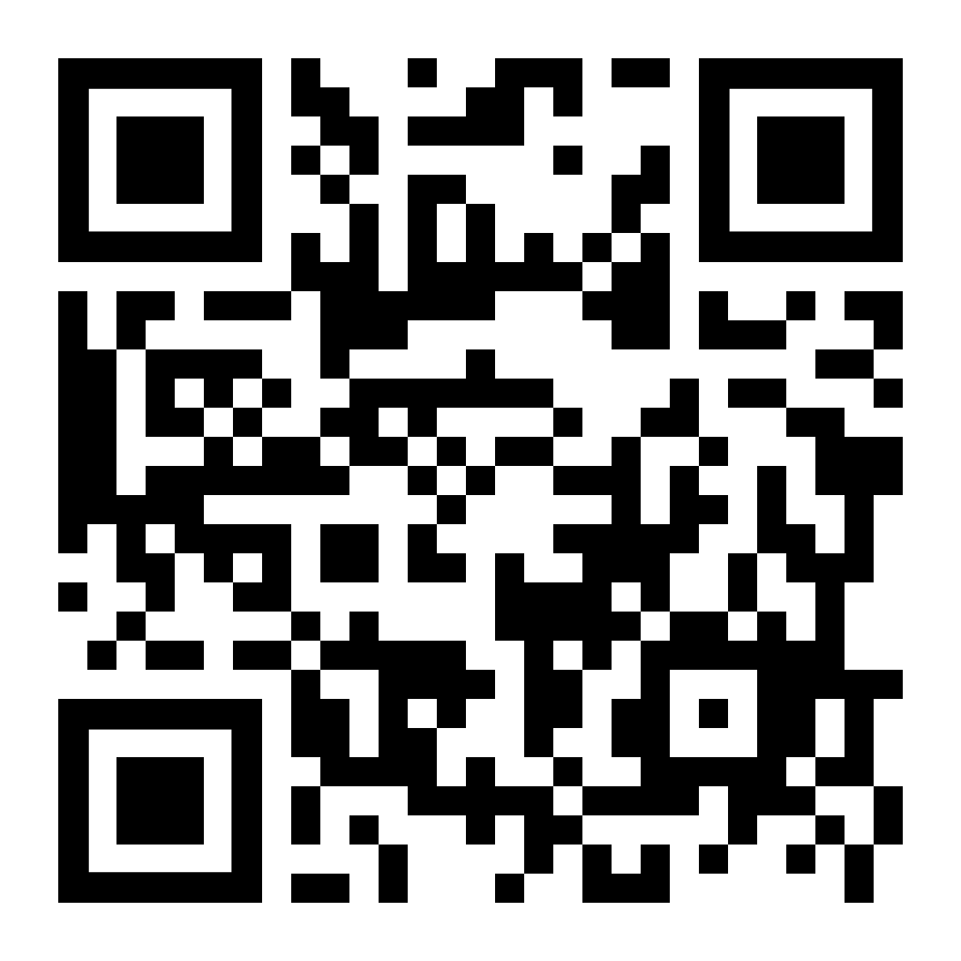
SECTION 5.6
Vote for which problem you want to go over first.

Slide 37
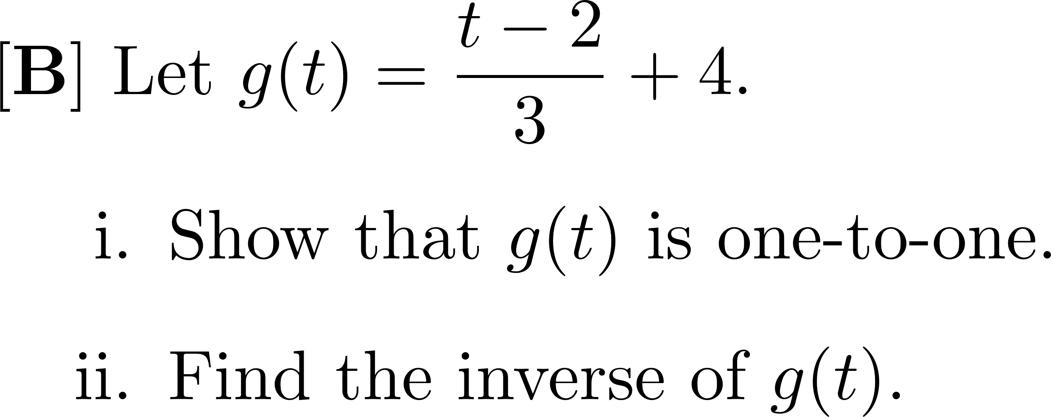

Slide 40
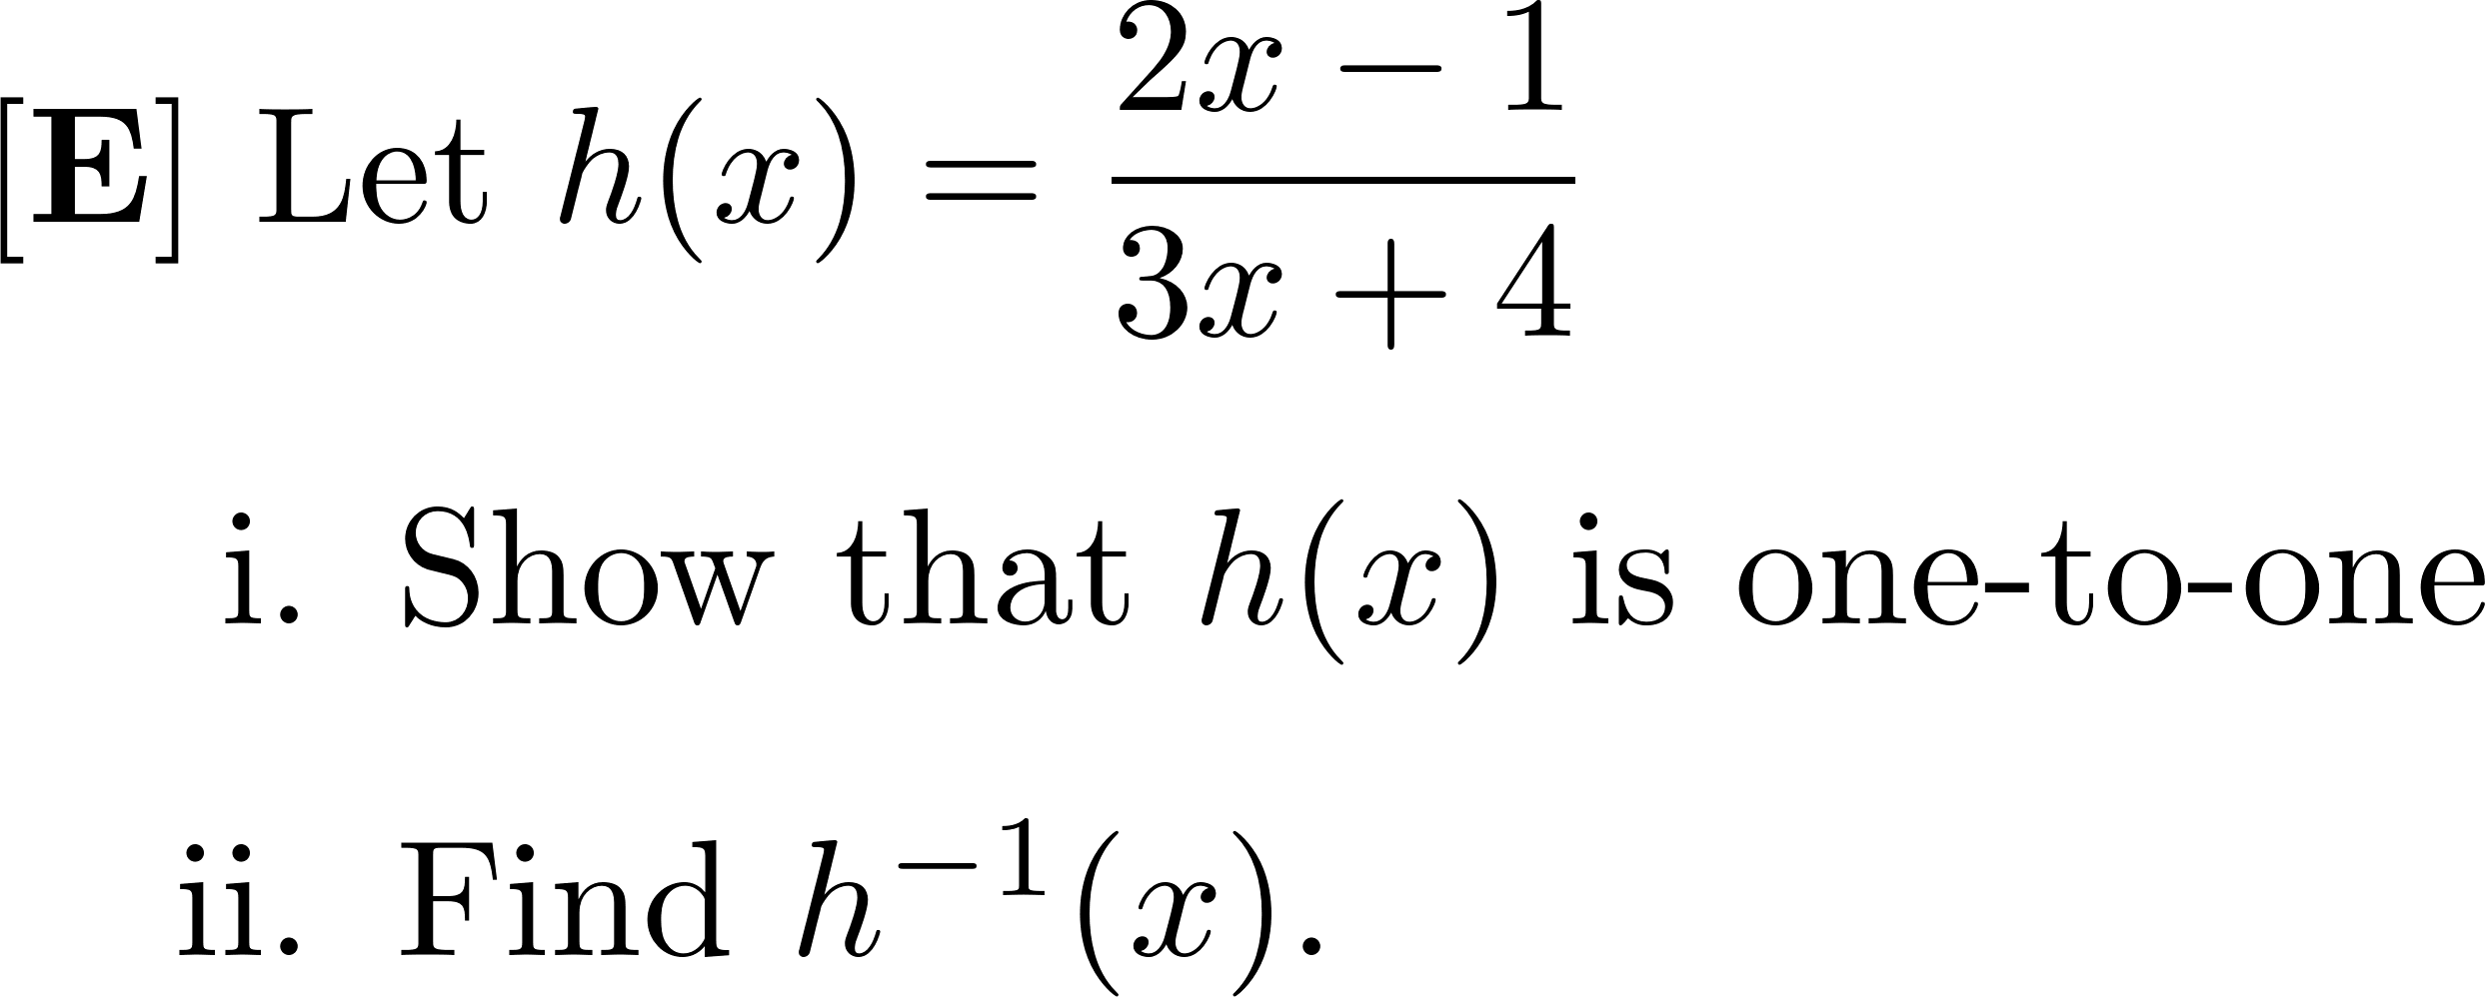

Slide 42
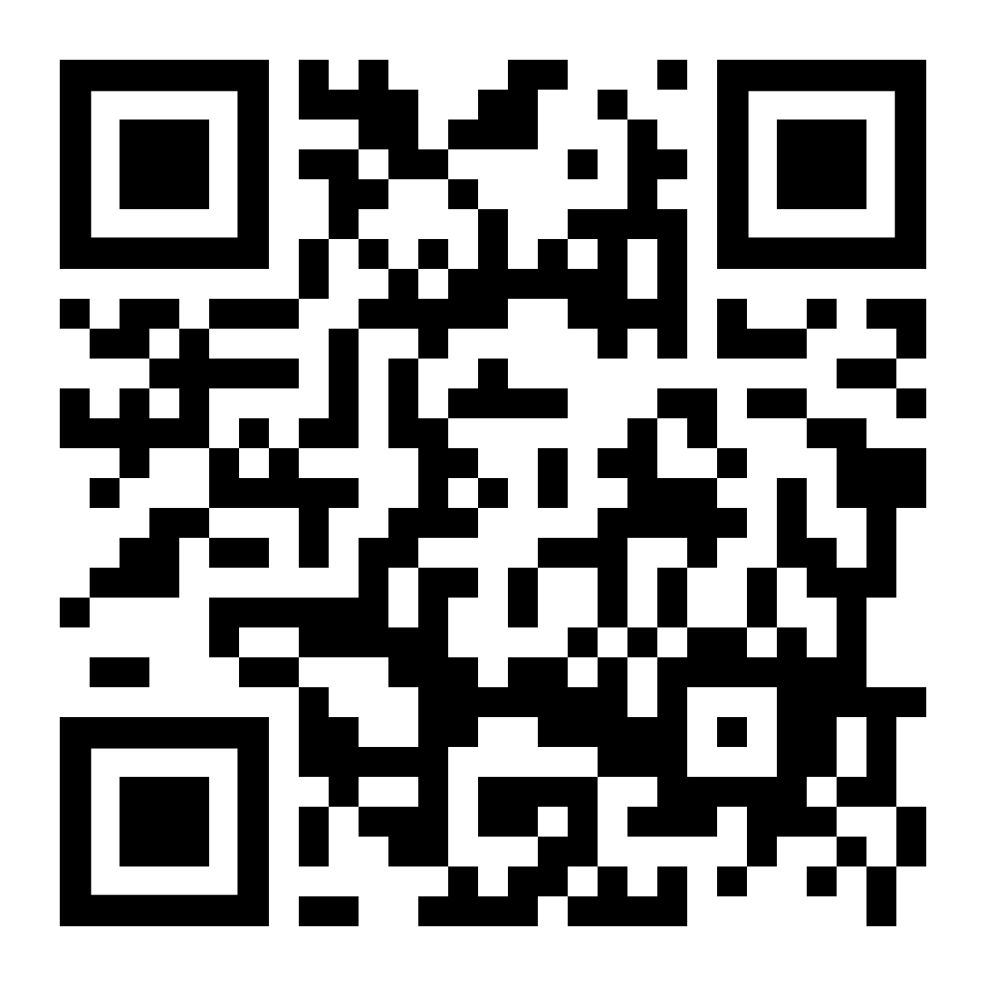
SECTION 6.1
Vote for which problem you want to go over first.

Slide 47
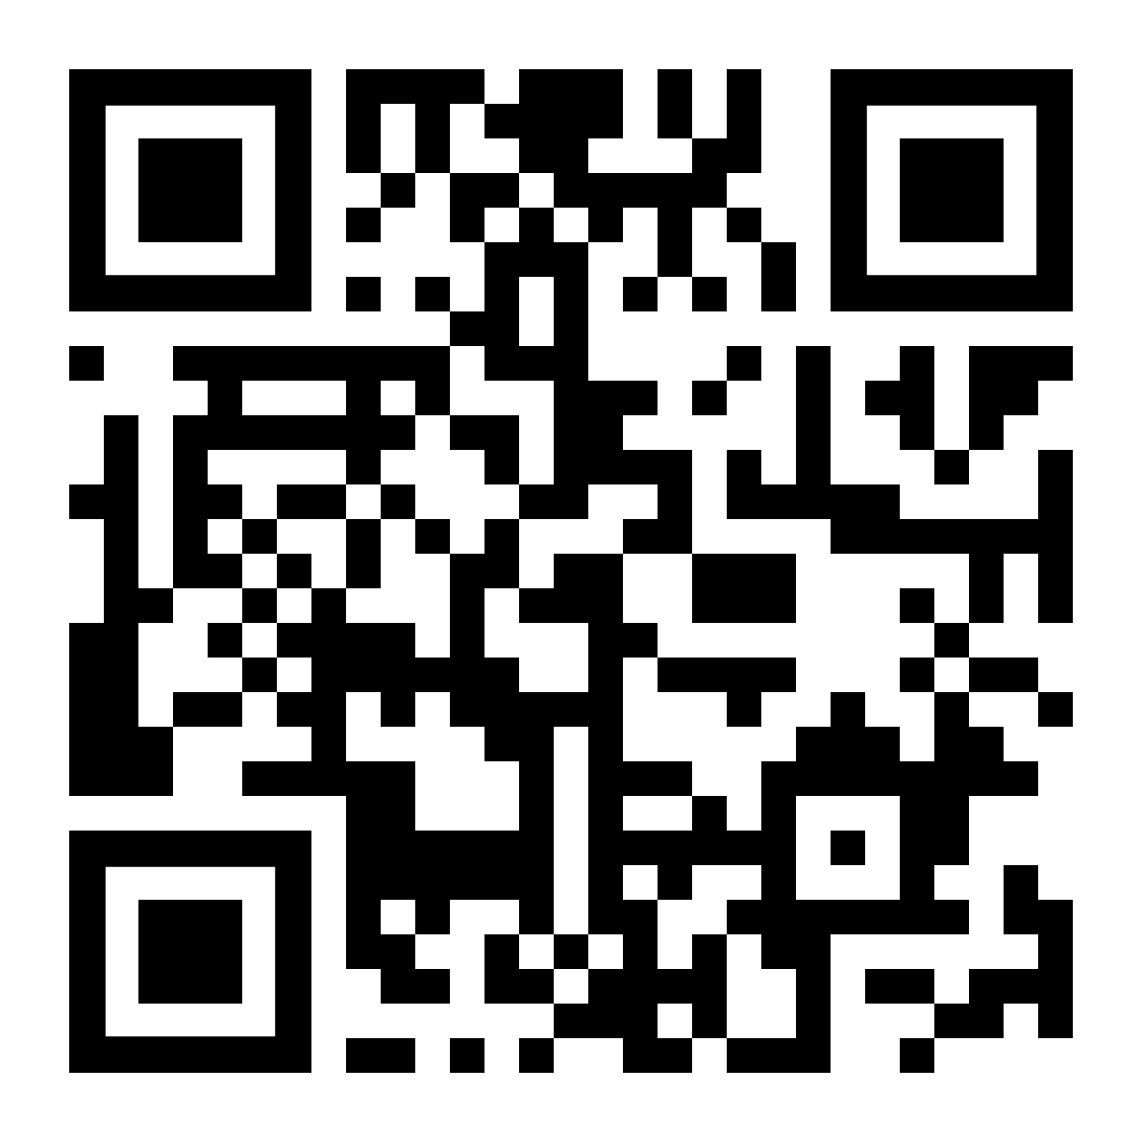
SECTION 6.2
Vote for which problem you want to go over first.

Slide 54
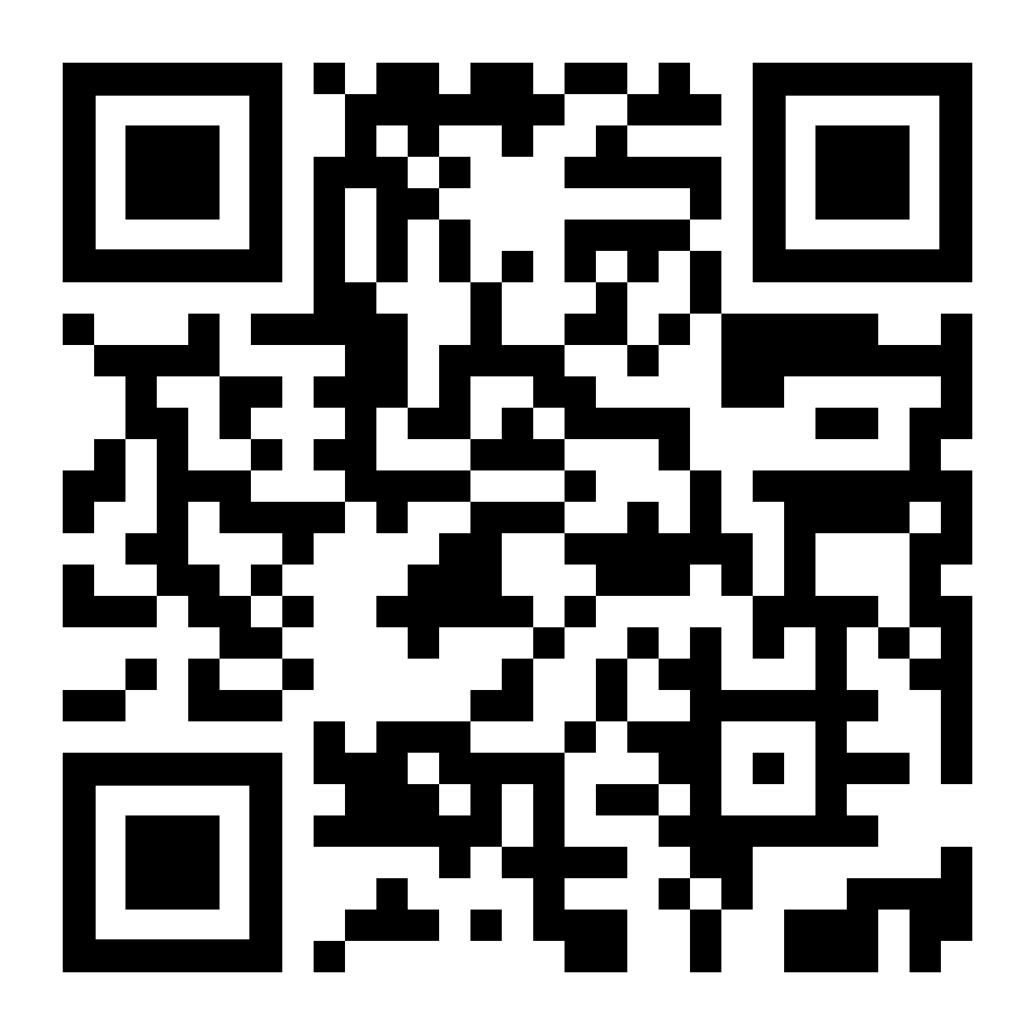
SECTION 6.3
Vote for which problem you want to go over first.

Slide 61
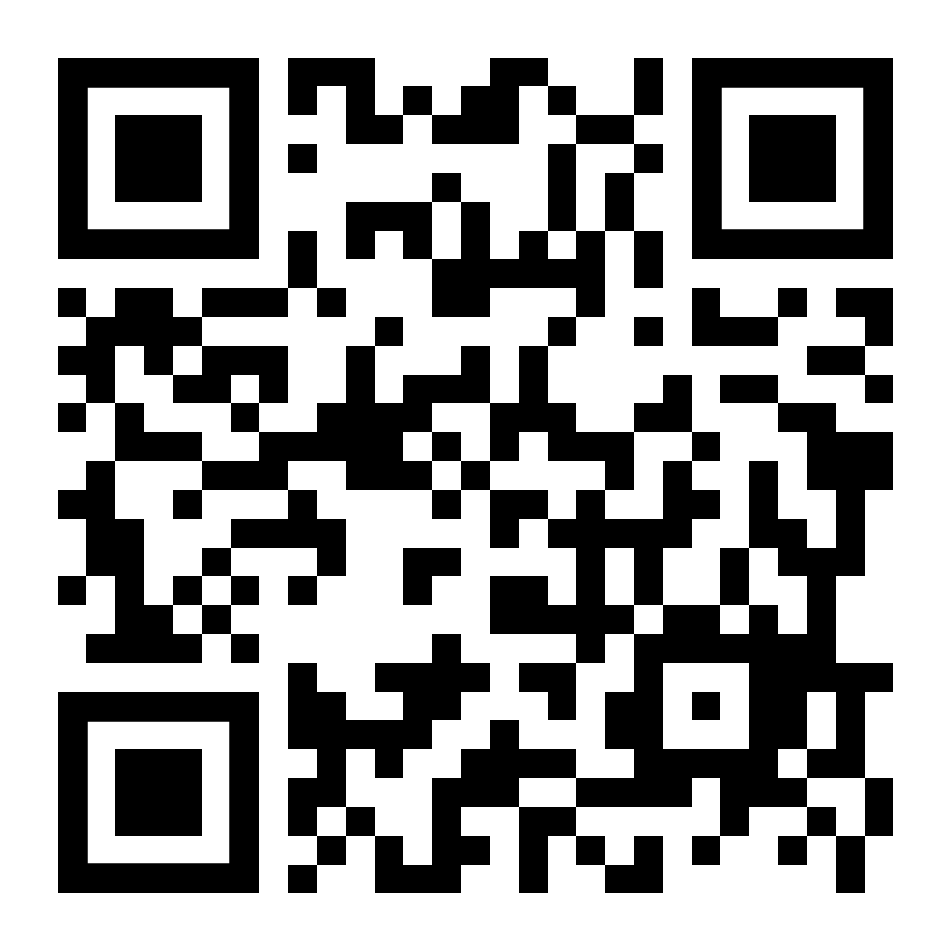
SECTION 6.4
Vote for which problem you want to go over first.

Slide 68
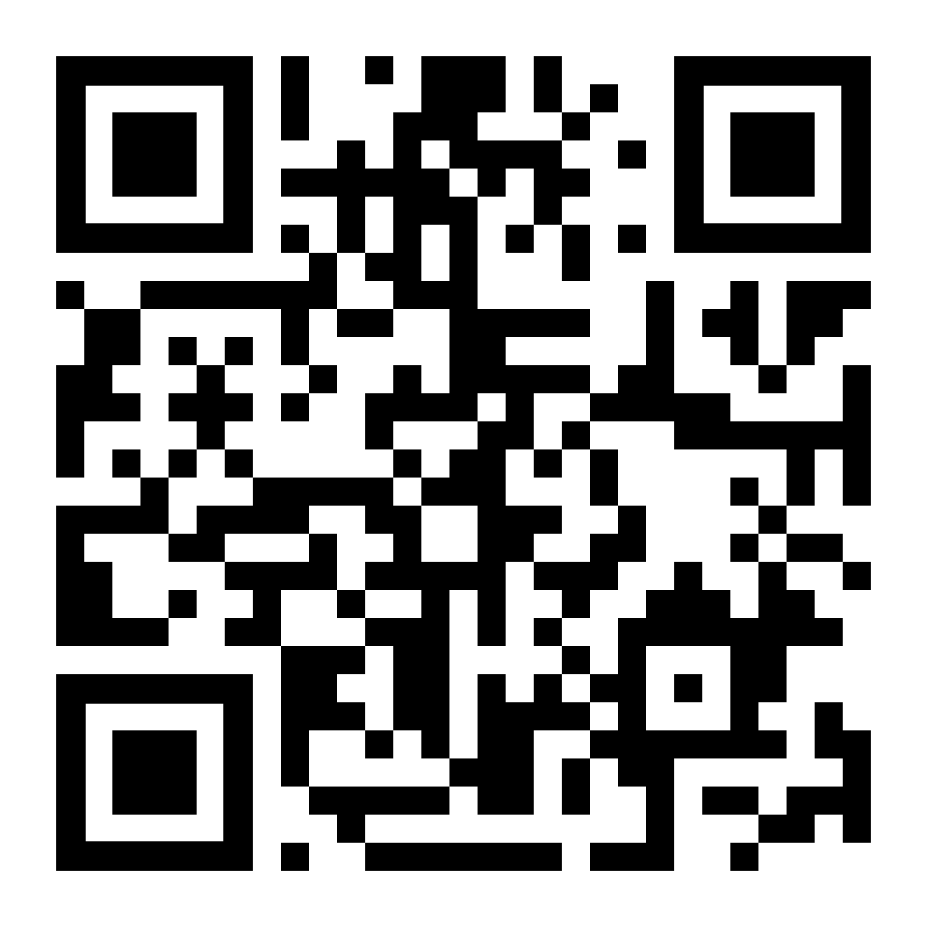
SECTION 6.5
Vote for which problem you want to go over first.

Slide 75
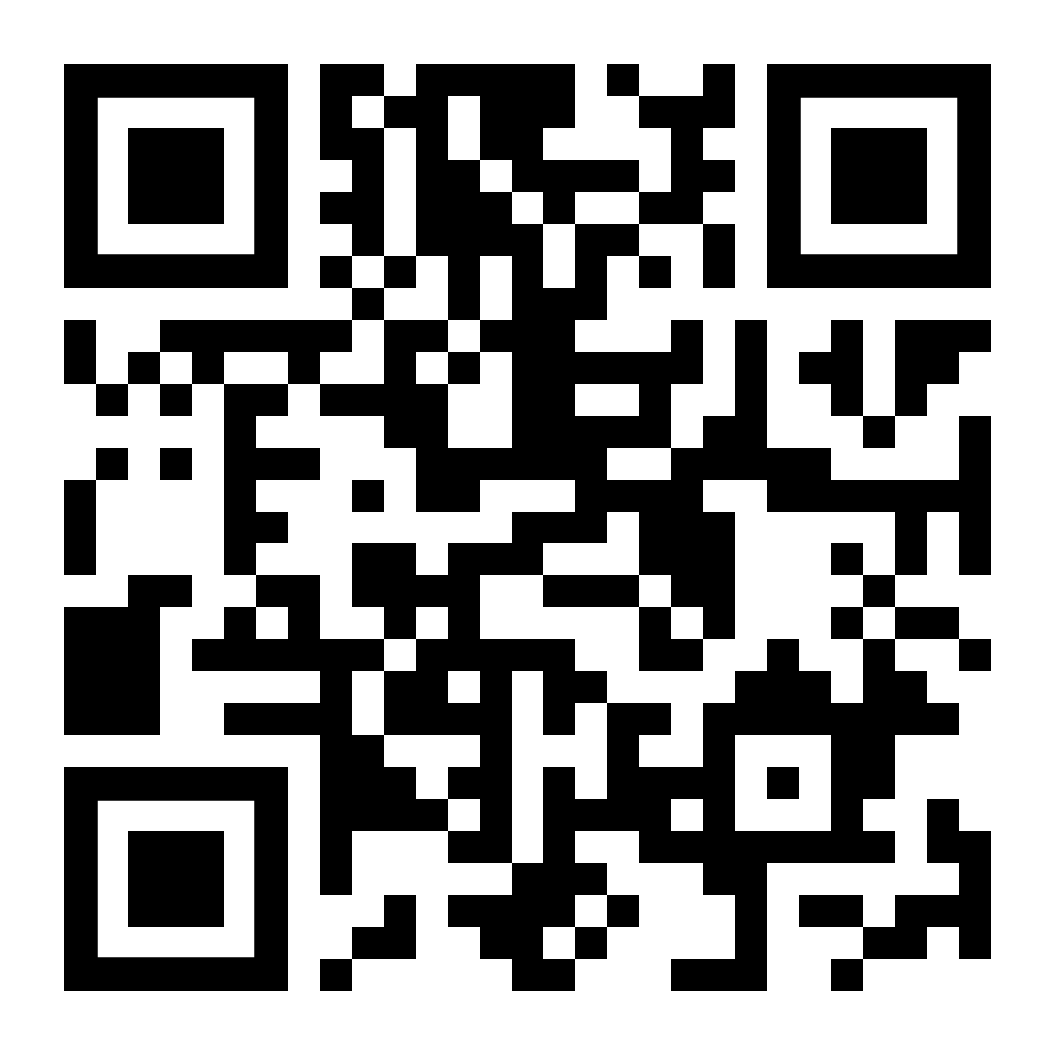
Exit Survey
romansimkins.com/pal

