Slide 1
Rejecting the Finality of Death:
Memento Mori Photography
Anna Skapoulas

Slide 2
Table of contents
01
02
03
History
Why?
Techniques
04
05
Identification
Myths

Slide 3
01
The History of Postmortem Photography

Slide 4
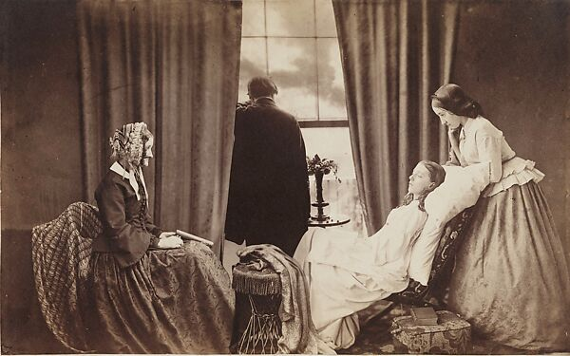
Changing Meanings of Death
18th century and before: effect diffused throughout entire community
19th century: concentrated within small family systems
Decrease in communal living and agriculture, increase in industry
Visual imagery of death represents attempts at coming to terms with new meanings
From ambiguous to individual
‘Fading Away’ by Henry Peach Robinson, 1858.
“Grief in nineteenth century America is explainable by the fact that society was undergoing a confusing and disorienting transition from an extended family system to a small family system. The small family system… is a form of socialization that creates overidentification and overdependence, and in which each person appears to the others to be irreplaceable”
(Meinwald, 1990, p. 8).

Slide 5
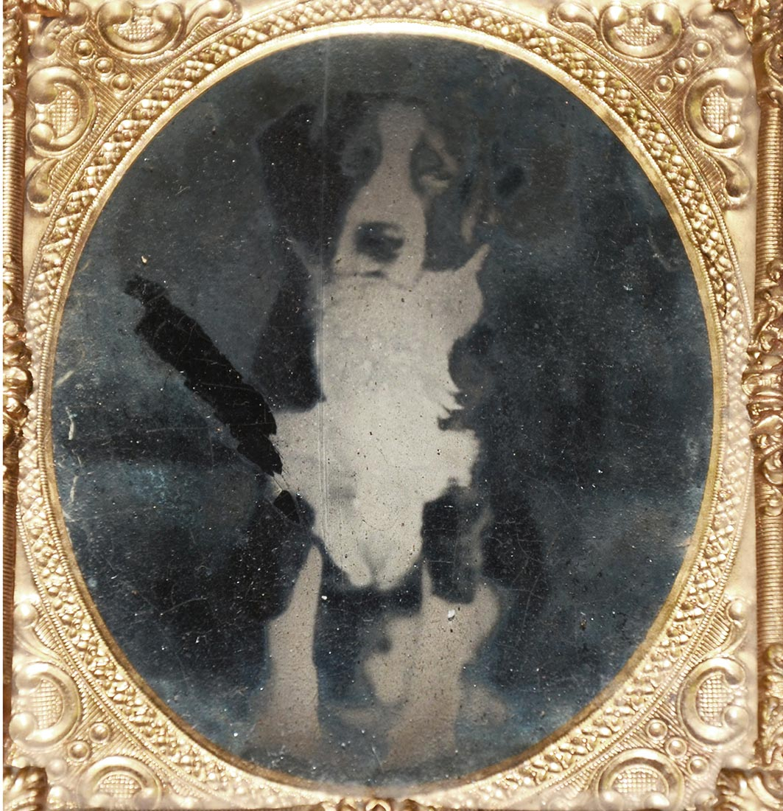
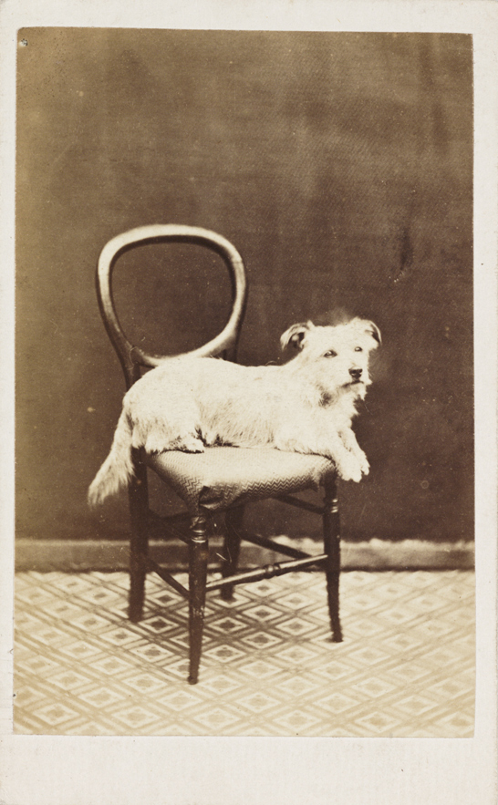
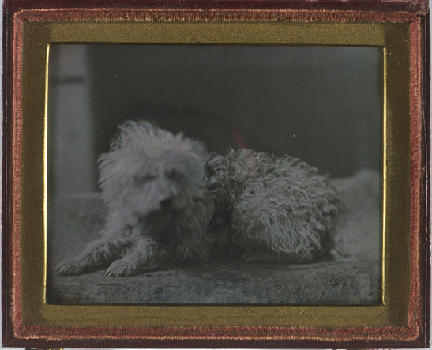
The Advent of Photography
Daguerreotype
Ambrotype
Tintype
Carte-de-Visite
Image on a silver-coated copper plate
Initially extremely expensive
Became less expensive, available to more people in 1840s with rise in photographers
Image on a glass plate
Less expensive
Extremely fragile
Image on an iron plate
Even less expensive
Image on a piece of paper
Least expensive
1839
1851
1853
1854
1860s
Daguerreotype
Ambrotype
Tintype
Accessible &
Affordable
Carte-de-Visite

Slide 6
02
Why take photos of the dead?

Slide 7
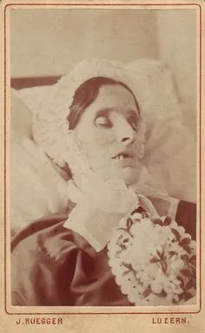
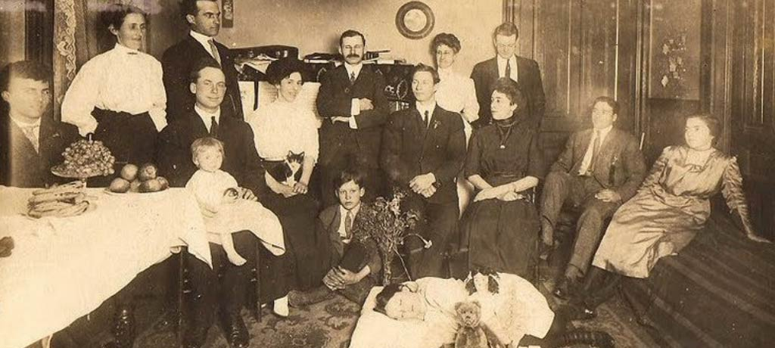
For the Observer
During and before the nineteenth century, people tried to retain the presence of their dead and think of them often
Similar to embalming today, postmortem photography acted as a preservation of the body for the gaze of the observer
Many people would only accept that a person was dead after viewing their body
“Often the first time families would have a photo taken and the last chance to capture the permanent likeness of a child” (Bell, 2016)
Some photos depict subjects as if asleep
“Someone who is asleep may, afterall, wake up, if only in the dreams or fantasies of the living” (Meinwald, 1990)
“Surmount the fact of separation” (Meinwald, 1990)

Slide 8
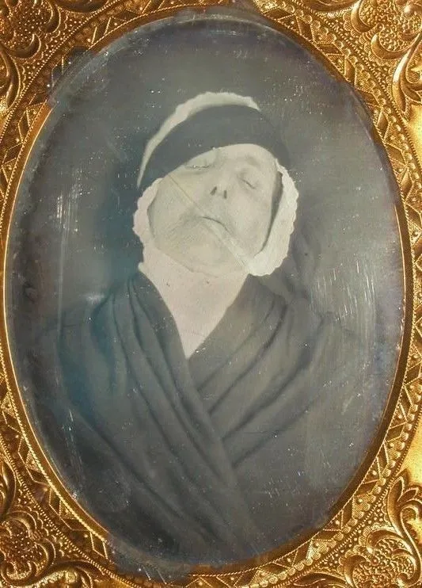
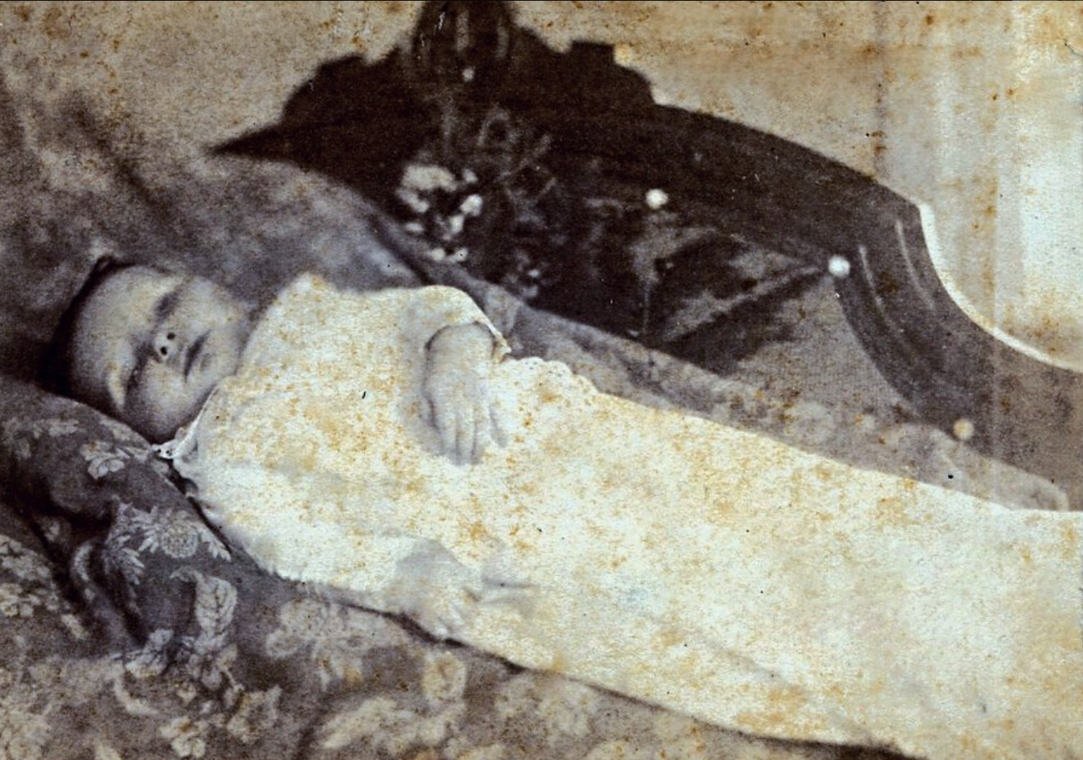
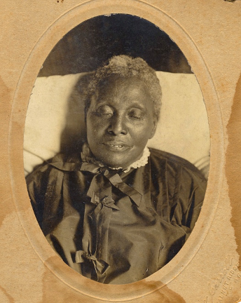
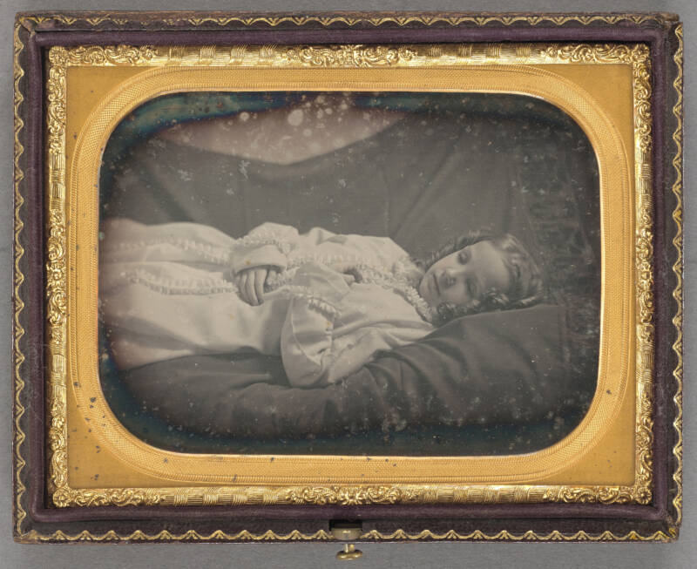
For the Individual
Postmortem photos were often the only time a child’s likeness would be recorded
Same for the elderly in the early years of photography
Portraiture as an expression of identity and individual worth
Especially popular in America, a nation undergoing its own self definition
Individualism seen as a national trait

Slide 9
03
Postmortem photography techniques

Slide 10
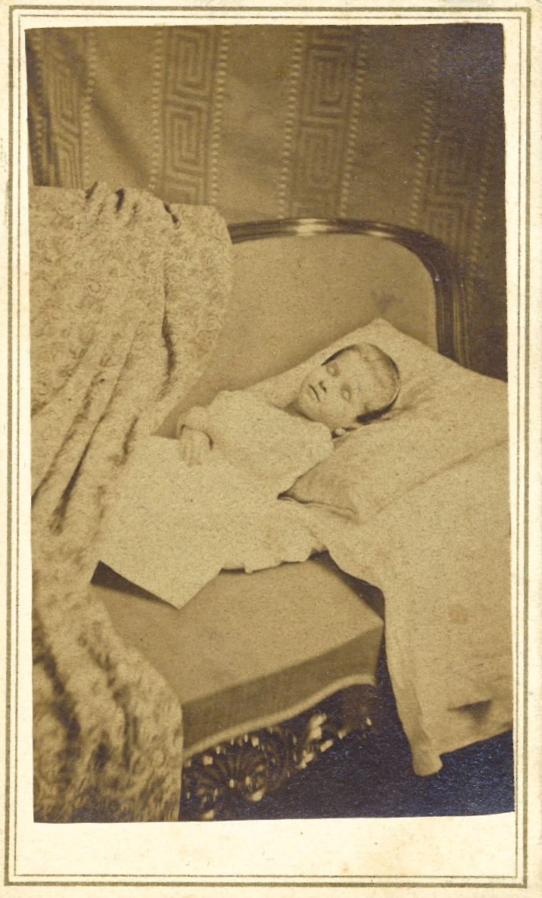
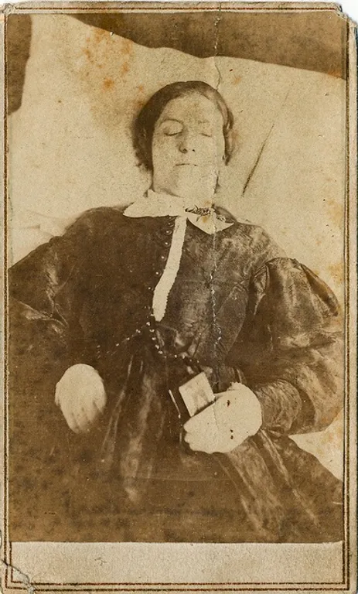
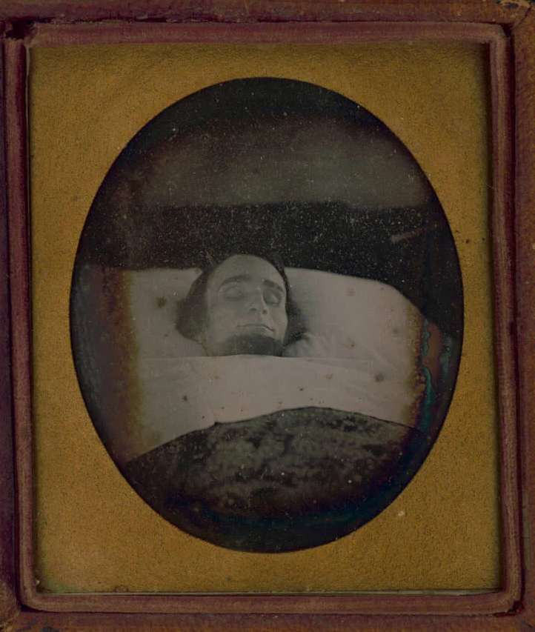
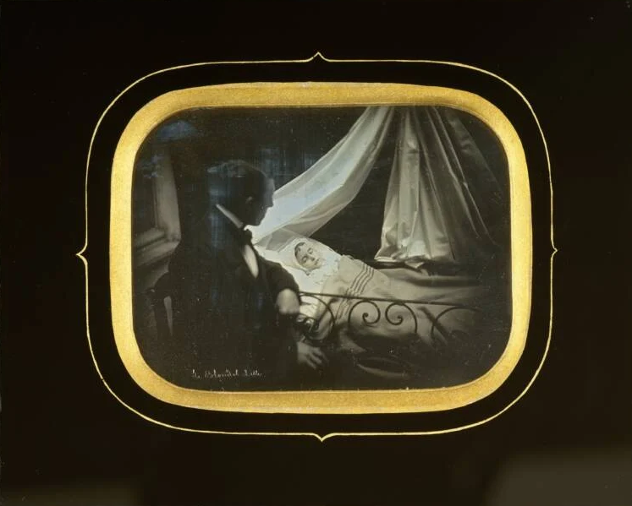
Design in Early Photos
Early photos: more variety
Family cleaned, dressed, prepared the body at home
Look as though just died, usually in bed
Sometimes staged by photographer

Slide 11
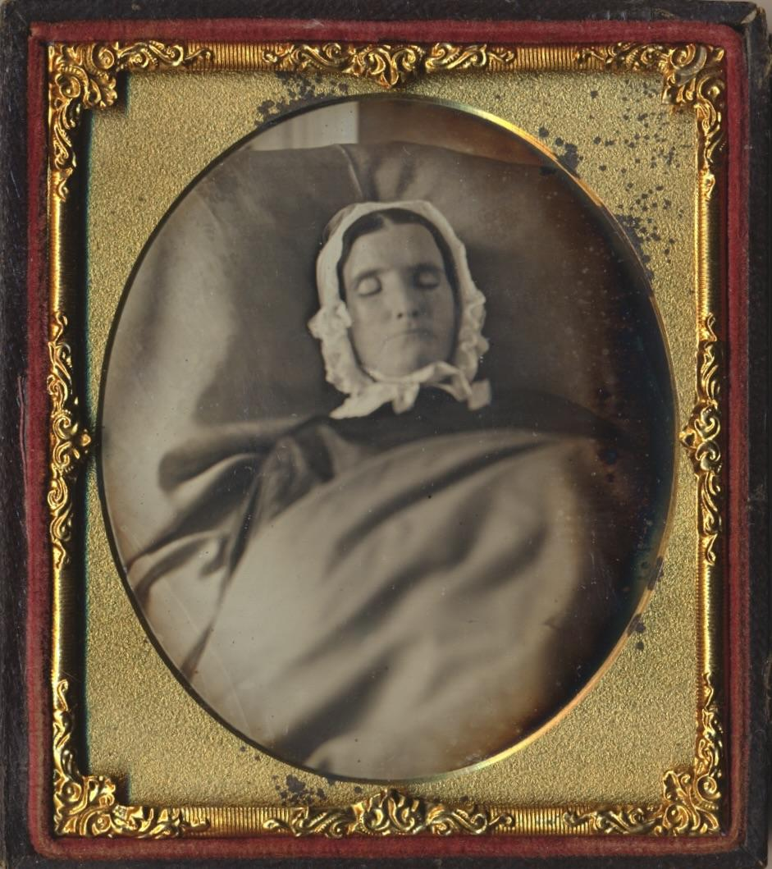
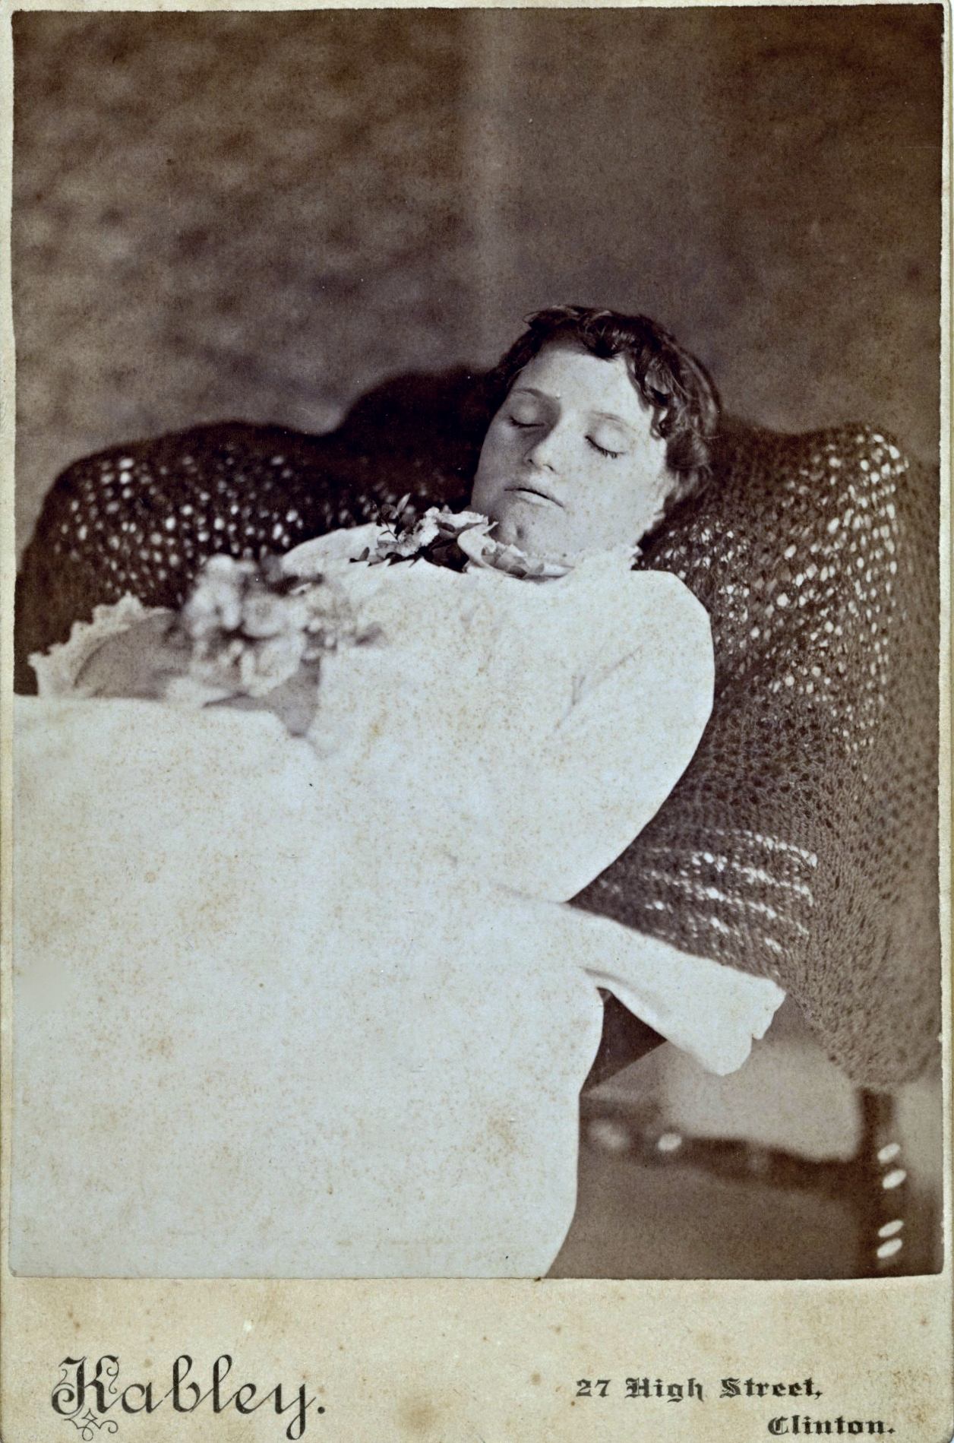
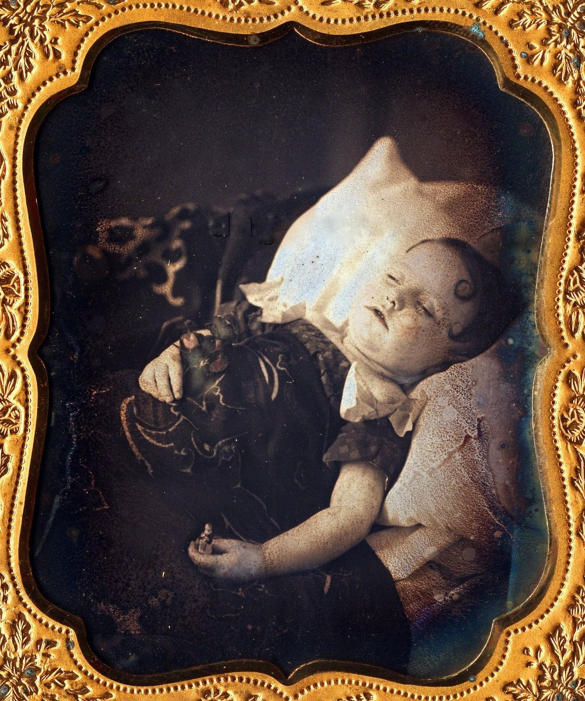
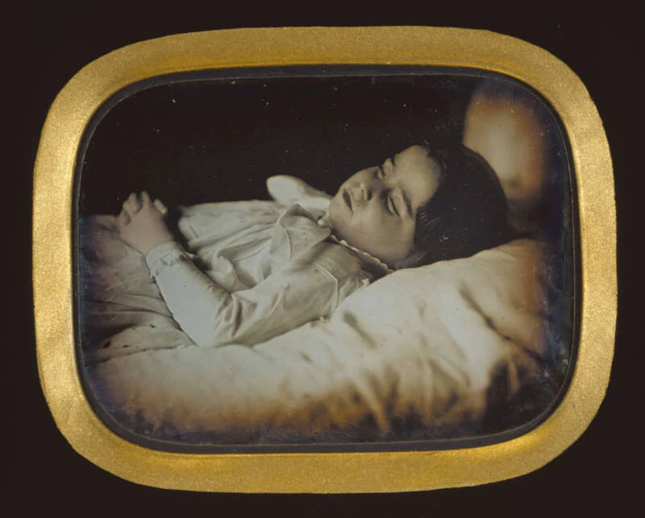
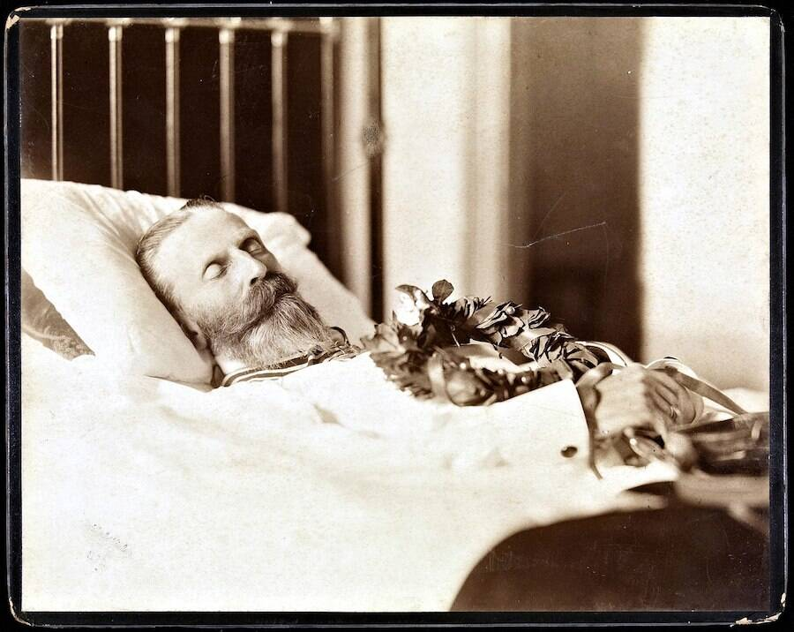

Slide 12
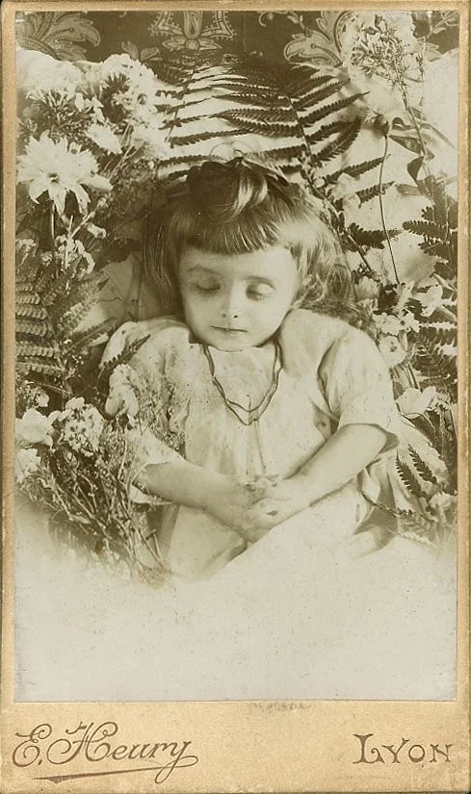
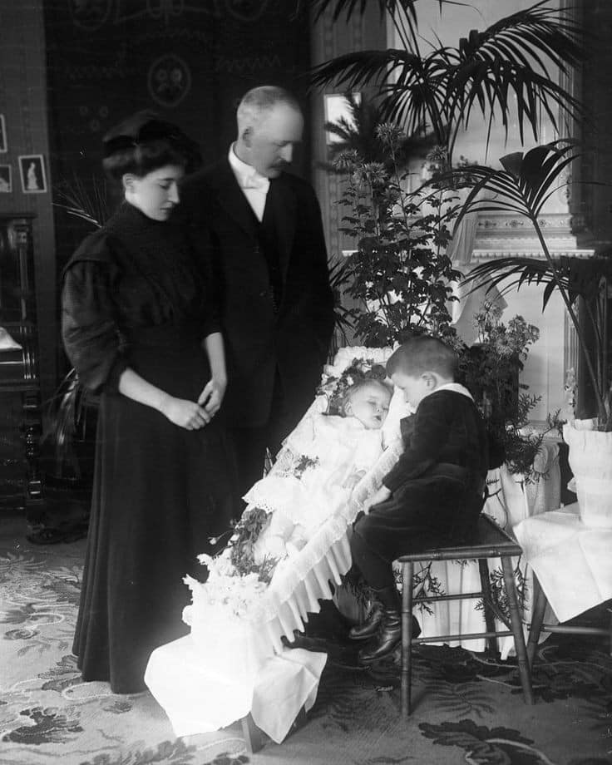
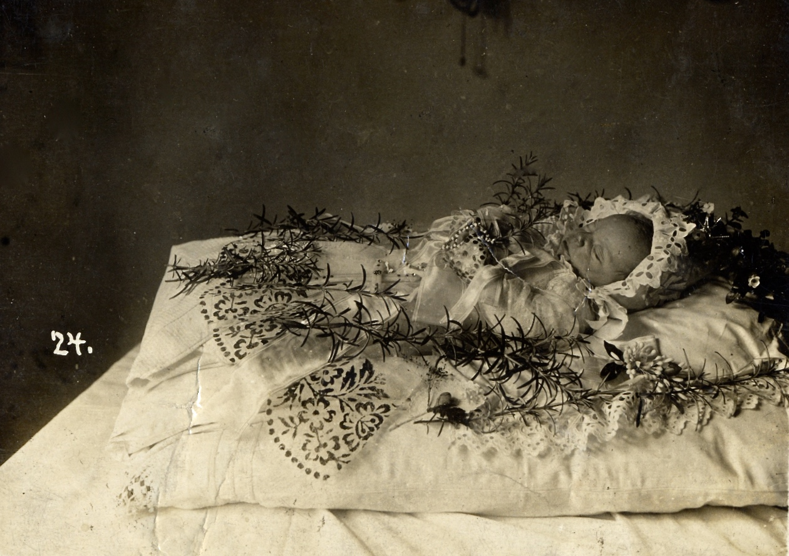
Design in Later Photos
Later photos: more uniform
Advent of funeral industry & embalming
Documenting work of undertaker
Almost always in coffin

Slide 13
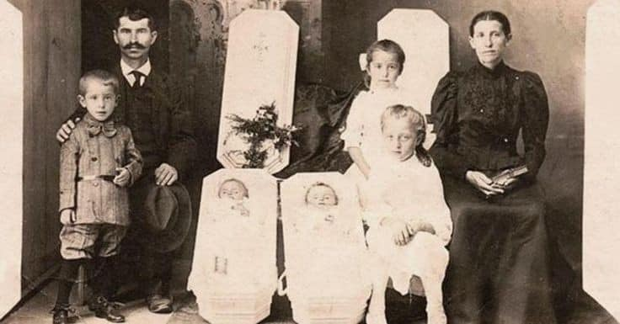
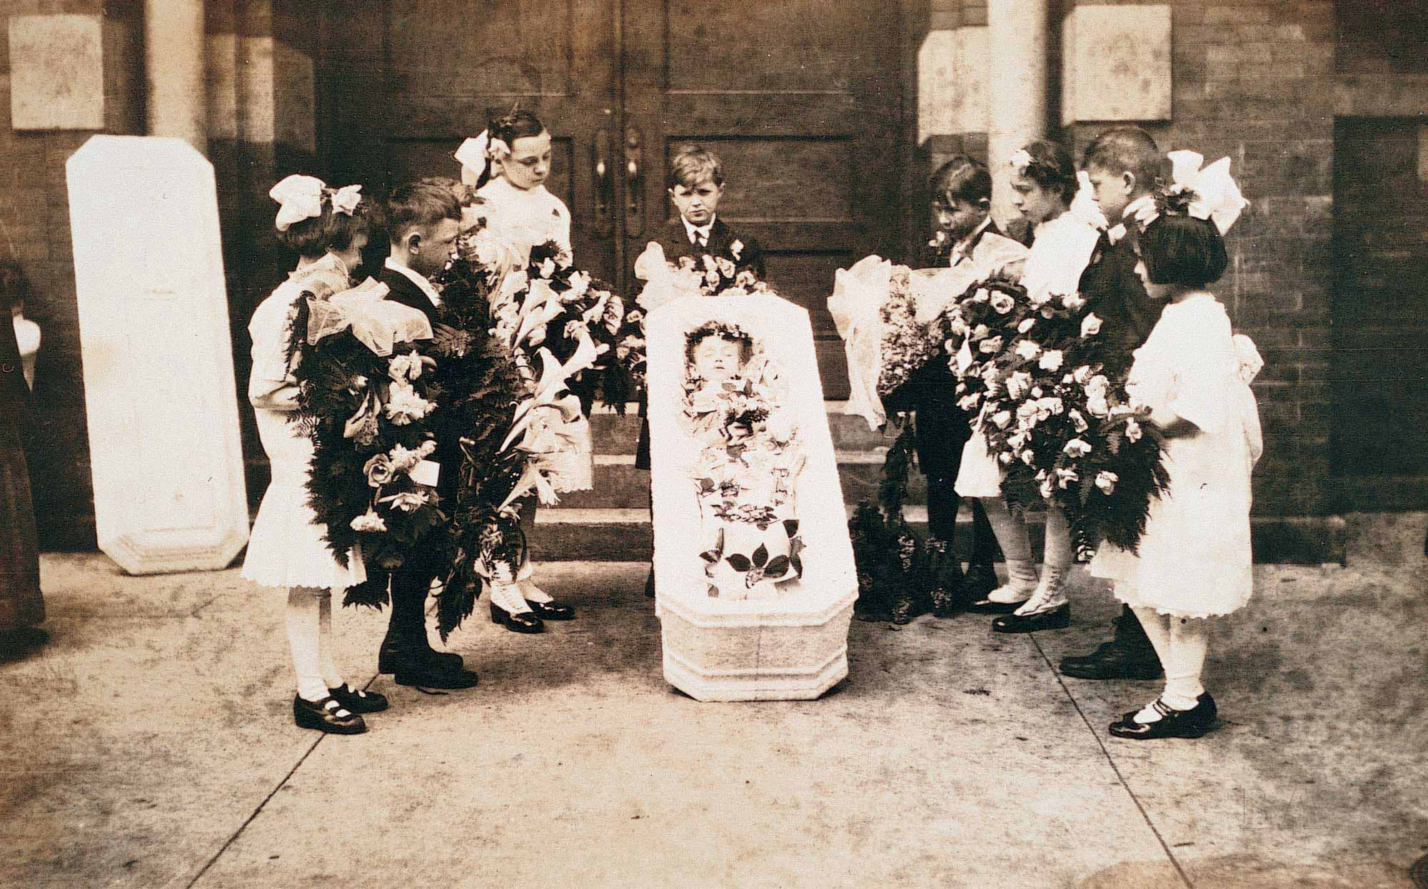
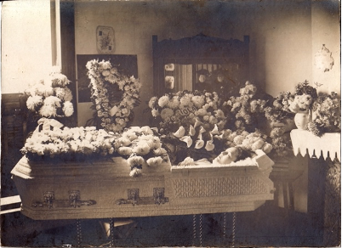
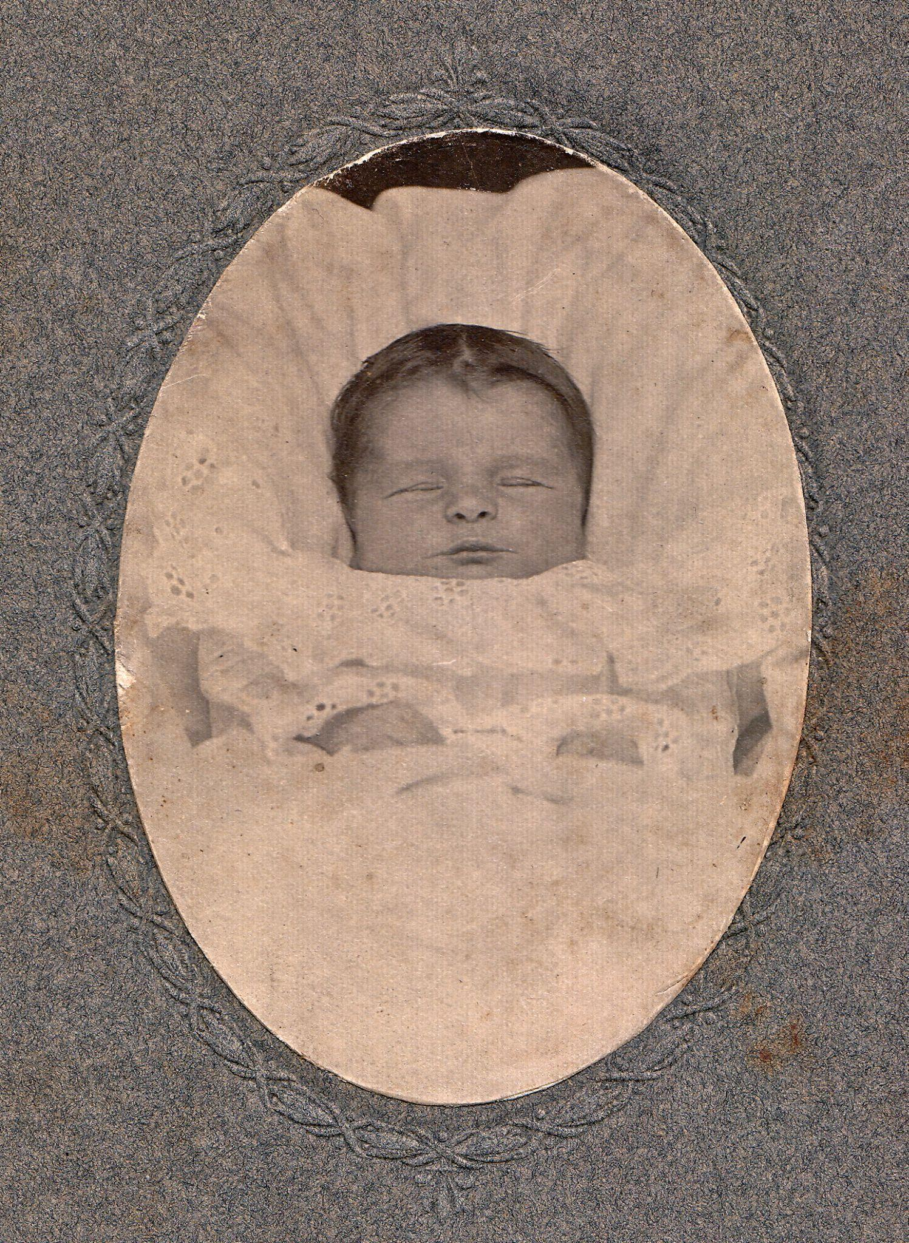
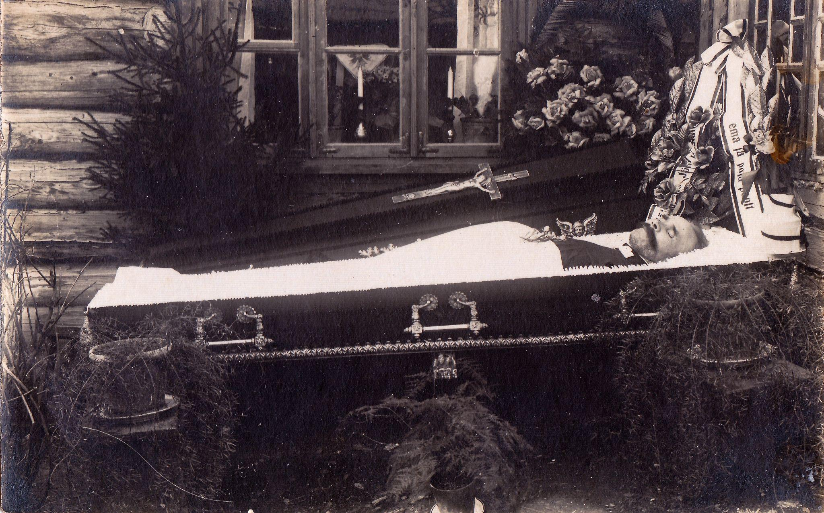

Slide 14
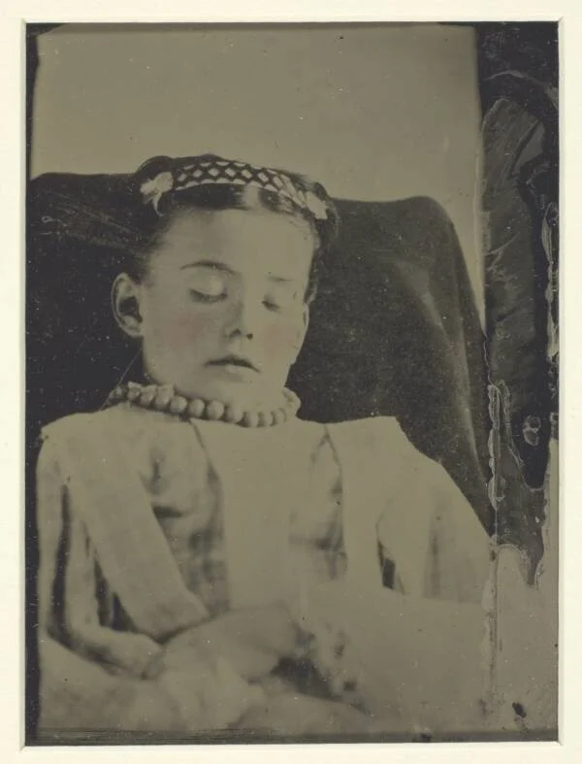
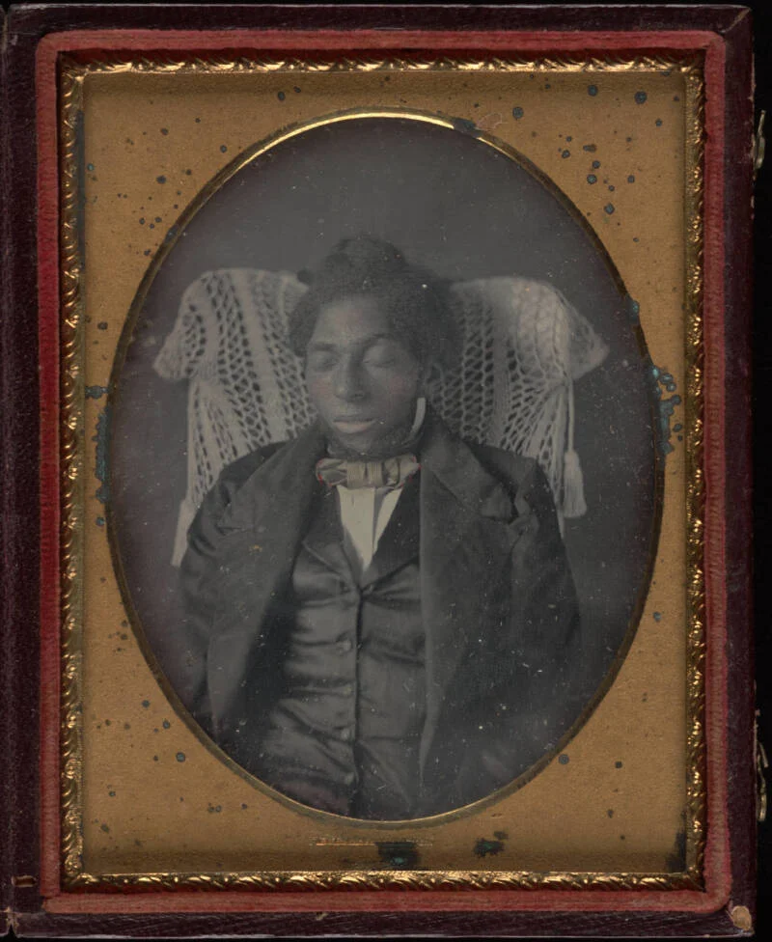
Appearance of Life

Slide 15
04
How to spot a postmortem photograph

Slide 16
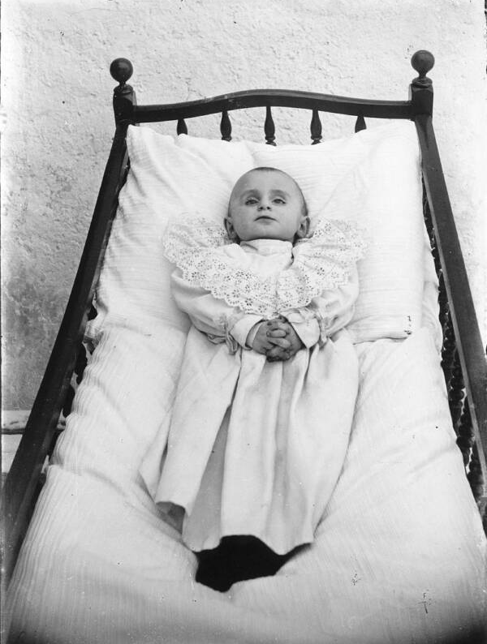
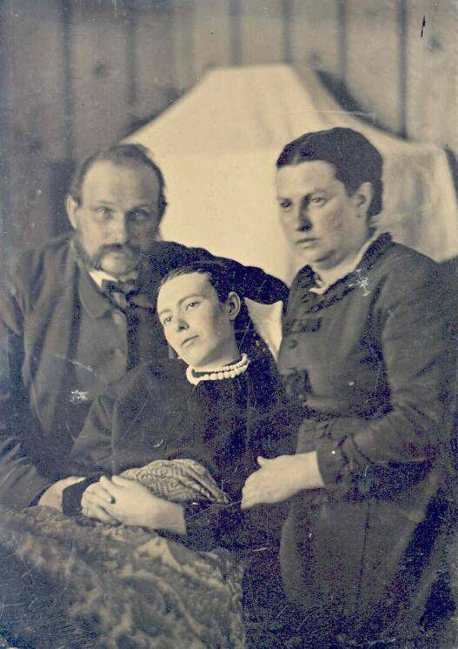
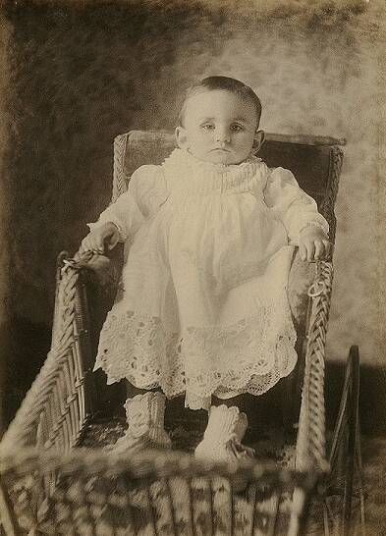
Focus

Slide 17
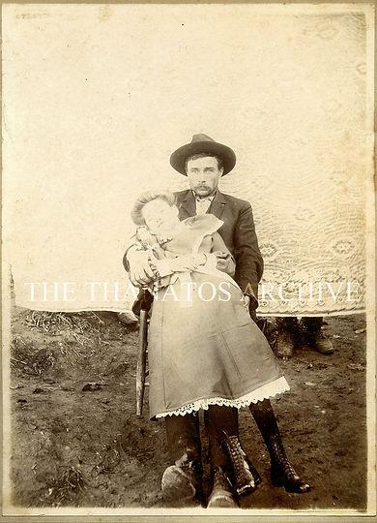
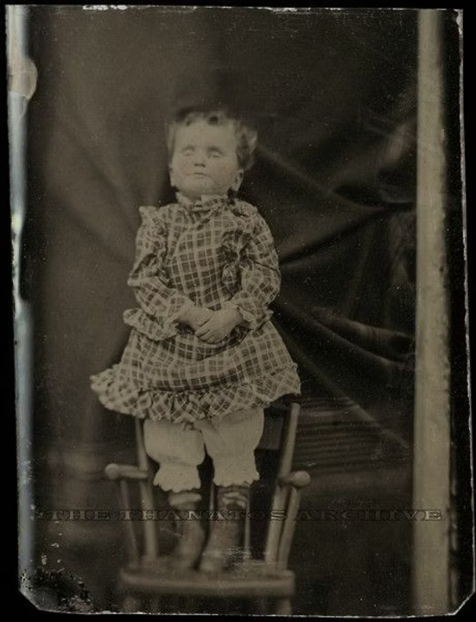
Held Up

Slide 18
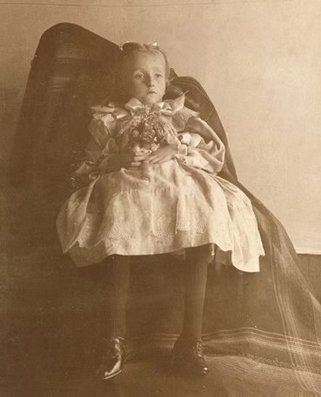
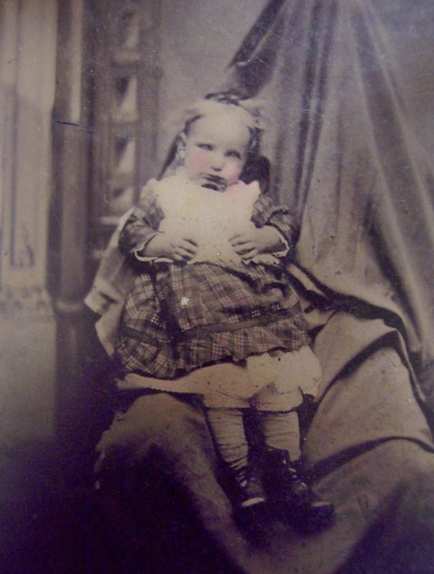
Draped Person

Slide 19
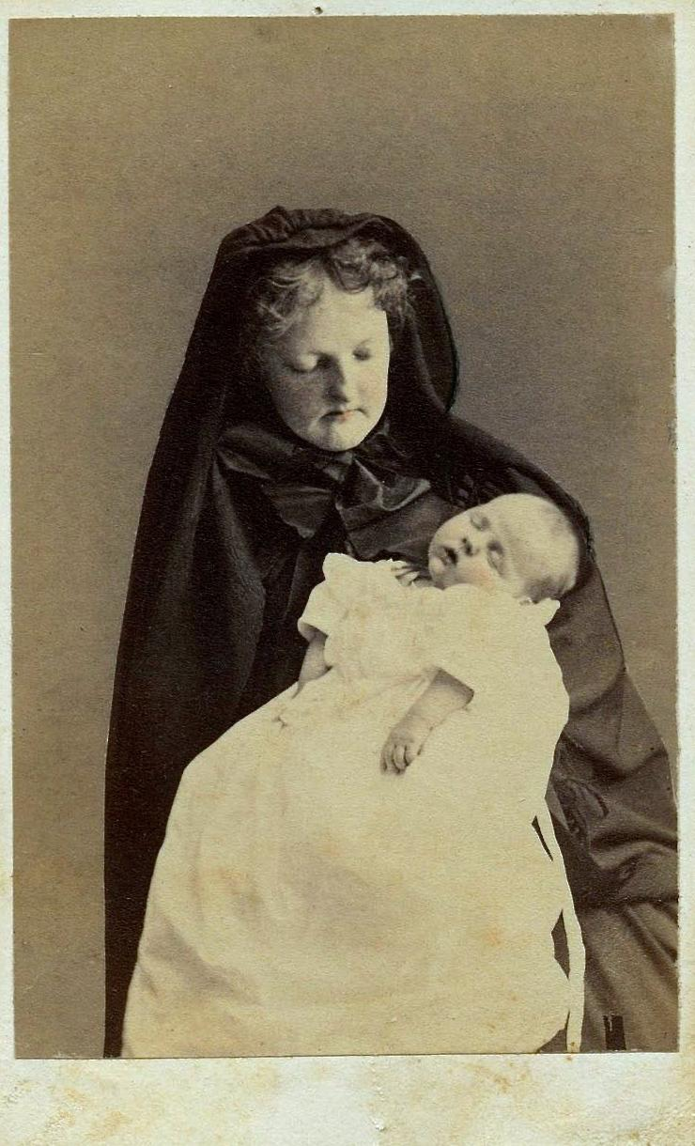
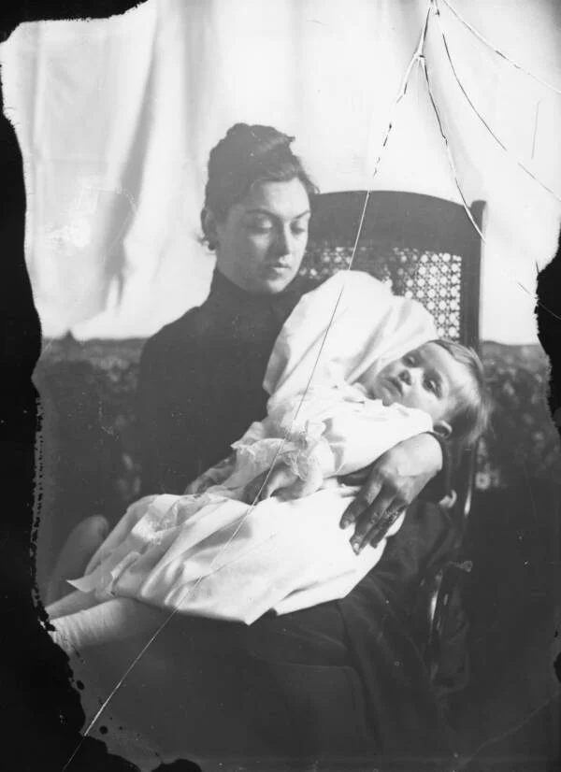
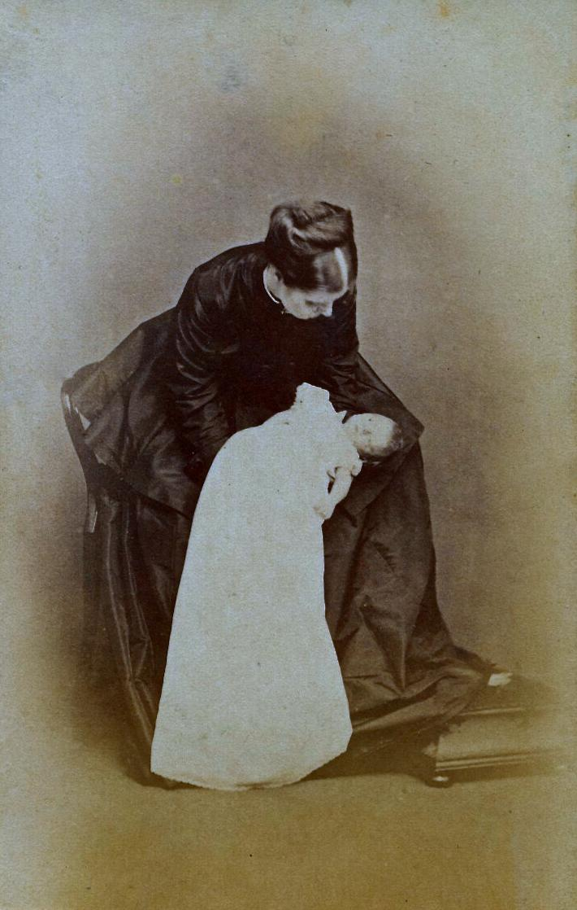
In Mourning

Slide 20
05
Myths

Slide 21
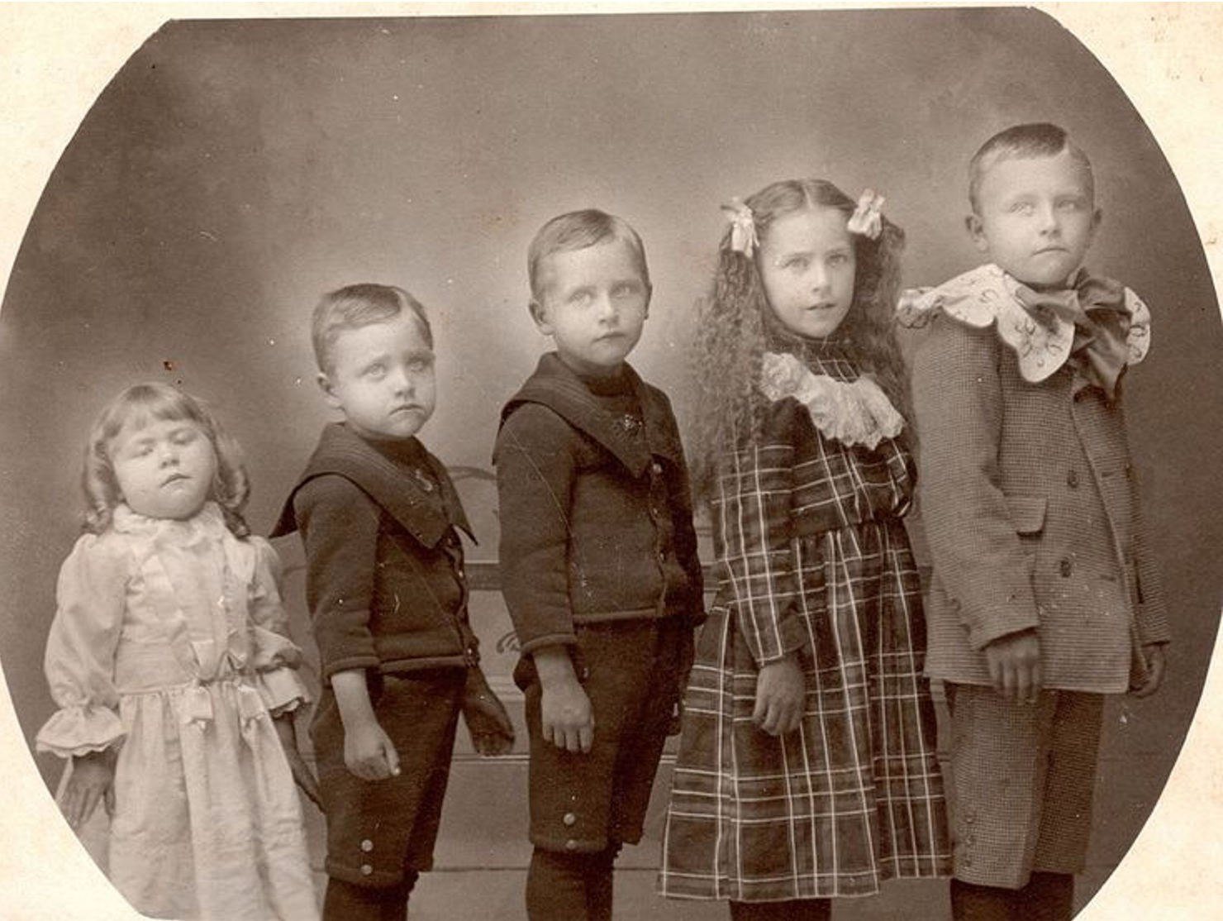

Slide 22
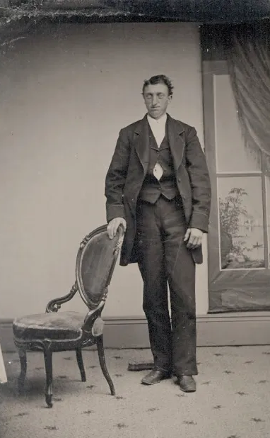
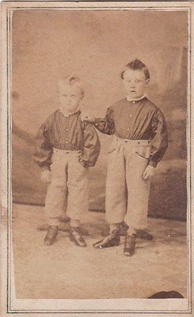
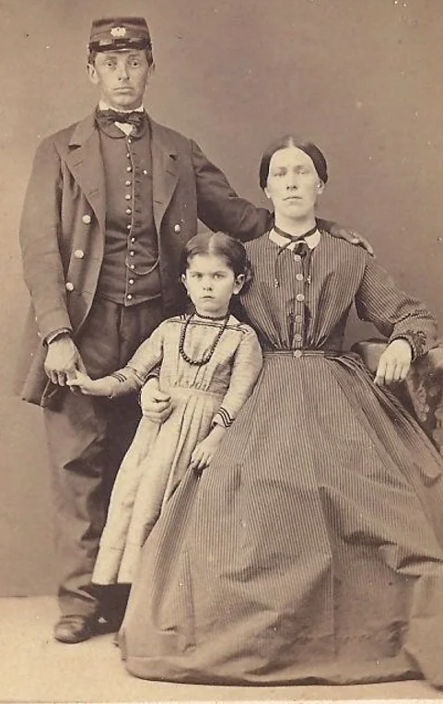
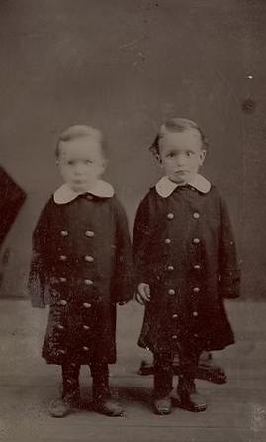
The Myth of the Standing Corpse

Slide 23
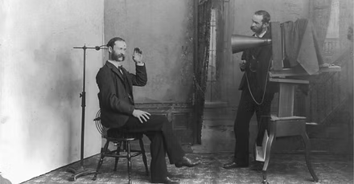
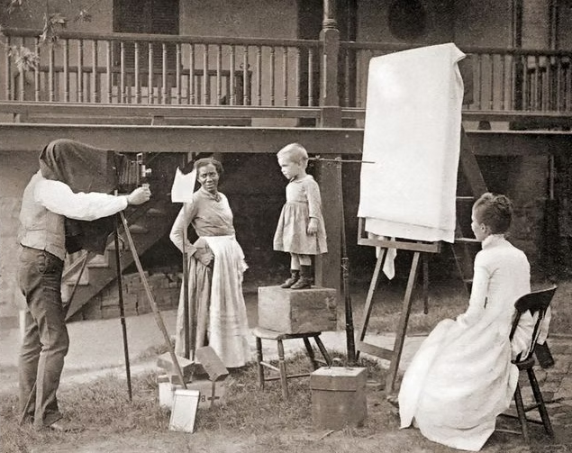
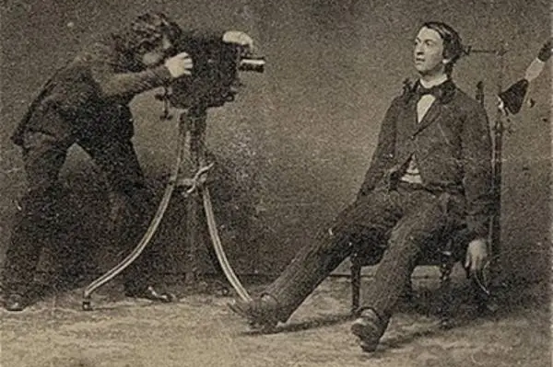

Slide 24
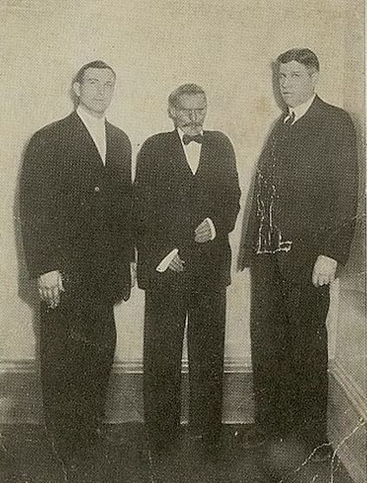
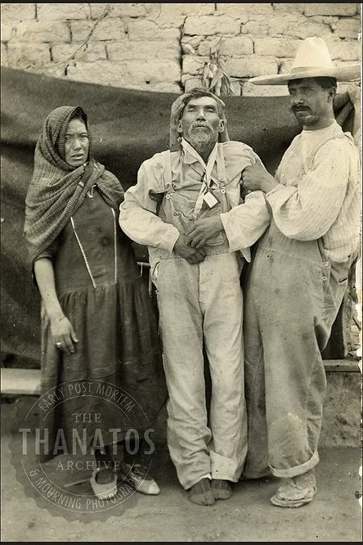

Slide 25
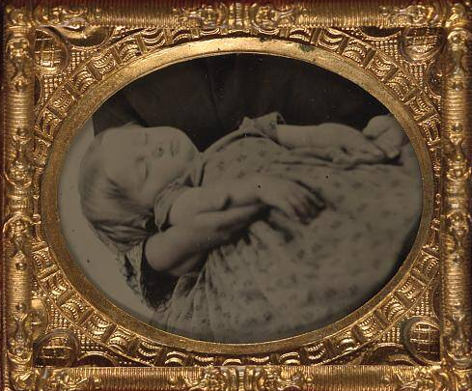
Children: Asleep or Dead?

Slide 28
References
Bell, B. (2016, June 5). Taken from life: The unsettling art of death photography. BBC News.
https://www.bbc.com/news/uk-england-36389581
Carlton, G. (2020, December 16). 27 Victorian death photos – And the disturbing history behind them. All that’s
interesting. https://allthatsinteresting.com/victorian-death-photos
Doughty, C. [Caitlin Doughty]. (2017, January 12). Victorian STANDING corpse photographs? [Video]. YouTube.
https://www.youtube.com/watch?v=E8DxI8Pn1Uw
Lenora. (2024, March 4). Memento mori: Victorian post-mortem photography. The Haunted Palace Blog.
https://hauntedpalaceblog.com/2024/03/04/memento-mori-victorian-post-mortem-photography-2/
Meinwald, D. (1990). Memento mori: Death in nineteenth century photography. California Museum of Photography,
University of California.
Cantrell, S.M. (2023, March 24). Victorian postmortem photos: The myth of the stand alone corpse.
https://dealer042.wixsite.com/post-mortem-photos/blank

